Slide 1
SPETRA UNDERGRADUATE RESEARCH JOURNAL
Levent Atici
Professor of Anthropology
Executive Director of Undergraduate Research

Slide 2
Presentation Outline
What is research?
Types and value of undergraduate research
Spectra general information
SPECTRA aims and scope
SPECTRA policies

Slide 3
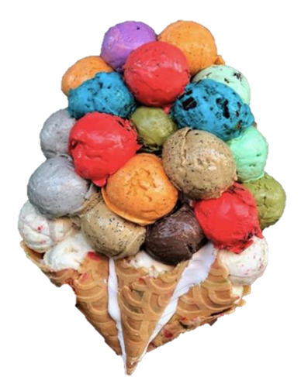
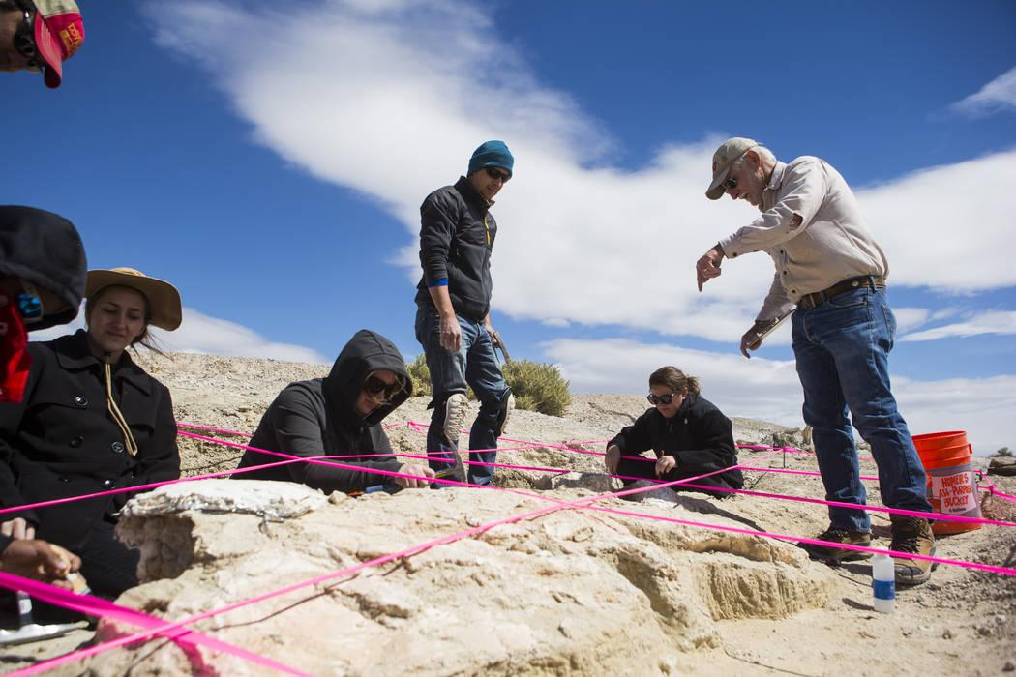
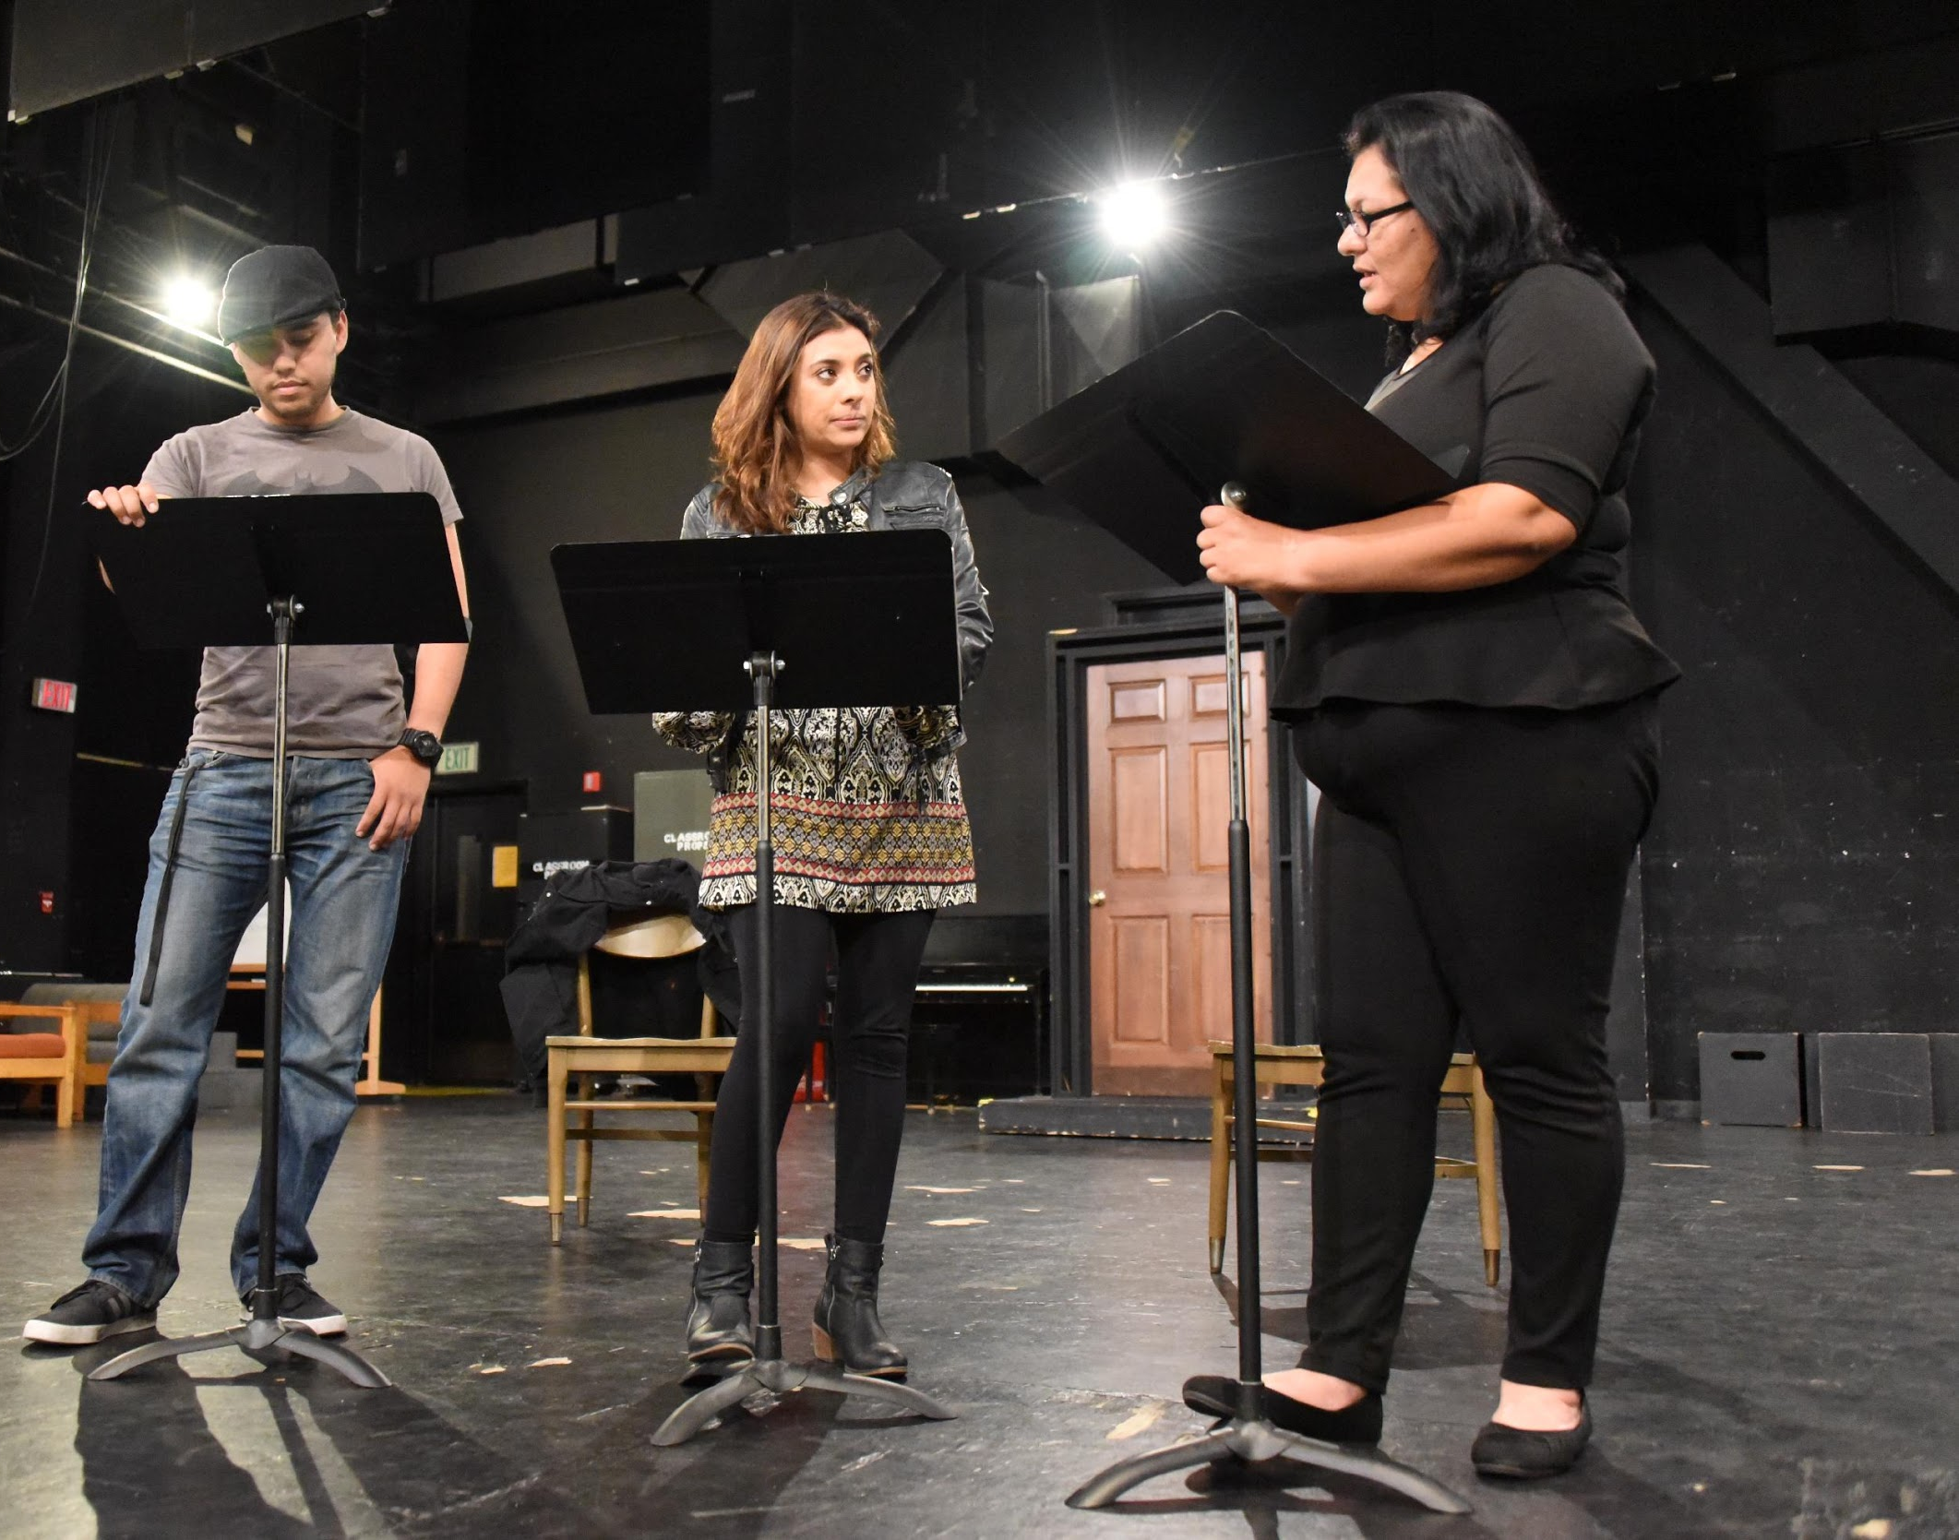
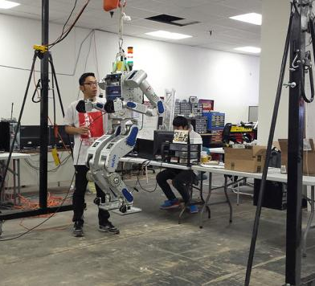
What is Research?
These are many ways to define or classify research:
By academic discipline, method of data collection, and/or purpose

Slide 4
What is Undergraduate Research?
Research is an inquiry or investigation that makes an original, intellectual, or creative contribution to a discipline, area, question, challenge, or theme
Undergraduate Research is faculty-driven, student-centered, and institutionally supported and provides the combination of factors necessary for pedagogical effectiveness, enhanced learning outcomes, and research productivity
Metacognition is thinking about your thinking! You need to be reflective about how you think and learn

Slide 5
Why do Research?
Enhances student learning through mentoring relationships with faculty
Increases retention and graduation in academic programs
Increases enrollment in graduate education and provides effective career preparation
Develops critical thinking, creativity, problem solving, and intellectual independence
Develops an understanding of research methodology
Promotes an innovation-oriented culture

Slide 6
Types of Research
Applied Research
Basic Research
Scientific study and research that seeks to solve practical problems and to find solutions to everyday problems, cure illness, and innovate new technologies, rather than to acquire new knowledge for the sake for knowledge’s sake.
Cure cancer
Design more efficient and affordable cars
Innovate smaller, lighter, faster, cheaper computers/phones
Driven by a researcher’s interest in a specific question for the sake of generating new knowledge or expanding existing knowledge base. There is no visible value or gain-seeking or commercial interest.
How did the universe begin?
Why do birds migrate?
What was the meaning(s) of the Stone Age hand stencils?

Slide 7
Types of Research
Quantitative Research
Qualitative Research
Refers to the systematic empirical investigation of any phenomena via statistical, mathematical, or computational methods and technics with the goal of developing generalizable models, theories and hypotheses pertaining to phenomena.
Questionnaires, surveys, observations, numerical measurements, statistical analysis
Deals with phenomena that are difficult or impossible to measure or quantify mathematically, such as beliefs, meanings, emotions, and symbols in order to gain deep insights into human behavior and the reasons that govern such behavior.
Interviews, focus groups, participant observation, case studies, story telling and other narratives

Slide 8
Types of Research
Descriptive
Exploratory
Predictive
Explanatory
Theoretical
Empirical
Experimental
Ethnographic
Historical
Phenomenological

Slide 9
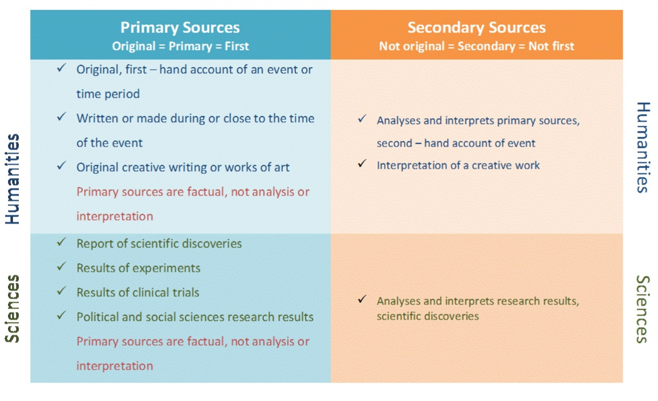
RESEARCH CYCLE: UNDERSTAND SOURCES
Source: https://uj.ac.za.libguides.com/c.php?g=581225&p=4012253

Slide 10
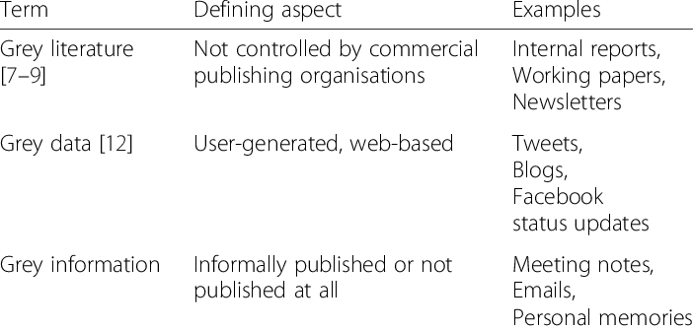
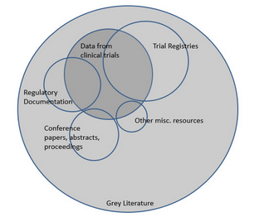
RESEARCH CYCLE: UNDERSTAND SOURCES
Gather Relevant and Useful Information
Understand “grey literature”

Slide 11
SPECTRA: Journal Information
Bi-annual (semesterly)
Double-blinded, peer-reviewed
Multidisciplinary
Open-access
Primarily dedicated to the publication of undergraduate student research at the University of Nevada, Las Vegas
If and when possible, well-qualified student research from other Nevada institutions will also be published

Slide 12
SPECTRA: Staff Editors
Levent Atici, Ph.D., OUR Editor-in-Chief
Rafael Oganesyan, Ph.D., OUR Senior Managing Editor
Kira Tran, OUR Managing Editor
Aaron Cheng, Undergraduate Researcher Senior Editor
Emily Carter, Undergraduate Researcher Senior Editor
Ava Plat, Undergraduate Researcher Senior Editor
Xavier Lawruk, Undergraduate Researcher Associate Editor
Undergraduate Researcher Associate Editor
Undergraduate Researcher Associate Editor

Slide 13
SPECTRA: Staff Editors
Student Editor Position:
We are seeking highly motivated students to serve in a student editor role for the journal.
The successful candidate will be expected to manage:
E-mail communications
Solicit student and faculty reviewers
Organize manuscript submissions
Screen submitted manuscripts for compliance with style, formatting, and other requirements before external reviews
Work closely with the Journal’s Senior Managing Editor and other editors
This position will be a great experience for students who are contemplating graduate school and/or a research career. The expectations of the position would be a full academic year and maybe extended contingent upon performance. Ideal qualifications include:
Strong interest in research and research communication, research, and manuscript editing
Strong verbal , written, and editing communication skills
Highly developed organizational and time management skills to work around deadlines
Strong computer skills
Professional conduct and desire to learn

Slide 14
SPECTRA: Aims and Scope
Elevate the status of undergraduate research education at UNLV
Promote, expand, and enhance undergraduate student research participation at UNLV
Provide an outlet for undergraduate students to develop and hone research publishing skills
Support and reward undergraduate students’ research involvement and add value to their overall education, professional development, and career readiness
Provide undergraduate authors with the opportunity to engage in collaboration with their peers and faculty members, both in their research and during the publication process.

Slide 15
SPECTRA: Subjects
As the Office of Undergraduate Research (OUR) defines research in the broadest and most inclusive way, OUR’s SPECTRA aspires to showcase student research across the academic spectrum by accepting submissions from the following areas of interest:
STEM—Sciences, Engineering, Math, Health Sciences, Medicine, and Nursing
NON-STEM—Fine Arts, Business, Education, Hospitality, Liberal Arts, and Urban Affairs

Slide 16
SPECTRA: Submission Types
In order to represent the full spectrum of research and to ensure a diverse publication, we accept submissions of:
Primary research articles
Primary review articles
Research protocol articles
Archival research articles
Thesis-based research from laboratory and field work, term papers (with the approval and endorsement of the instructor), or other faculty-supervised projects
Fiction
Poetry
Photo essays

Slide 17
SPECTRA: Research Stages
We accept research at any stage including the options listed below:
Literature-based research (e.g., review of climate change research)
Publicly available data (facts) rather than interviews and surveys (opinions)
Evaluation of previously published data (open access databases, published research)
It is acceptable to present incomplete research or preliminary analysis or results
It is acceptable to present research plans, goals, and methodologies
It is acceptable to talk about anticipated trajectories or expected findings etc.

Slide 18
SPECTRA: Instructions for Authors:
Manuscripts for the following submission types should contain the sections listed below:
1) Primary research article, 2) Primary review articles, 3) Research protocol article, 4) Archival research articles, 5) Thesis-based research articles
Title page
Abstract
Keywords
Introduction
Methods
Results
Discussion
Conclusions
List of Abbreviations Used (if any)
Conflicts of Interest
Ethics Approval and/or Participant Consent
Authors' Contributions
Acknowledgements
Funding
References
Figures
Tables
Additional Files

Slide 19
SPECTRA: Submission and Review Process
External Review Questionnaire Section 1: Content and Structure Assessment
Is the title of the paper appropriate and likely to serve its purpose?
Is the abstract specific, and representative of the paper?
What is the objective or purpose of the research? Is this clearly stated?
Does the author define the general problem area? What does the author intend to discuss? Why?
Does the author try to build on past research and provide background information?
Does the author clearly establish why this research is carried out, needed and/or its potential contribution to its field?
Does the author define any terms? Are the definitions specific, useful, circular?
Does the author adequately describe and explain the materials and methods used?
Does the author explicitly and thoroughly state the major findings and conclusions?
Have the results and conclusions are clearly and explicitly connected and supported by the author's analyses, arguments, findings or evidence?
Has the author overlooked anything?
Does the author discuss the impact and broader implications of the findings?
Does the author suggest areas for further research or discussion?
Does the author accomplish her/his objective? Does the author do what she/he has set out to do?

Slide 20
SPECTRA: Submission and Review Process
External Review Questionnaire Section 2: Style and Format Assessment
What is the effect of the author's language? Is the vocabulary and sentence structure appropriate? Does the author maintain neutrality in his/her choice of words and terms or are they emotionally charged or biased?
Does the English text of the manuscript require revision to grammar, syntax, or English expression?
Are illustrations, tables or graphs used? Do they complement the text? Are they the best method to present data, or are they unnecessary?
Has the author cited the most pertinent literature adequately?
Are the references and citations formatted correctly?
Has any material in the manuscript been previously published? (If so, where?)
Please indicate any errors or necessary improvements to the discussions of fact, interpretation, or calculations.
Do you wish to identify yourself to the author?
Please enter any additional confidential remarks for the editor here:
Overall Recommendation:
Incomplete submission
Accept? Accept with minor revisions? Accept with major revisions?
Reject?

Slide 21
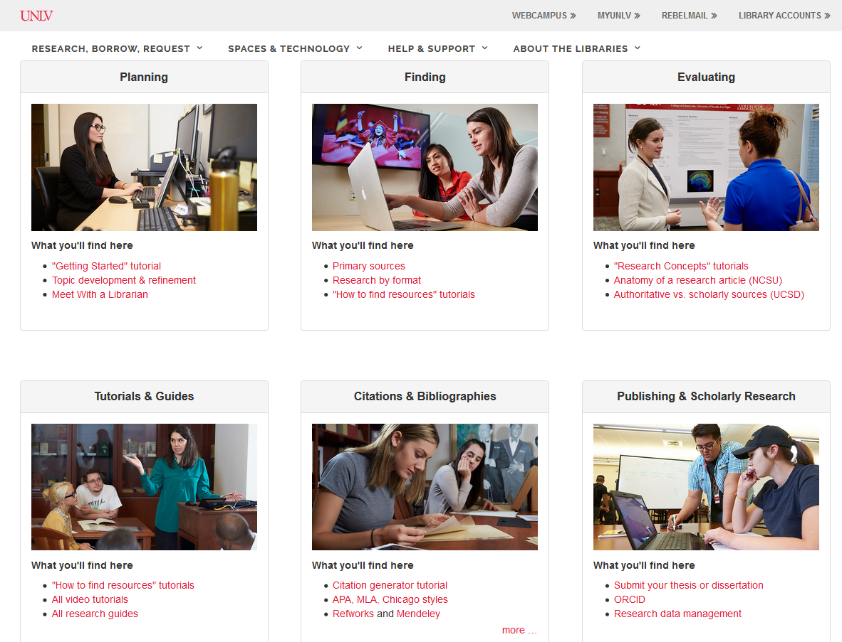
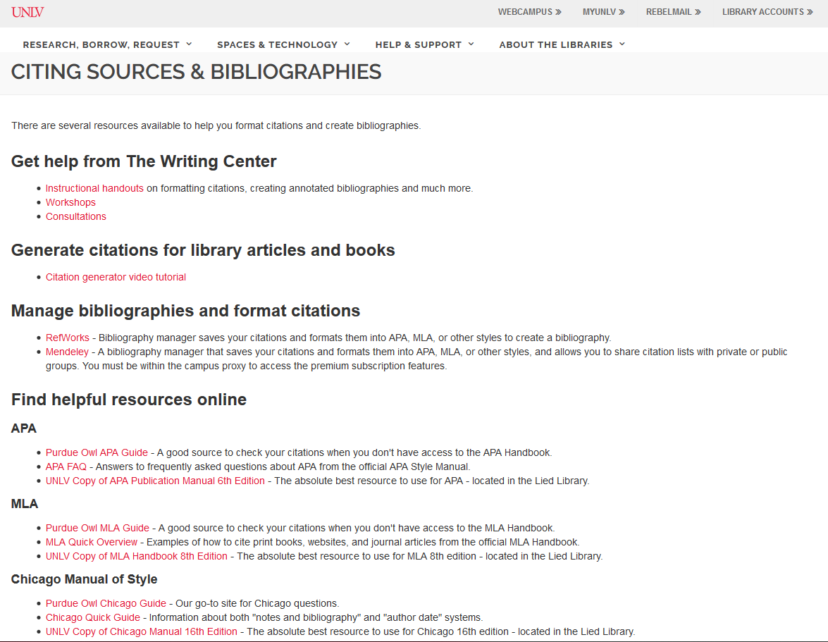
SPECTRA: Campus Resources

Slide 22
