Slide 1

Preparing an idr
GENERAL ACCOUNTING
CONTROLLER’S OFFICE
http://controller.unlv.edu/general_accounting.html

Slide 2

WHAT IS AN IDR?
IDR stands for “Inter-Departmental Requisition”
Used to record the sale of goods or services between campus departments.
Can also be used to record the transfer of cash between two accounts.
There are 3 types of IDR’s:
  IX – Expense Transfer
  TV – Transfer Voucher
  II – Intra-Institutional Voucher

Slide 3
TYPES OF IDR’s - IX
IX
Expense Transfer Voucher
When to use:
This type of IDR is used to record the sale of goods and services by campus service centers to campus departments. It can also be used to record the sale of goods and services between campus departments.
Example:
Your department purchases business cards from Reprographics.
Campus Service Centers include:
Telecommunications (monthly phone charges)
Facilities (monthly utilities allocation)
Parking Services
Reprographics
Police Services
Mail/Delivery Services
Surplus
Office of Information Technology (computer parts)
Departments that provide space rentals (ex: Student Union, UNLV Foundation, Science & Engineering Building)

Slide 4
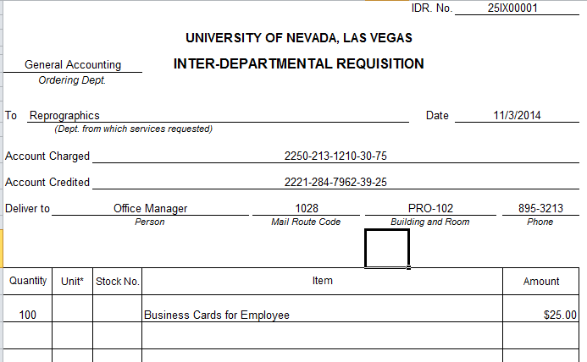
TYPES OF IDR’s – IX EXAMPLE
Example: General Accounting purchases business cards from Reprographics for a new employee
Distinguishing Features:
Object codes 30 and 39 are used.
  Object code 30 (General Operations) is used for the Account Charged because an expense is being recorded
  Object code 39 (Recharge) is used for the Account Credited because an inter-campus revenue is being recorded.
The Sub-Object codes ( in this case 75 & 25) will change depending on what type of expense/revenue is occurring.
  See General Accounting’s website for a list of all active sub-object codes for the current year.

Slide 5
TYPES OF IDR’s - TV
TV
Transfer Voucher
When to use:
This type of IDR is used to record the transfer of cash from one campus account to another when no identifiable expense has occurred. TV’s are generally used to provide funding for the receiving department.
Example:
Your department is helping to sponsor an event held by Alumni Relations. Since it is not paying for a specific expense of the event, a TV would be used to transfer cash.
Common Uses:
Funding a renovation project for your area through Planning & Construction
Sponsorship of another department’s event
Reimbursing a Dean’s hosting account for hosting expenses charged
Restrictions:
Only soft money accounts can be used when processing a TV. State accounts (Fund 2101) and Grant accounts (Funds 2330-2399) cannot be used because their guidelines prohibit the transfer of cash.

Slide 6
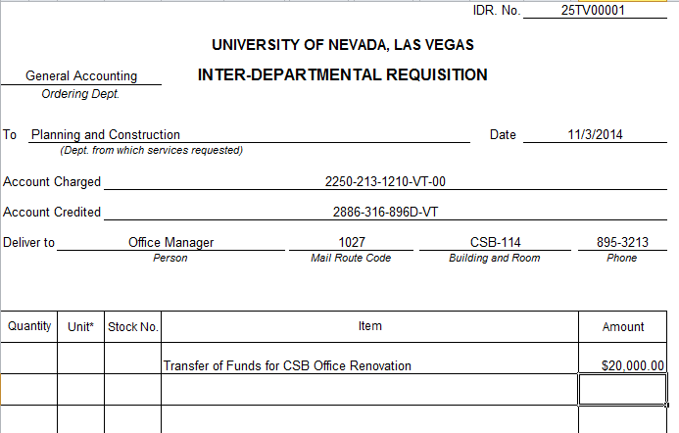
TYPES OF IDR’s – TV EXAMPLE
Example: General Accounting is funding the renovation of their office space .
Distinguishing Features:
Object code VT is used.
  Object code VT (Voluntary Transfer) is used in both the Account Charged and Account Credited because it represents that a transfer of cash is occurring.
The Sub-Object codes
  Sub-Object 00 is used for the Account Charged to represent that a transfer out is occurring.
  There is no sub-object code needed for the Account Credited. By using only an Object code, it represents that a transfer in is occurring.
NOTE: VT and VT-00 are the only Object/Sub-object codes that can be used for TV’s

Slide 7
TYPES OF IDR’s - II
II
Intra-Institutional Voucher
When to use:
This type of IDR acts as an invoice for the seller and a payment voucher for the buyer in an intra-institutional sale. In this case, the “seller” is an organization entity within the institution (UNLV) instead of an outside vendor. It is used when an agency account (Fund 2776) is providing sales or services to a UNLV department, or for certain Rebel Card transactions.
Example:
Your department is paying for application or tuition fees for a student.
Common Uses:
II’s are the least commonly used type of IDR. They are mainly used if the buying department is charging an expense line (object codes 52 and below) and the selling department is crediting a revenue line (object codes 53 and above)
Note:
If you think you may have an II transaction, you can contact General Accounting at extension 5-3957 for further guidance.

Slide 8
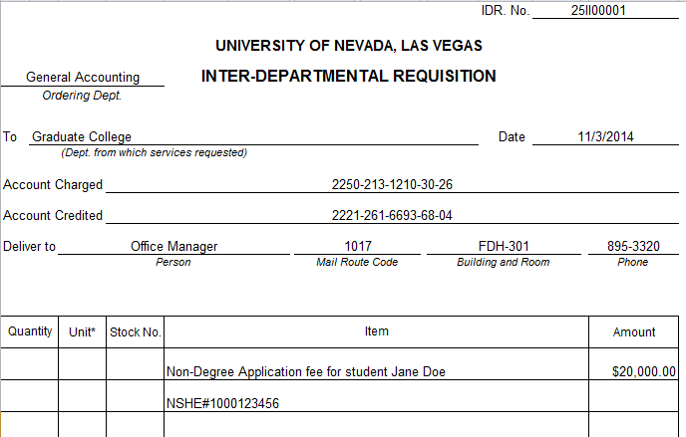
TYPES OF IDR’s – II EXAMPLE
Example: General Accounting is paying for a student’s application fee.
Distinguishing Features:
Object code 30
  Object code 30 (General Operations) is used for the Account Charged because an expense is being recorded
Revenue code 68
  Revenue code 68 (Tuition & Fees Unrestricted) is used for the Account Credited because a revenue is being recorded.
The Sub-Object/Sub-Revenue codes ( in this case 26 & 04) will change depending on what type of expense/revenue is occurring.
  See General Accounting’s website for a list of all active sub-object/sub-revenue codes for the current fiscal year.
NOTE: Revenue codes 78, 79, and 81 can also be used on an II document

Slide 9
PREPARING THE IDR
STEP 1:
Download the IDR Template file from the General Accounting website located at: http://controller.unlv.edu/general_accounting.html
STEP 2:
Determine which type of IDR (IX, TV, or II) will be needed to process the transaction.
STEP 3:
Determine which accounts will be charged and credited (ex: 2101-213-1210)
STEP 4:
Determine which Objects/Sub-Objects or Revenues/Sub-Revenues to use
(Reference previous slides on Types of IDR’s)
STEP 5:
Complete the IDR template (example on next slide)
STEP 6:
Have an authorized signer for the account being charged sign the IDR
STEP 7:
Submit the IDR to General Accounting for Processing

Slide 10
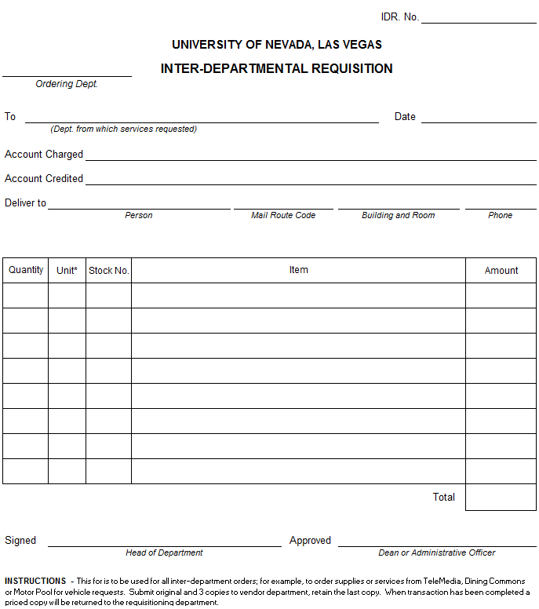
PREPARING THE IDR
FIELDS THAT NEED TO BE COMPLETED:
Ordering Department
  The department who is buying
Selling Department
  The department who is selling
Date
  The date that the IDR is prepared
Account Charged
  The buying department’s account number
Account Credited
  The selling department’s account number
Deliver To
  The contact person from the selling department
Transaction Description
  Explanation of the transaction that is occurring
Amount
  Dollar amount of the transaction
Submitted Signature
  Who prepared the IDR
Authorized Signature
  Authorized signer for the account number being charged
❶
❷
❸
❹
❺
❻
❼
❽
❾
❿

Slide 11
IDR NUMBERING
There are two options for numbering:
  Number is assigned by General Accounting
  Number is assigned by the department receiving the fund
The department whose account is being credited is responsible for the IDR number.
There are some campus departments that process a high volume IDR’s throughout the year and have their own numbering sequences.
  A list of these departments and their numbering can be found in the Pre-Assigned IDR Numbers document located on the General Accounting website
  Generally, a department must create at least 100 or more IDR’s per year to be assigned a numbering sequence
All other departments without number sequences send their IDR’s to General Accounting for numbering.

Slide 12
IDR NUMBERING
FORMAT OF IDR NUMBERS
IDR Numbers will always post to accounts in the following format:
Example: 25IX00001
(Institutional Code) (Second Digit of Fiscal Year) (Document Type) (5 Digit Number)
2 5 IX 00001
UNLV’s Institutional Code is 2
The “5” represents Fiscal Year 15
The IDR type is an Expense Transfer (IX)
00001 is the Document Number (must be 5 digits long)
Some additional examples:
24TV00025
This would be Transfer Voucher number 00025 that posted in fiscal year 2014
23II00010
This is Intra-Institutional Voucher number 00010 that posted in fiscal year 2013
NOTE: When looking up an IDR in Advantage or Data Warehouse, the document type will always be “PV”, as there is no IDR, TV, IX, or II document types in the system.

Slide 13
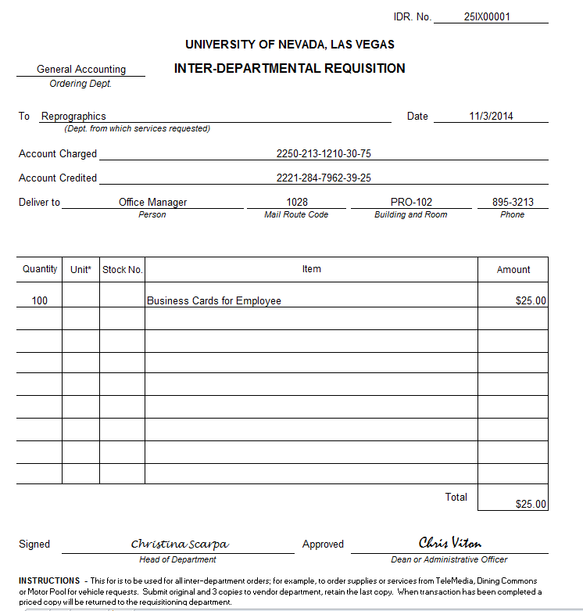
COMPLETED IDR EXAMPLE

Slide 14
REMINDERS FOR IDR’s
Please make sure that both the Account Charged and Account Credited fields contain a full account number including:
  Fund – Agency – Organization -- Object/Revenue – Sub-object/Sub Revenue
  Example: 2101-213-1210-30-13
Check the budgets for both accounts to ensure that:
  Enough funds are available for the Account Charged
  The accounts have a budget line established for the Object/Revenue codes being used in the transaction.
Remember that Transfer Vouchers (TV’s) cannot use State accounts or Grant accounts (These are funds 2101 and 2300-2399)
  Also, only the VT/VT-00 Object codes can be used on TV’s
Please make sure that the IDR has been signed by an authorized signer for the account being charged before it is submitted for processing.
  If you need assistance determining signature authority for an account, please contact General Accounting at extension 5-3957.

Slide 15
WHEN SHOULD I NOT USE AN IDR?
There are several transactions that should be submitted using a Journal Voucher (JV) instead of an IDR:
Reversal of an IDR that has already been processed
  Example: An IDR was processed twice and one of the documents needs to be reversed.
Reassignment of expenses between accounts
  Example: Moving an expense that was charged to an operating account to a hosting account.
Corrections of account errors
  Example: Reassigning a Pcard expense that was charged to the wrong account.
IDCR (Indirect Cost Recovery) distributions
Any transaction that is splitting the amount of the IDR between 2 or more accounts to be credited.
  Advantage does not allow more than one account to be credited on an IDR.
For information on how to prepare and submit a journal voucher, please reference the “How to Prepare a JV” Powerpoint presentation located on the General Accounting website.

Slide 16
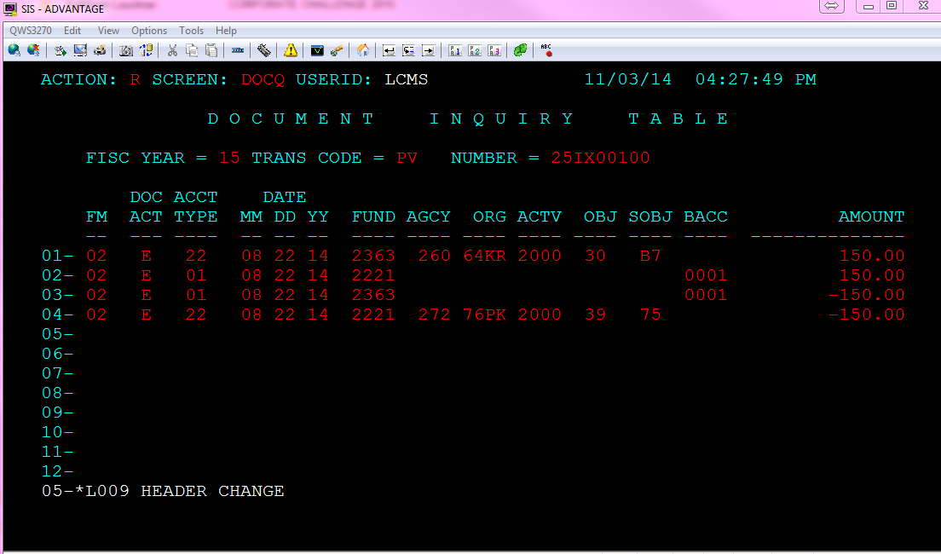
CHECKING THE STATUS OF AN IDR
You can check the status of an IDR in both Advantage and Data Warehouse
If you know your IDR number:
In Advantage, you can go to the Document Inquiry Screen (DOCQ)
  Enter “S” in Action
  Tab down and enter the Fiscal Year, “PV” for Trans Code, and your document number and then press Enter.

Slide 17
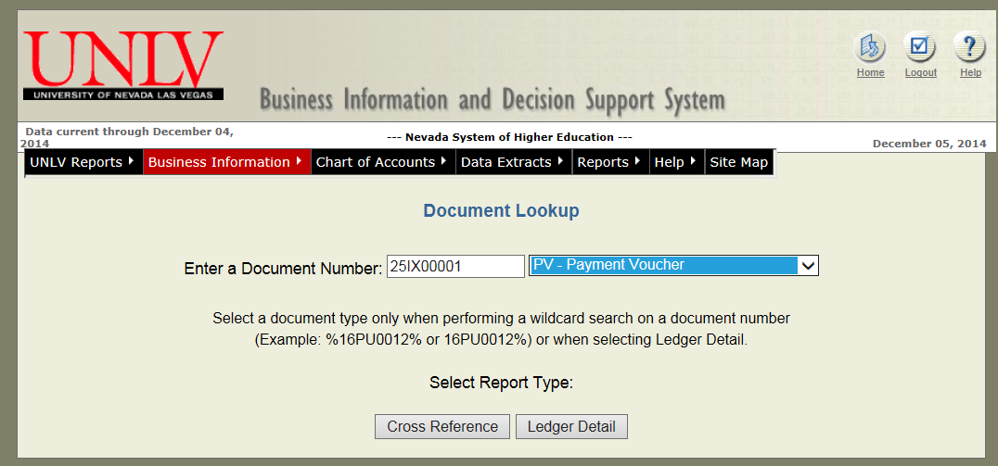
CHECKING THE STATUS OF AN IDR
If you know your IDR number:
In Data Warehouse, you can go to the Document Lookup Screen (located under “Business Information”)
  Enter the full document number
  Select “PV-Payment Voucher” as the document type
  Click Ledger Detail

Slide 18
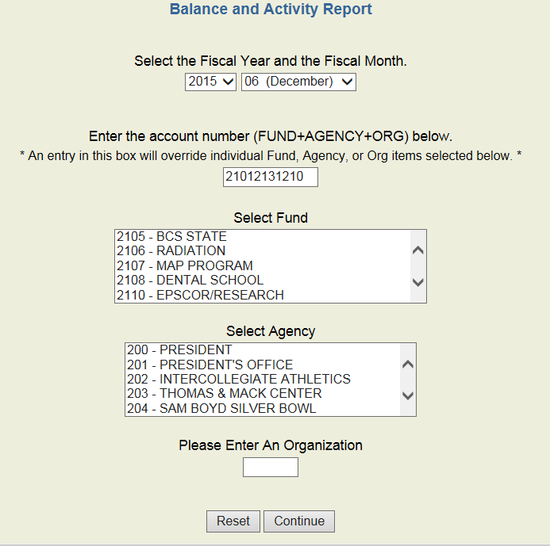
CHECKING THE STATUS OF AN IDR
If you do not know your document number:
In Data Warehouse, you can use the Balance and Activity report (located under “Reports” → “Business Reports”)
  In the box circled below, enter the Fund-Agency-Org of the account number that was to be charged/credited on the IDR and press Continue

Slide 19
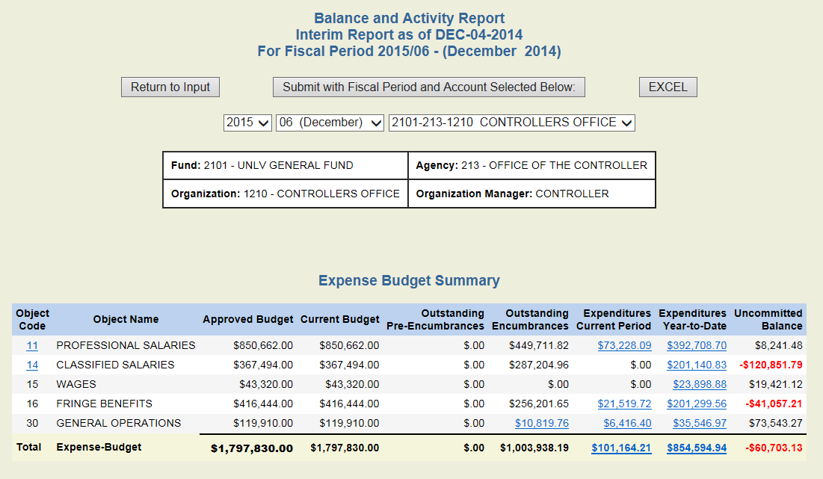
CHECKING THE STATUS OF AN IDR
Click on the underlined number in Expenditures Year-to-Date column for the Object that is being charged.
This will show a listing of all expenses that have posted to that Object code for the year.
If the IDR has been processed, you will see it on this report.

Slide 20

QUESTIONS
If you have any questions on IDR preparation, please feel free to contact General Accounting at extension 5-3957 and we will be happy to assist you.
Please refer to our website at http://controller.unlv.edu/general_accounting.html for more informational presentations that may be of assistance.

