Slide 1
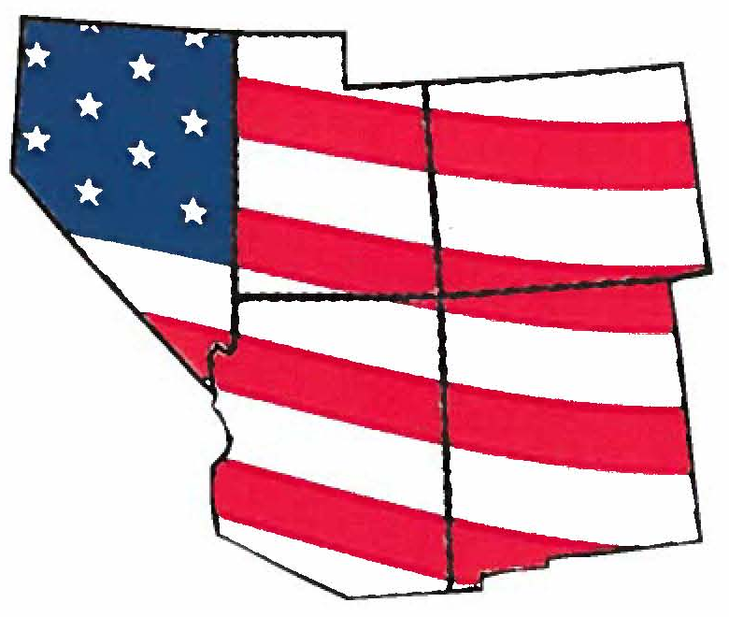

How The Mountain West States Voted in 2016:
Post-Election Analysis of Trends, Demographics,
and Politics in America’s New Swing Region

Slide 2
Who Voted?
David Damore, Ph.D.
Professor, Department of Political Science, UNLV
Fellow, Brookings Mountain West

Slide 3
Voter Turnout, 2012 and 2016
State | 2012 |  | 2016
 | Registered | Age Eligible | Registered | Age Eligible
AZ | 74.4% | 53.0% | 57.1% | 43.2%
CO | 71.2% | 70.6% | 69.3% | 65.6%
NV | 80.8% | 56.5% | 76.7% | 57.1%
NM | 62.7% | 54.8% | 61.9% | 54.7%
UT | 80.2% | 56.1% | 60.7% | 42.8%
Data from state election returns and United States Elections Project

Slide 4
Exit Polls, 2016
State | White |  |  | Black |  |  | Latino |  |  | Asian |  |  | Other
 | Share | D | R | Share | D | R | Share | D | R | Share | D | R | Share | D | R
AZ | 75% | 39% | 52% | 2% | - | - | 16% | 60% | 30% | 2% | - | - | 5% | - | -
CO | 78% | 45% | 47% | 4% | - | - | 12% | 67% | 30% | 3% | - | - | 4% | - | -
NV | 62% | 56% | 5% | 9% | 81% | 12% | 18% | 60% | 29% | 6% | 62% | 36% | 4% | 46% | 45%
NM | 49% | 47% | 42% | 1% | - | - | 40% | 54% | 33% | 1% | - | - | 9% | 53% | 33%
UT | 86% | 47% | 25% | 0% | - | - | 9% | 63% | 24% | 1% | - | - | 3% | - | -
Data from Election Polling Services, Edison Research
In 2012 the Exit Polls estimated that Mitt Romney won 25% (AZ), 23% (CO), NV (24%), and 29% (NM) of the Latino vote
In 2016 Latino Decisions estimated that Donald Trump won 12% (AZ), 16% (CO), and 16% (NV) of the Latino vote (+/- 4.9 percentage points)

Slide 5
Errors in the Exit Polls
Exit Polls are one (of many) attempts to measure voting behavior
  Exit Polls were created to assist news organizations interpret outcomes
  Exit Polls draw voters from a handful of precincts and they do not select many high-density Latino, African American, or Asian American precincts
  Increases in early voting means that Exit Polls are now done partially by phone

Slide 6
Errors in the Exit Polls
Exit Polls demographics of Latinos do not match reality
  Few interviews are completed in Spanish (25 to 30% of Latino voters prefer Spanish)
  Compared to the CPS, Exit Polls typically have 11 to 12% more college graduates and 5% more respondents with above-median incomes
  Exit Polls for Latino voters are inconsistent with high-quality, large sample pre-election polls and actual results

Slide 7
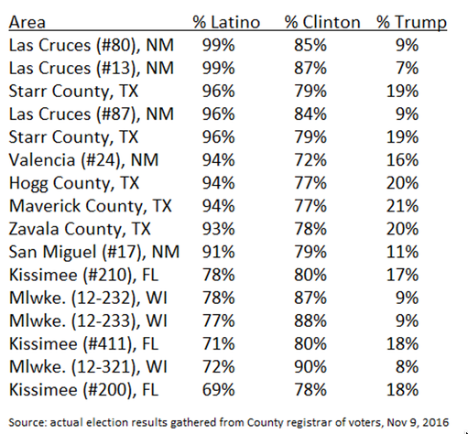
Source: “Lies, Damn Lies, and Exit Polls…”, Gary Segura and Matt Barreto, Huffington Post, 11/9/16

Slide 8
The Latino Vote
David Damore, Ph.D.
Professor, Department of Political Science, UNLV
Fellow, Brookings Mountain West

Slide 9
The Latino Electorate
Latino voters in the Mountain West were critical if not decisive in Hillary Clinton’s wins in Colorado (9 EC votes), New Mexico (5 EC votes), and Nevada (6 EV votes)
In Arizona (10 EC votes, increased Latino turnout helped to close the GOP margin (Romney + 10.1 versus Trump + 4.3) and defeat Sheriff Joe Arpaio

Slide 10
The Latino Electorate in Nevada
26% were first time voters
  43% of those 39 or younger
53% named immigration reform their top issue priority, followed by jobs and the economy (33%)
  11% cited anti-immigrant or Latino discrimination
60% decided who to vote for president more than six months ago

Slide 11
The Latino Electorate in Nevada
45% responded that they voted to support and represent the Latino community
  34% voted to support Democratic candidates (37% contacted by Democrats)
  9% voted to support Republican candidates (16% contacted by Republicans)
82% support DACA and 66% oppose GOP efforts to kill the implementation of DAPA
  81% said immigration was the most important or one of the most important issues in their vote choice
  68% know a family member, friend, or co-worker who is undocumented

Slide 12
Contours of the Latino Vote in Nevada
Candidate | All | Men | Women | Spanish | < $40k | No College | 18 to 39 | 1st Time Voter | Dem | Rep | Other
President
Clinton | 81% | 74% | 88% | 90% | 86% | 85% | 89% | 92% | 98% | 17% | 74%
Trump | 16% | 23% | 10% | 9% | 10% | 12% | 7% | 4% | 1% | 79% | 19%
U.S. Senate
Cortez- Masto | 79% | 76% | 82% | 87% | 82% | 82% | 85% | 86% | 97% | 13% | 71%
Heck | 19% | 22% | 15% | 10% | 15% | 16% | 12% | 13% | 1% | 85% | 25%
U.S. House of Representatives
Democrat | 83% | 77% | 87% | 90% | 87% | 85% | 89% | 91% | 99% | 18% | 75%
Republican | 15% | 20% | 10% | 9% | 10% | 13% | 8% | 7% | 1% | 82% | 15%
Source: 2016 Latino Decisions Election Eve Poll, Nevada Sample, n = 400 (moe +/4.9 percentage points)

Slide 13
How The Mountain West States Voted in 2016:
Post-Election Analysis of Trends, Demographics,
and Politics in America’s New Swing Region

