Slide 1




UNLV
Controller’s Office
University of Nevada Las Vegas
Accounts Payable Department
Welcome to
Accounts Payable Training
Presented by:
Accounts Payable
UPDATED 09/25/14

Slide 2
Accounts Payable Management
Vice President of Finance
Gerry Bomotti
Call 895-3571
Controller
Chris Viton
Call 895-3517
Assistant Controller Accounts Payable Manager
Yvette Walton
Call 895-1143
Accounts Payable Supervisor
Alo Faleafine
Call 895-1156

Slide 3
Accounts Payable Information
CAMPUS SERVICES BUILDING
Second Floor Room 245
Next door to Payroll
Mail stop - 1053
Important Phone Numbers:
Accounts Payable – (702)-895-1157
Accounts Payable Supervisor
Alo Faleafine – (702) 895 – 1156
Accounts Payable Manager
Yvette Walton – (702) 895 – 1143
Fax Number – (702) 895-1519

Slide 4
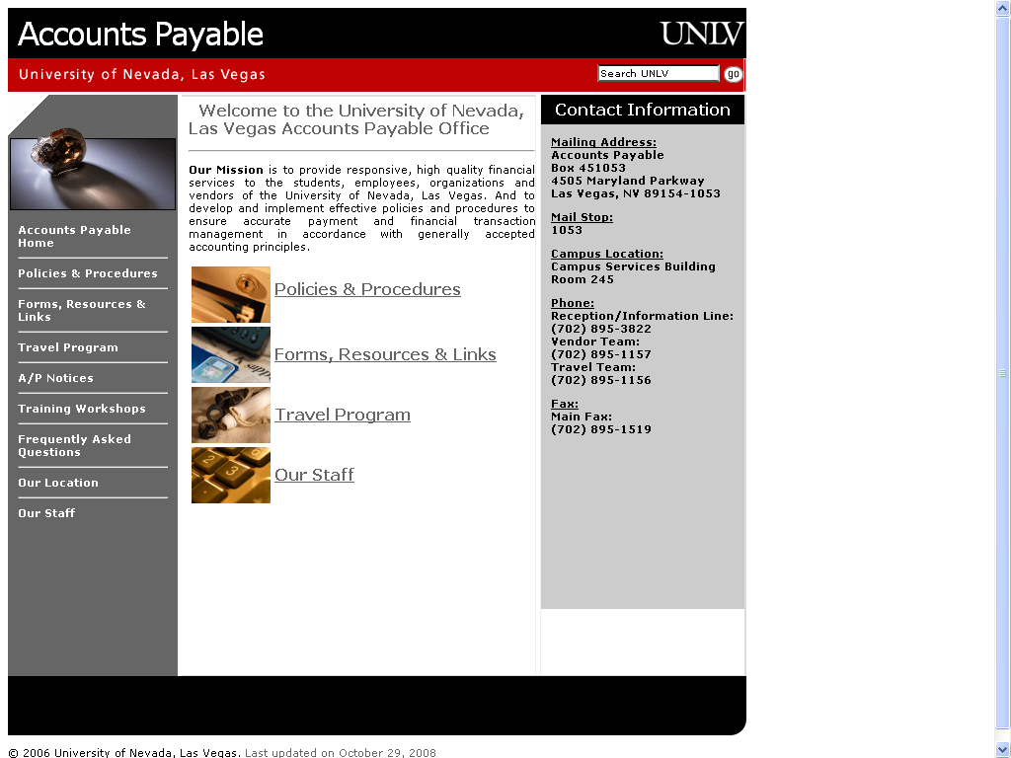
accountspayable.unlv.edu

Slide 5
Team Responsibilities
UNLV
Controller’s Office
University of Nevada Las Vegas
Accounts Payable Department
All vendors are split up alphabetically among AP personnel. The alphabet distribution is below:
Arlene Heine
Assigned Alphabet – A - D
Janine Nakazone
Assigned Alphabet – E - M
Bethann Carrington
Assigned Alphabet – N - S
Maryevette Toyama
Assigned Alphabet – T – Z
All AP Staff can be reached at (702) 895 - 1157

Slide 6

What Does Accounts Payable Do?
UNLV
Controller’s Office
University of Nevada Las Vegas
Accounts Payable Department
Processes invoices for payment against purchase orders.
Receives and routes invoices to departments for approval
Processes payments to vendors and employees via Payment Voucher.
Disburses checks, EFT files, & Paymode files.
Maintains processed payment documents.
Accounts Payable does not process RX’s, Purchase Orders, or Purchase Order Modifications. All of these items are processed in Purchasing and can be contacted at (702) 895 – 3521.

Slide 7
Purchasing Department Documents
UNLV
Controller’s Office
University of Nevada Las Vegas
Accounts Payable Department
RX (Requisition) used for purchases of goods or services of an amount.
RX’s are converted to purchase orders and vendors must invoice UNLV referencing the PO # on the invoice.
If a “Cash With Order” is requested, obtain a vendor quote/invoice, attach to RX and send to Purchasing.
Copies of Purchase Orders and Modifications are not sent to Accounts Payable.
Contact the Purchasing Department for quote limits, bid limits, contract and insurance requirements. http://www.unlv.edu/purchasing

Slide 8
VENDOR INVOICES

Slide 9
UNLV
Controller’s Office
University of Nevada Las Vegas
Accounts Payable Department
Paying Vendor Invoices
All Vendor invoices should be mailed directly to the department.
Invoices that are sent to A/P by the vendor will be routed to the responsible person listed on the PO.
If invoices are being sent to you from A/P please request that your vendor send the invoices directly to you by contacting the vendor.
When speaking with the vendor be specific to tell them that the billing address change is for your account only and not UNLV as a whole.

Slide 10
Paying Vendor Invoices (cont)
UNLV
Controller’s Office
University of Nevada Las Vegas
Accounts Payable Department
To pay an invoice to a vendor, send the approved invoice to Accounts Payable. AP will verify the following:
The invoice must be approved by the department with a signature.
The PO information
PO number
Line number to pay from in PO
Amount to pay. (Only current charges, not balance due)
The invoice submitted is not a statement.
Whether partial or final payments are being made against the PO.
If goods or services were provided to UNLV, where we have been invoiced for those goods and services but there is no PO number…

Slide 11
After the Fact Purchases
UNLV
Controller’s Office
University of Nevada Las Vegas
Accounts Payable Department
All goods or services from vendors should be requisitioned through the Purchasing Department with a RX.
If a RX was not submitted before a purchase and an invoice needs to be paid, it is considered an “After-the-Fact” purchase and will to be put on a payment voucher.
Submit the PV to Accounts Payable with an explanation of why the purchase was not completed with an RX.
The PV, and supporting documentation will be sent to purchasing for an “After-the-Fact” approval.
Once the purchase has been approved by Purchasing the approved PV will be keyed for payment by Accounts Payable.

Slide 12

UNLV
Controller’s Office
University of Nevada Las Vegas
Accounts Payable Department
Shipping
All shipping of goods should be charged to UNLV’s FedEx account and facilitated through UNLV’s shipping and receiving department.
Your vendors should be following instructions on your PO which indicate that all shipping to and from UNLV is charged to UNLV’s FedEx account.
If shipping appears on your invoice, payment will be delayed as it must be routed to Mike Lawrence for further payment approval.

Slide 13
PAYMENT VOUCHERS

Slide 14
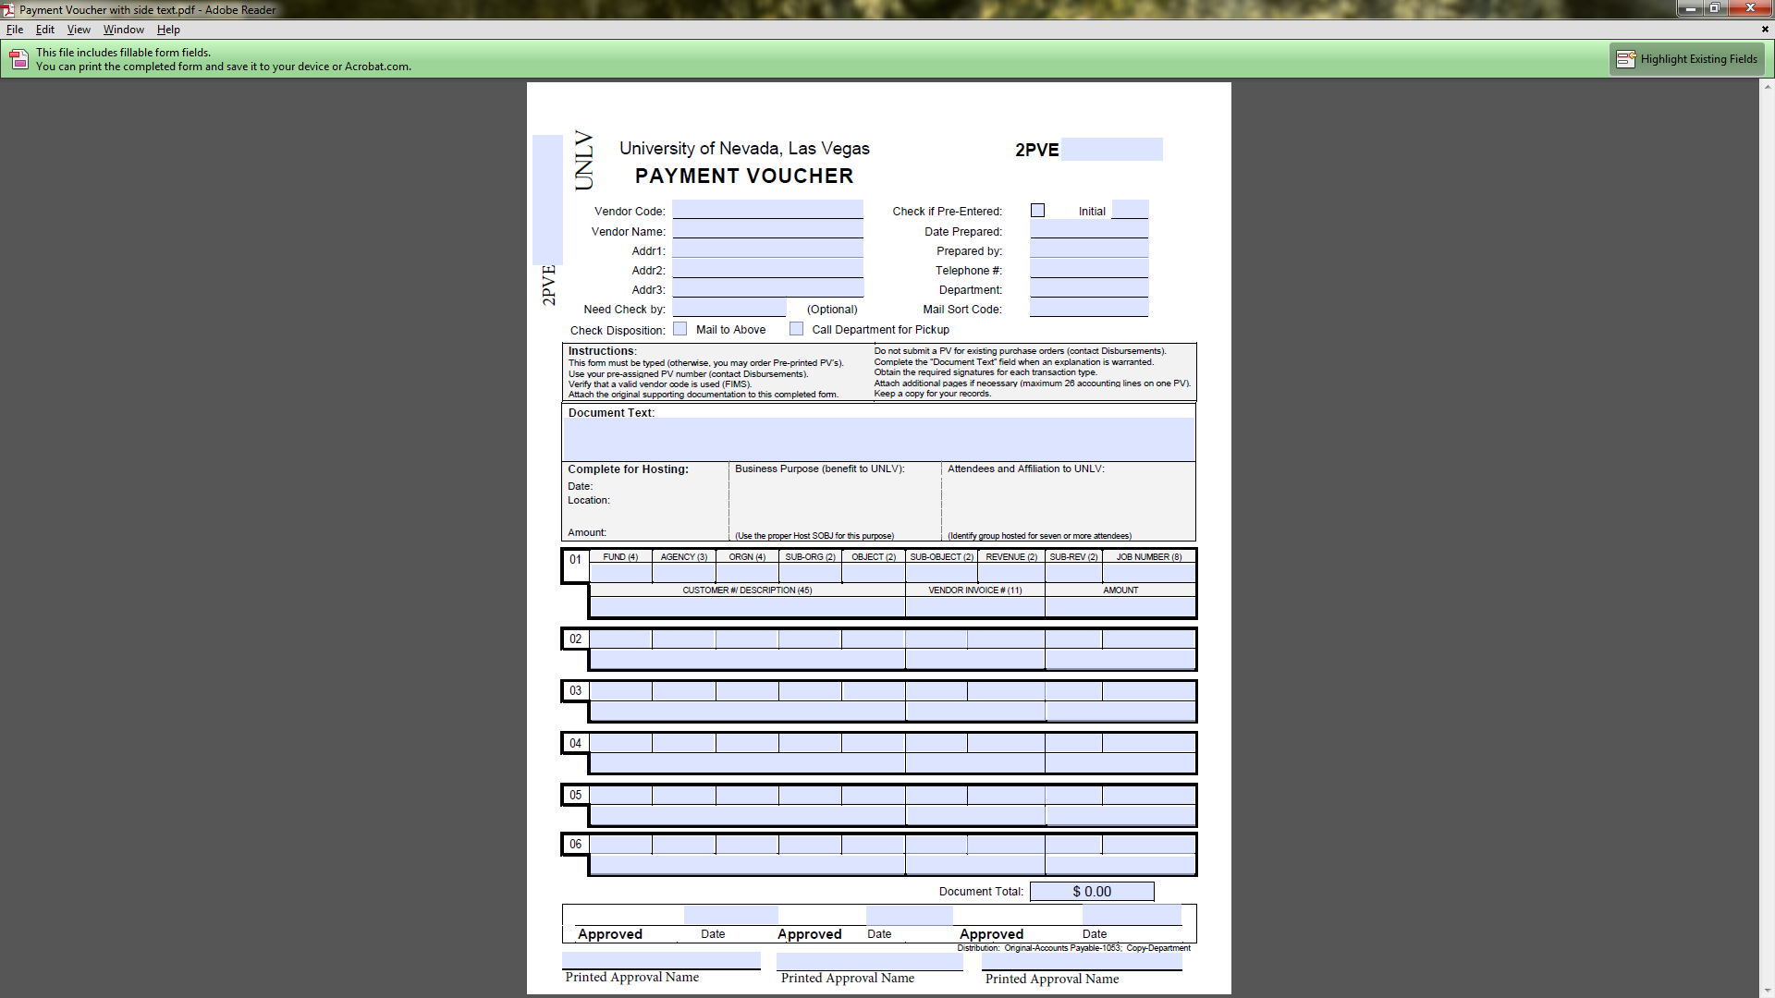

Slide 15

Payment Vouchers
After-the-Fact Payments
Employee/Student Reimbursements (Non-Travel)
Hosting Reimbursements
Prizes or Awards to non UNLV students and employees
Memberships, Subscriptions, Accreditations, Licenses, Royalty/Patent Fees, Sponsorships & Dues
Agency Account Disbursements (2776)
Grant Sub-Award Payments
Research Participant Reimbursements
Conference Payments– (Travel)
Guest & Candidate – (Travel)
Lodging Prepayments – (Travel)

Slide 16

Receipts Policy
Original Receipts are required and must include the following:
Date of Purchase
Contains the Vendor/Business Name
Total amount paid
Description of what was purchased
Method of Payment - (Type of payment Visa, Discover, AMEX, MC, Cash, Check etc.) If MC payment, please be sure the receipt shows the last 3 digits of the MC.
Affidavit for Lost Receipt Form available on our website
Altered receipts may not be accepted without a valid explanation of the alteration and who altered it

Slide 17
UNLV
Controller’s Office
University of Nevada Las Vegas
Accounts Payable Department
Employee & Student Reimbursement
Use a payment voucher to reimburse employees or students for non-travel UNLV business expenses.
Follow receipts policy for all reimbursements.
Include reason for reimbursement.
Only original receipts are acceptable.

Slide 18

Hosting
All hosting payments need to have the approval of the hosting authority; always the Dean, VP, or higher (unless delegated otherwise.)
Use the Host Explanation Form to easily communicate the 5 W’s:
Who
What
Where
When
Why (Purpose)

Slide 19
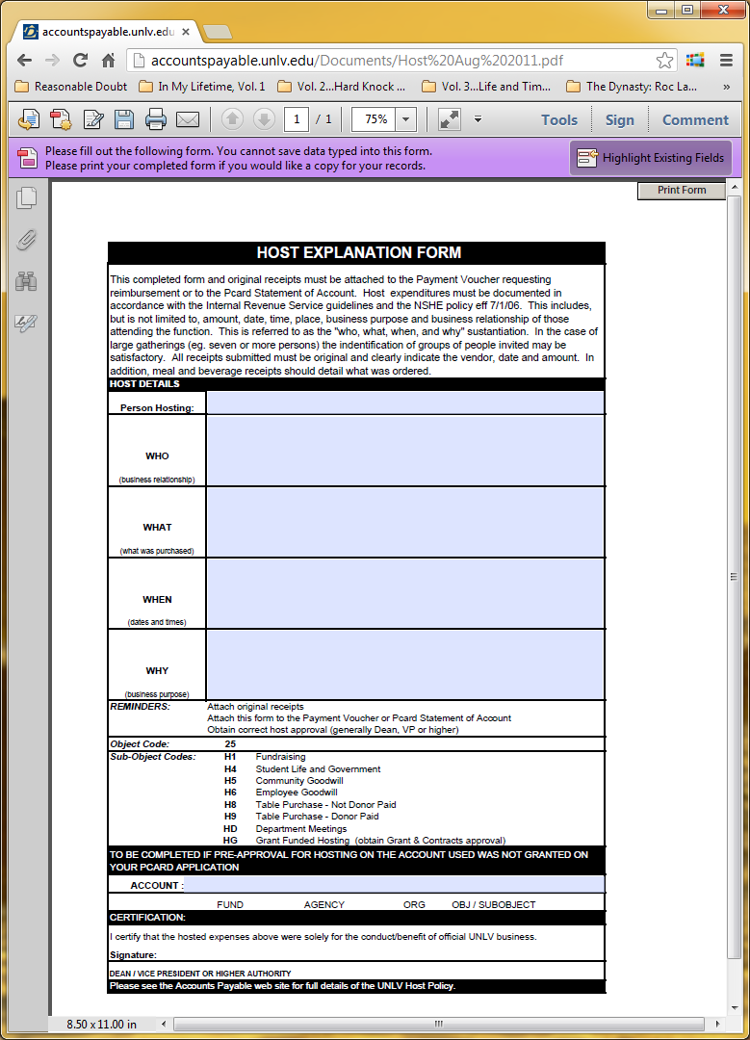

Slide 20
Host Sub-Object Codes
UNLV
Controller’s Office
University of Nevada Las Vegas
Accounts Payable Department
To identify host expenditures by eligible classification, object code 25 has been created for all host account expenditures. Host object/sub-object codes can only be used with host accounts.
The following sub-object codes are to be used to identify expenses as indicated:
25 H1 Fundraising
25 H4 Student Life and Government
25 H5 Community Goodwill
25 H6 Employee Goodwill
25 H8 Table Purchase – Not Donor Paid
25 H9 Table Purchase – Donor Paid
25 HD Department Meetings
25 HG Grant Funded Hosting

Slide 21

UNLV
Controller’s Office
University of Nevada Las Vegas
Accounts Payable Department
Prizes and Awards
Prizes and Awards are paid out using a form found on the Human Resources website: http://hr.unlv.edu/policies/awards.html
Fill out the form and submit it to Human Resources. They will review the form and send them on to Accounts Payable if they are students and to Payroll if they are employees/student workers.
If the award is for a non-UNLV affiliate then you will prepare a payment voucher and attach a W-9 and some kind of backup showing the amount and name for the award.
http://accountspayable.unlv.edu/Topics/prizeaward.htm

Slide 22
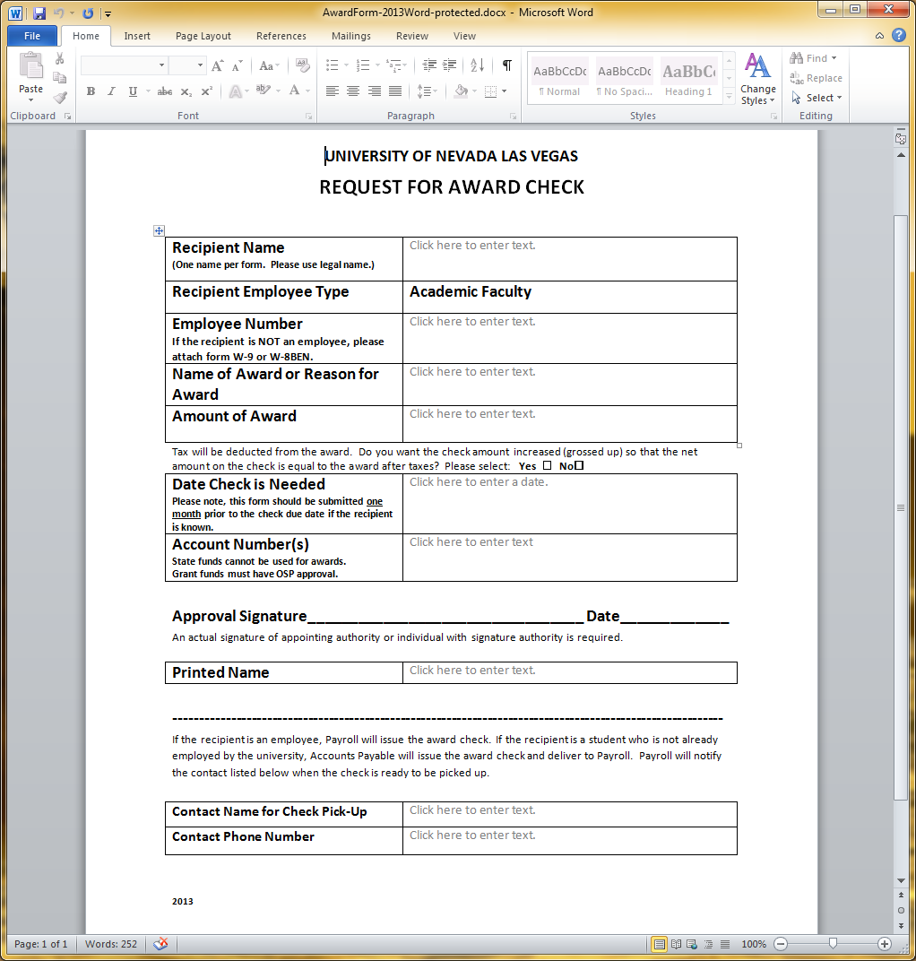

Slide 23

Memberships, Dues and Licenses
UNLV
Controller’s Office
University of Nevada Las Vegas
Accounts Payable Department
Institutional Memberships, Dues, Licenses & Associations:
Held in the name of the University
Can be paid using state funds (21XX)
Are permitted to be paid for using a payment voucher or P-Card
Requires AVP/VP or Dean approval
Individual Memberships, Dues, Licenses & Associations:
Held in the name of an individual
Are not permitted to be paid using state funds (21XX)
Are paid on a reimbursement basis only
Are not permitted to be paid using the P-Card
Requires Dean or Director approval
Dues assess a qualified individual by education, field or interest
Individual licenses must be required in the employee's work position
http://accountspayable.unlv.edu/Topics/memberships.html

Slide 24
Pre-Payment of Conferences
UNLV
Controller’s Office
University of Nevada Las Vegas
Disbursements Department
Local Conferences (within 75 miles of Las Vegas)- Prepay on a payment voucher or pay using your PCard. Attach a copy of the conference schedule/brochure and completed registration form.
Travel Status Conferences (outside 75 miles of Las Vegas) – Prepay on a payment voucher or pay using your PCard. Attach a copy of the conference schedule/brochure and completed registration form.
Meal per diem will not be paid for meals included with the conference while on travel status.
While in travel status Departments may pay for conference extras (workshops, luncheons, tours, etc.) if included within conference fees.
Please allow ample time for processing as certain vendors may take time to set up.
Notes:
Joseph Honrath
X53439 honrath@ccmail.nevada.edu

Slide 25
Candidate Travel
Expenses incurred by a UNLV Candidate to travel to UNLV for the prospect of employment are reimbursable to the candidate, unless purchased by the UNLV PCard.
Candidate travel is arranged by the candidate and/or the responsible UNLV department and can be purchased by candidate and/or the university PCard.
Candidate travel is audited and treated like employee out of state travel and are subjected to the same lodging and meal per diem rates via the General Services Administration (GSA). No Lodging Exceptions
Candidates cannot use the State Contracted Car Rental Agencies when renting a vehicle.

Slide 26
Candidate Travel Reimbursement
Reimbursements to Candidates are requested on a UNLV Payment Voucher and must include the following:
UNLV Search and Position Number
Original itemized receipt(s) showing the method of payment (UNLV Receipts Policy)
Candidate schedule of events such as time of interview & time of recruiting meals
Travel Itinerary Worksheet

Slide 27
Candidate Travel Reimbursement
Reimbursements may be made for:
Airfare – requires airline itinerary showing dates and times of departure and arrival and method of payment.
Lodging – requires detailed hotel bill showing zero dollar balance and method of payment. Lodging nightly rates will be audited according to current GSA rates. No Lodging Exceptions
Public ground transportation – (i.e. taxi, shuttle, etc.) Valid receipt(s) required.
Car Rental – requires detailed itemized receipt.
Personal vehicle mileage – will be reimbursed at the standard IRS mileage rate for the convenience of the university or half the IRS mileage rate at the convenience of the candidate.
Meal per diem – will be given in accordance with UNLV employee travel policy. No receipts required.

Slide 28
Candidate Travel Reimbursement
Reimbursements may not be made for:
Tips or gratuities
Room Service
Personal Phone Charges (non-UNLV business related)
Personal Incidentals
In-flight meals
GPS or Satellite Radio when renting a vehicle.

Slide 29
Candidate Family Travel
Candidate family travel reimbursement is only allowed after a Candidate has accepted a University Job Offer.
If requesting reimbursement for Candidate family travel, use a UNLV Payment Voucher and attach travel itinerary worksheet and all related lodging receipts.
Candidate family travel cannot be reimbursed on the 1st interview trip.

Slide 30
Candidate Family Travel
Candidate Family Travel will be reimbursed according to The State Administrative Manual, Section 0248 – Per Diem and Subsistence Allowances for Moving:
Allowable per diem and subsistence allowances:
1. Per Diem will be paid for the actual days in transit not to exceed six days. The employee may elect to utilize a portion of the total day allocation to locate suitable housing before the move, with prior approval.
Per Diem and mileage rates allowable for location of housing will only apply to the employee and spouse and will be reimbursed at the established in-State rates.
2. Allowable per diem shall be equal to regular travel status for the employee and family members.
3. Allowable lodging will approved as follows:
a. For the employee: Established in-State rates.
b. For the spouse: Three-fourths the amount allowed the employee up to the actual.
c. For each additional member of the family: Age twelve or over, three fourths of the employee allowance up to the actual; under age twelve, one-half the employee allowance up the actual.
4. Receipts are required for lodging if the family accompanies the employee

Slide 31
Candidate Travel Codes
EXPENSE | OBJECT CODE | SUB-OBJECT CODE
Candidate Airfare | 30 | C3
Candidate Lodging | 30 | CL
Candidate Car Rental | 30 | CC
Candidate Other Expenses | 30 | C4

Slide 32
Candidate Recruitment Expenses
Recruitment expenses are any internally incurred expenses related to the recruitment of prospective employees (or students) that are either purchased by the university PCard or a university employee.
Although hosting in nature, these expenses do not need a host account and can be reimbursed using other university accounts.
When reconciling, please use the following candidate recruitment accounting code:
Expense | Object | Sub-Object
Candidate Recruitment | 30 | RC

Slide 33
Candidate Recruitment Reimbursements
Reimbursements of recruitment expenses to university employees or students need to be requested on a UNLV payment voucher and must include the following:
UNLV search and position number of job vacancy
Original itemized receipt(s) showing the method of payment (UNLV Receipts Policy)
When reimbursing a candidate recruiting meal, tips are reimbursable up to 20% of the cost of the meal (Subtotal) less any alcohol purchases. Tips on alcohol purchases are not allowed. Also, please include a list of people that attended the recruiting meal.
Spouses of UNLV Employees are not eligible for reimbursement and their portion of the recruiting meal needs to be deducted. If paid by PCard, the amount deducted needs to be paid back to UNLV.

Slide 34
Prepaying Lodging
Lodging (make sure to check GSA rates before making lodging reservations)
P-card
Use credit card authorization form only if room and taxes are to be charged to the P-card
Payment Voucher
Attach reservation confirmation showing traveler’s name and total amount to be charged with detail (rate per night, taxes, and fees)
NOTE – W-9 AND VENDOR APPLICATION FORM IS REQUIRED FOR ALL NEW VENDORS.

Slide 35
Which document do I use?
UNLV
Controller’s Office
University of Nevada Las Vegas
Accounts Payable Department
To determine how to pay an item first determine who you are paying (vendor vs. individual).
To pay a vendor for goods or services not yet received, submit a requisition (RX) to Purchasing.
To pay a vendor for goods or services already received submit the request on a payment voucher (PV).
- This is considered an “After-the-fact” purchase.
To pay an individual (non-UNLV) affiliate for services (future or already received), submit an Independent Service Provider (ISP) contract or Independent Contractor Agreement (ICA).

Slide 36
UNLV
Controller’s Office
University of Nevada Las Vegas
Accounts Payable Department
Reminders on Invoices and Payment Vouchers
We can not short pay invoices or pay prior balances due. We can only pay current charges.
If the vendor does not show in the vendor database, they will need to go online and register with the supplier registration website:
https://supplierregistration.purchasing.unlv.edu.
Do not use vendor codes that start with “F”.
All new foreign vendors require a completed W-8BEN and all foreign payments (PV or invoice) must have D.Honrath’s approval.

Slide 37

Nonresident Aliens
Debbie Honrath – (702) 895 - 1243
Contact the Office of International Students and Scholars when bringing in any foreign nationals to assist with employment, visa and travel issues as well as immigration advising and related documents.
It is important that the individual have the correct immigration status for the type of payment requested, or we may not legally be able to pay the individual under immigration law.
Accounts Payable handles payments and reimbursements to nonresident alien candidates, volunteers, and independent contractors after approval has been obtained from UNLV’s NRA tax specialist (Debbie Honrath).
Check in advance when bringing in a nonresident alien independent contractor or contracting with a foreign company who will be providing services in the U.S. The nonresident alien will need to complete additional forms in person when they arrive. Contact Debbie Honrath to setup any required meetings before the independent contractor leaves the U.S.

Slide 38

ISP’s & ICA’s
When bringing individuals to UNLV, first determine their classification.
If you are doing business with a non-UNLV affiliated individual their payment will be on an Independent Service Provider Contract (ISP) or Independent Contractor Agreement (ICA).
Contracts are available thru Accounts Payable.

Slide 39
Financial Data Warehouse
It is a user friendly system that provides multiple sources of information and is a great research tool. Data warehouse provides a number of reports that are available to you and you are able to check payment status of an invoice, payment voucher, or travel document.
https://dewey.scsr.nevada.edu:8250/portal/page/portal/BIDSS_Login
Several options provide drill-down features which will help the user to further research a problem or find information without the need to know or understand the complexities of the on-line financials system Advantage.
All the information presented through this system is current as of the close of business the prior night.
Access is granted through The Office of Information Technology.

Slide 40

UNLV
Controller’s Office
University of Nevada Las Vegas
Accounts Payable Department
Why does Accounts Payable have so many policies and procedures that we must follow?
NRS (Nevada Revised Statutes)
http://www.leg.state.nv.us/NRS/
NAC (Nevada Administrative Code)
http://www.leg.state.nv.us/NAC/CHAPTERS.HTMl
SAM (State Administrative Manual)
http://budget.state.nv.us/SAM2002.htm
IRS (Internal Revenue Service)
Tax Code, Regulations, Revenue Rulings, Revenue Procedures, Case Law
http://www.irs.ustreas.gov/
USCIS (U.S. Citizenship and Immigration Services)
Legal payments to nonresident aliens
http://uscis.gov/graphics/
BOARD OF REGENTS and CHANCELLOR’S MEMOS
http://system.nevada.edu/Board-of-R/Handbook/index.htm
http://system.nevada.edu/Resources/Employees/Chancellor/index.htm
Accounts Payable payments and documentation are audited by many entities not limited to the Legislative Counsel Bureau, NSHE Internal Audit Dept, Board of Regents, Internal Revenue Service, PWC CPA firm.

Slide 41




Questions Comments
UNLV
Controller’s Office
University of Nevada Las Vegas
Accounts Payable Department

