Slide 1
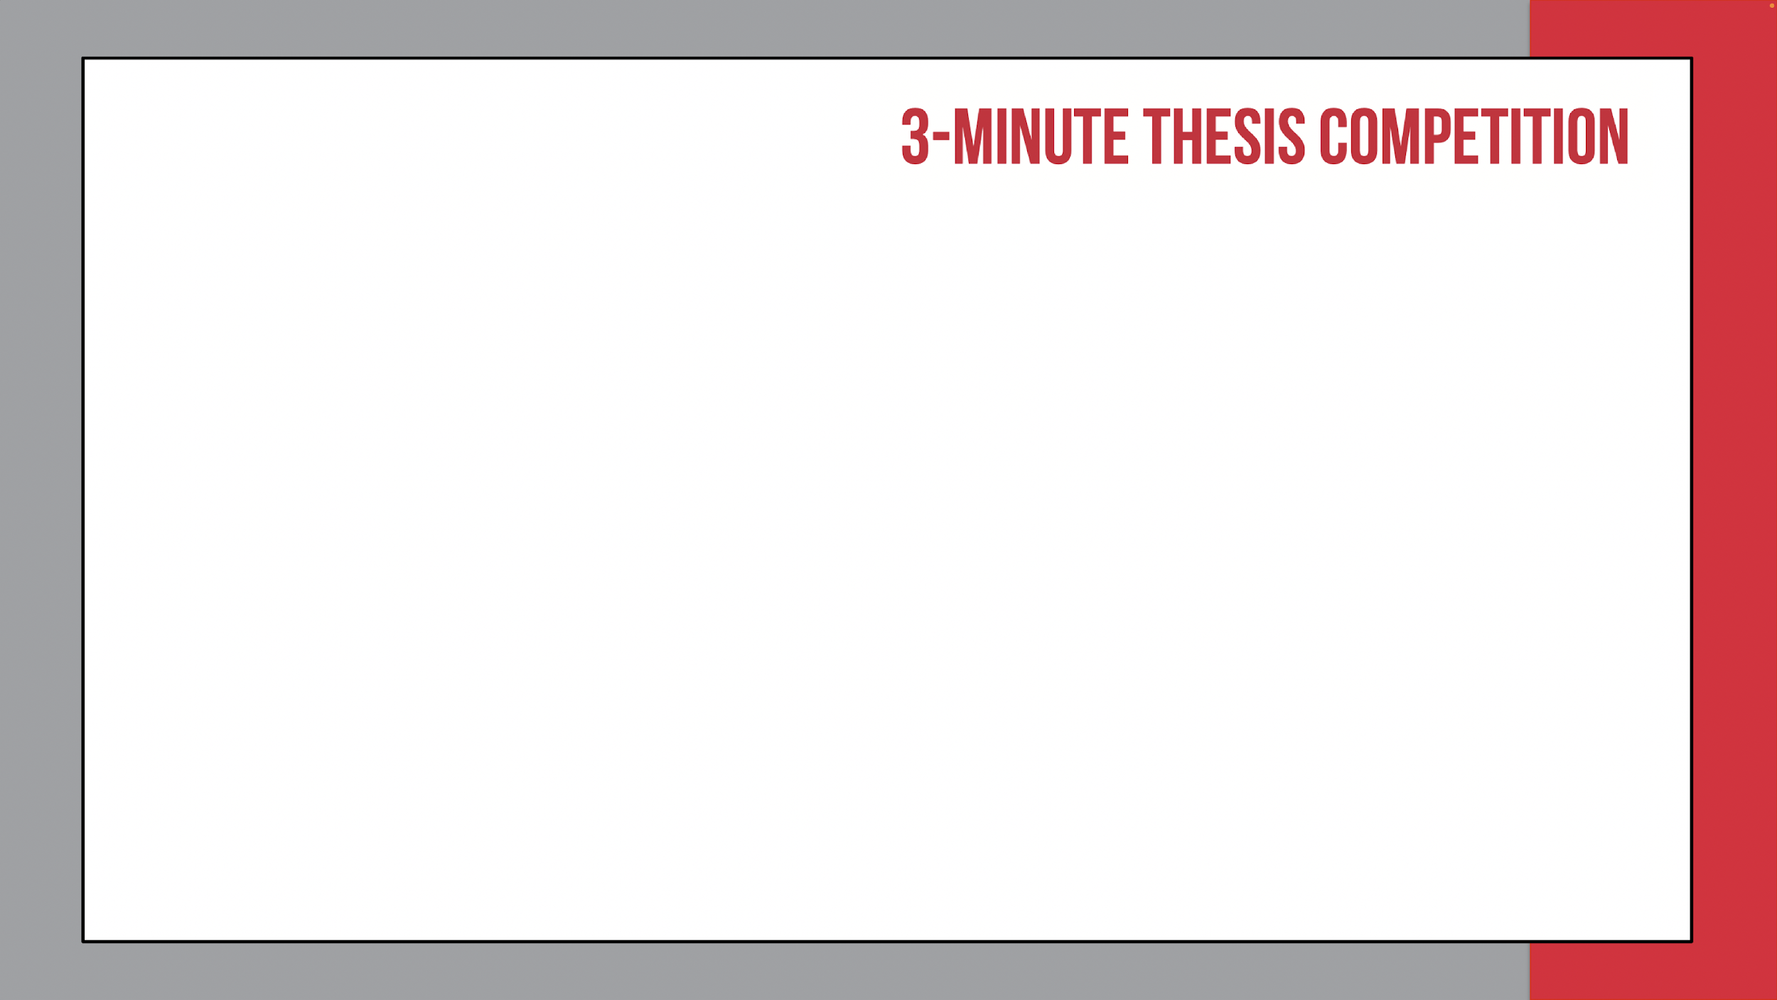
UNLV Rebel Grad Slam
PowerPoint Requirements
All contestants must prepare 1 PowerPoint TITLE SLIDE and 1 PowerPoint CONTENT SLIDE using the format provided (slide 3 and slide 4 in this presentation). Download this presentation in PowerPoint format to complete your edits.
Please keep the 16:9 aspect ratio.
All slide text (including headers) must be black.
Any images, photos, graphics, graphs, or illustrations included on your slide must include a credit for the original source of the image, photo, etc. if they were not solely created by the presenter.
Keep all images and text within the black border of the PowerPoint slides, as images or text outside of this area might be cut off.
Slides are not permitted to contain slide transitions, animations, or 'movement' of any kind.
No other types or designs of slides will be allowed.
Presentations may not include any additional electronic media (e.g. sound and video files)
You cannot modify your PowerPoint slide between rounds.

Slide 2
UNLV Rebel Grad Slam
Presentation Requirements
The slide will be visible from the beginning of the speaker’s presentation.
No additional props (e.g., costumes, laboratory equipment) are permitted.
Notes are not permitted.
Presentations are limited to 3 minutes maximum and Slammers exceeding 3 minutes are disqualified.
Presentations are considered to have commenced when a presenter starts their presentation through movement or speech.
The scoring and decision of the judges is final.
Business casual is encouraged for all rounds of competition.
Preliminary and Semi-Finals round contestants must check in 10-15 minutes prior to the start of the competition.
Finals round contestants must check in 30 minutes prior to the start of the competition.
Please note that all rounds may be recorded. If recording occurs, your 3MT® slide will be embedded into a video and posted online. Participation in the Rebel Grad Slam 3MT constitutes consent for your image and slides to be photographed, filmed, and shared by the UNLV Graduate College.

Slide 3




Student Name Presentation Title
Degree/Program: e.g. Master of Arts - Anthropology
Advisor: e.g., Dr. Emily Lin
Rebel Grad Slam 2025

Slide 4

Blank slide template

