Slide 1
Overcoming Legislative Gridlock: How Procedural Rules Affect Obstructionism
Molly C. Jackman
Governance Studies
Brookings Institution

Slide 2
Obama and gun control
Acceptance speech, 2008:
“Don’t tell me we can’t uphold the 2nd Amendment while keeping AK-47s out of the hands of criminals.”
January 2011 (after Tuscon shooting):
“That's why our focus right now should be on sound and effective steps that will actually keep those irresponsible, law-breaking few from getting their hands on a gun in the first place.”
July 2012 (after Aurora shooting):
“I…believe that a lot of gun owners would agree that AK-47s belong in the hands of soldiers, not in the hands of criminals.
January 2013 (after Newton shooting):
“in the coming weeks I’ll use whatever power this office holds” in an effort “aimed at preventing more tragedies like this.”
September 2013 (after Naval Yard shooting):
“No other advanced nation endures this kind of violence — none…And there is nothing inevitable about it. It comes about because of decisions we make or fail to make. And it falls upon us to make it different.”

Slide 3
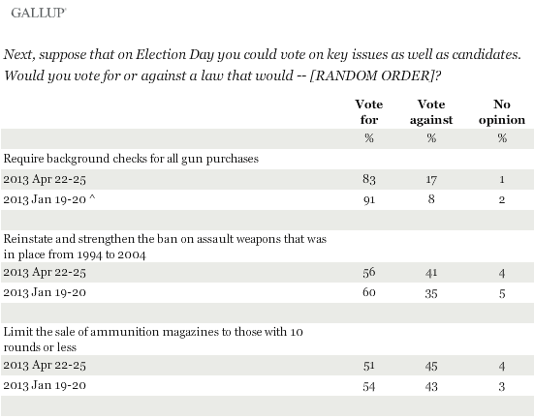
Public opinion on gun control

Slide 4
Congressional action on gun control
In the 113th Congress, 72 bills have been introduced.
56 to restrict gun rights.
16 to expand gun rights.
Zero have become law (so far…).

Slide 5
Most bills do not receive a vote!
In this session, 8/72 bills reported from committee, and one received a floor vote.
112th Congress:
28 bills introduced to restrict gun rights.
Four made it out of committee.
Four received a floor vote.
Three passed chamber where introduced (House).
Zero made it out of committee in the Senate.
26 bills introduced to expand gun rights.
Zero made it out of committee.

Slide 6
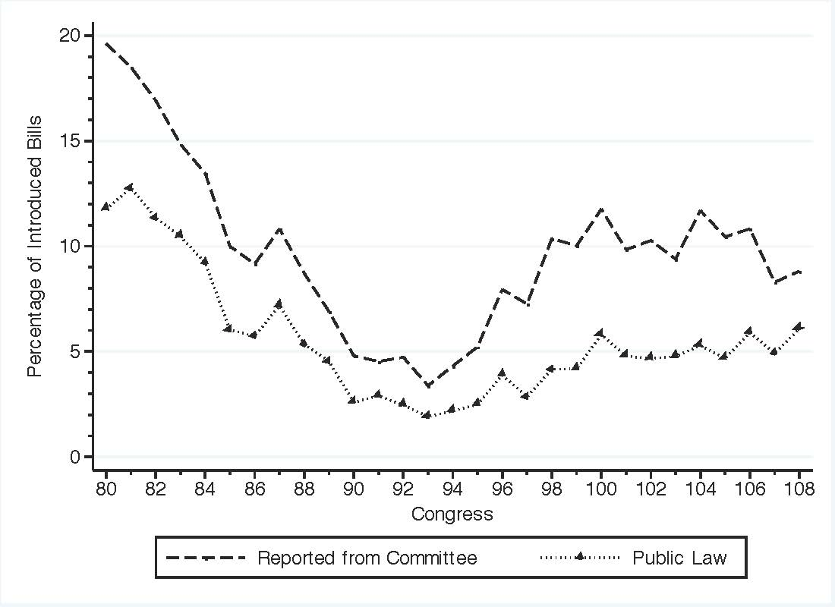
Progress of Bills in the House
Source: Congressional Bills Project.

Slide 7
What causes legislative inaction?
Bad bills get blocked.
Majority party size.
Reid almost didn’t bring assault weapons ban to a vote, because he knew it would be DOA in the House.
Polarization within and across parties.
15 red state Democratic Senators voted against ban.
Highest level of party unity in House history.
These factors cannot account for the totality of obstructionism!
Need procedural rules to facilitate bill blocking.

Slide 8
Procedural rules in the U.S. House
Committees can block bills (i.e., decline to hear them or to report them).
Speaker and Rules Committee have lots of discretion to determine the order of bills on the calendar.

Slide 9
Majority party gatekeeping
The majority party has a gatekeeping right if procedures allow it not to act on a proposal, and the result of inaction is that the status quo policy remains in effect.
E.g., majority appointed committees can block bills, majority leader sets floor agenda.
The majority party has gatekeeping power if it has a gatekeeping right and that right produces an outcome that is preferable to the one that would have occurred absent the right.
Do majority party gatekeeping rights lead to increased majority party power?

Slide 10
Do majority party gatekeeping rights → power?
Do majority party gatekeeping rights increase majority party power above and beyond the size and heterogeneity of parties?
Ideally, need a baseline model:
What are legislative outcomes absent majority party gatekeeping rights?
Impossible in U.S. House.
How does variation in majority party gatekeeping rights explain variation in legislative outcomes?
Rules change infrequently and simultaneously. Cannot identify cause and effect.

Slide 11
New strategy
Look at the states!
Tons of variation in legislative outcomes.
In the 2011-2012 legislative session, 1008 bills introduced in the states to amend gun laws.
284 to strengthen gun rights, 425 to strengthen gun control.
148 bills passed.
Tons of variation in procedural rules/majority party gatekeeping rights?

Slide 12
Measuring rules in the states
Consider two main junctures in the legislative process for majority party gatekeeping: (1) committee stage and (2) calendar stage.
NCSL survey of committee procedures.
Survey of state legislative clerks and secretaries (with Sarah Anzia):
How bills are placed on the chamber’s floor calendars.
Who appoints committee members and chairs.
Whether the full chamber votes on committee assignments.
Notes:
Received 87 responses, coded 96 chambers.

Slide 13
Variation in state gatekeeping rights
Committee gatekeeping:
Can a majority party appointed committee decline to hear bills?
Yes in 72 chambers.
Can a majority party appointed committee decline to report bills?
Yes in 74 chambers.
Can a majority party appointed committee either decline to hear or to report bills?
Majority party committee gatekeeping exists in 79 chambers.

Slide 14
Variation in state gatekeeping rights (cont.)
Calendar gatekeeping:
Does a majority leader set the calendar?
Yes in 45 chambers.
Can majority party appointed committee set the calendar?
Yes in 16 chambers.
Does a majority party leader or committee set the calendar?
Yes in 61 chambers.

Slide 15
Nevada Assembly: committee gatekeeping
The majority party appoints committee members and chairs.
Susan Furlong (clerk): “Committee chairmanship and membership appointments are determined by the Speaker.”
Can committees can decline to hear bills? Yes! (NCSL).
Committees can decline to report bills? Yes! (NCSL).
Majority party has committee gatekeeping rights.

Slide 16
Nevada Assembly: calendar gatekeeping
What person, committee or process determines the order in which bills are heard by the floor?
Susan Furlong (clerk): “Once bills are reported out of committee, they are placed on second or third reading, as appropriate, in numerical order in accordance with our house rules and custom and precedence. A member may make a motion to place a bill in a different position on second or third reading or to put a bill on hold by moving it to the desk.”
Majority party does not have calendar gatekeeping rights.

Slide 17
Nevada Senate: committee gatekeeping
Who determines the appointment of committee members and chairs?
Sherry Rodriguez (Assistant Secretary): The Chair of each committee is chosen by the majority caucus (majority leader). Standing committees are ALWAYS Chaired by a member of the majority party. The members for each committee are assigned the same way, by the Majority Leader, except the Minority members are chosen and placed on each Standing Committee by the minority caucus (minority leader).”
Note: Committee appointments based on proportional representation (NCSL).
Can committees decline to hear bills? Yes! (NCSL).
Can committees can decline to report bills? Yes! (NCSL).
Majority party has committee gatekeeping rights.

Slide 18
Nevada Senate: calendar gatekeeping
What person, committee or process determines the order in which bills are heard by the floor?
Sherry Rodriguez (Assistant Secretary): “After a bill has been passed out of a Standing Committee, the bill comes to the Senate Front Desk with the committee’s recommendation on the bill. The bill is then placed on the Daily Agenda in numerical order placing Senate bills first and the Assembly bills following in their numerical order. A Senator may stand during the floor session and request that any bill on the Daily Agenda be moved to another position if they give the purpose for their request such as possibly waiting for an amendment.”
Majority party does not have calendar gatekeeping rights.

Slide 19
Measuring legislative outcomes
If the majority party has gatekeeping rights, no bill should come to a vote that the leadership opposes.
What bills might the majority party oppose?
Majority rolls: passing bills on which a majority of the majority party votes in opposition.
Majority party rolls should be low/zero in chambers where the majority party has gatekeeping rights.

Slide 20
Example: immigration reform
Stuck in committee.
Boehner invoked the Hastert Rule: “I don’t see any way of bringing an immigration reform bill to the floor that doesn’t have the majority support of Republicans.”
In other words, he will not allow a vote on a bill that would result in a roll (i.e., pass against the wishes of a majority of the majority party).

Slide 21
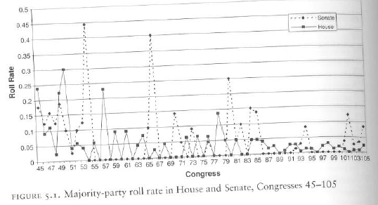
Source: Cox, Gary W. and Mathew D. McCubbins. 2005. Setting the Agenda.
New York: Cambridge University Press.
Notes:
45th: 1877-1879
105th: 1997-1999

Slide 22
NV House
Total votes: 138
Majority rolls: 3
Maj. roll rate: 0.023
NV Senate
Total votes: 129
Majority rolls: 1
Maj. roll rate: 0.008

Slide 23
Effect of committee gatekeeping rights on majority roll rates
 | No | Yes | Effect of gatekeeping right
Non-hearing right | 7.7% | 5.4% | 2.3 percentage points
Non-reporting right | 7.7% | 5.6% | 2.1 percentage points
Committee gatekeeping right | 7.7% | 5.4% | 2.3 percentage points
Majority roll rates are lower in chambers where the majority party has committee gatekeeping rights.

Slide 24
Effect of calendar gatekeeping rights on majority roll rates
 | No | Yes | Effect of gatekeeping right
Majority leaders has calendar gatekeeping right | 6.1% | 0.0% | 0 percentage points
Majority appointed committee has calendar gatekeeping right | 6.5% | 4.3% | 2.2 percentage points
Calendar gatekeeping right | 7.0% | 5.6% | 1.4 percentage points
Majority roll rates are lower in chambers where the majority party has calendar gatekeeping rights.

Slide 25
Rule configurations and majority rolls
 | Majority roll rate
Neither committee gatekeeping nor calendar gatekeeping | 8.4%
Committee gatekeeping but no calendar gatekeeping | 6.5%
Calendar gatekeeping but no calendar gatekeeping | 7.5%
Both committee gatekeeping and calendar gatekeeping | 5.3%
Majority roll rates are lower in chambers with majority party gatekeeping rights.

Slide 26
Example: Colorado House
Committee Gatekeeping | Calendar Gatekeeping | Effect size (percentage points) | Majority Roll Rate
No | No |  | 9.7%
Yes | No | -2.7 | 7%
No | Yes | -0.01 | 9.69
Yes | Yes | -5.2 | 4.5
Note: Bold font indicates statistically significant effect.
Majority party size (percentage point increase) | Effect size (percentage points)
9.5 (1 SD) | -3.1
16 | -5.2
Notes:
On average, chambers with this configuration of rules have roll rates = 10.5 %
Majority party size is 57% in Vermont Senate

Slide 27
Why should we care?
Procedural rules affect gridlock and policy outcomes.
5.2 percentage points = ~23 bills. And these are the important bills!

Slide 28
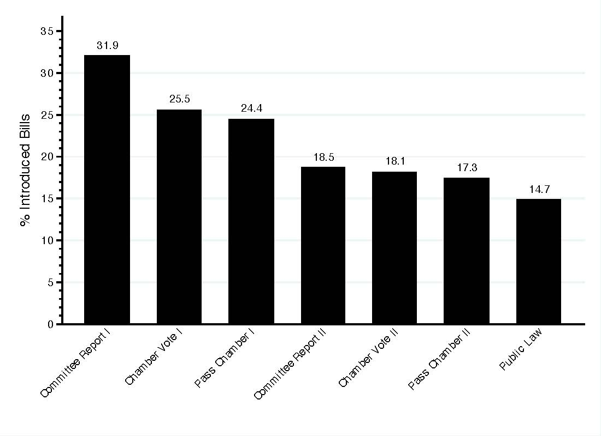

Slide 29
Progression of gun laws in state legislatures
 | Committee gatekeeping rights
 | Yes | No
Committee report | 30.5% | 56.1%
Final passage vote | 24.7% | 38.6%
Pass chamber | 23.7% | 36.8%
Public law | 8.8% | 15.1%
Calendar gatekeeping rights
Yes | No
27.3% | 46.9%
20.2% | 42.7%
20.0% | 41.2%
11.0% | 27.1%
Committee and calendar gatekeeping rights
Yes | No
31.7% | 63.6%
25.2% | 63.6%
24.2% | 54.6%
14.7% | 18.2%
Notes:
148 total passed, 860 failed.
42 laws passed that would weaken gun control, 51 to strengthen it

Slide 30
Why should we care?
Procedural rules affect gridlock and policy outcomes.
5.2 percentage points = ~23 bills. And these are the important bills!
2. Institutional design.

Slide 31
Conclusions
Partisan polarization is preventing important policymaking in the U.S.
The majority party exercises power in legislatures not only by pushing bills forward, but also by holding them back.
In order for this to be the case, it is necessary that the majority party has gatekeeping rights.
The majority party shares a greater policymaking advantage where:
It can block bills in committee.
If can block bills from appearing on the floor calendar.

Slide 32
Extra Slides

Slide 33
Table 5: Majority Negative Agenda Rights
 | (1) | (2)
Majority sets calendar | -0.019⁺ (0.012) | -0.005 (0.021)
Committee gatekeeping | -0.039** (0.014) | -0.027⁺ (0.18)
Committee gatekeeping x Majority sets calendar |  | -0.021 (0.027)
Majority party size | -0.316** (0.065) | -0.324** (0.067)
Intraparty heterogeneity | 0.019⁺ (0.012) | 0.020⁺ (0.012)
Interparty heterogeneity | 0.002 (0.014) | 0.002 (0.015)
Constant | 0.293** (0.055) | (0.290)** (0.054)
Interaction effect Committee gatekeeping and Majority sets calendar |  | -0.052** (0.015)
Observations | 93 | 93
R² | 0.310 | 0.316
Robust standard errors in parentheses. Significance tests are one-tailed. ⁺p<0.10; *p<0.05; **p<0.01
Notes:
If committees can block bills that would roll the majority before they make it to the calendar, the right of the majority to set the calendar may be inconsequential. In Column 1, we evaluate whether the effect of majority gatekeeping at the calendar stage persists if we also account for the right of majority appointed committees to block bills from ever reaching the calendar stage. The effect of calendar blocking is slightly smaller and less precisely estimated than in the previous model specifications; however, we still find that chambers in which a majority leader or majority appointed committee sets the calendar have majority roll rates that are 2 percent lower in than chambers where a majority party agent does not set the calendar, significant at the 10 percent level. We estimate a strong and sizable effect of committee blocking rights: they reduce majority roll rates by 4 percent, significant at the one percent level.
Next, we evaluate whether the right to block bills at both the committee stage and the calendar stage give the majority greater negative agenda-setting influence than having the right to block bills at just one of these junctures. We include an interaction between the committee blocking variable and the calendar blocking variable in our model specification. We find that the committee blocking variable has a negative and significant effect on majority roll rates. The calendar blocking right does not have a significant effect by itself. We do find, however, that the combination of both committee blocking and calendar blocking rights has a negative effect on roll rates above and beyond that of the committee blocking right alone: the combined effect of committee and calendar blocking on majority roll rates is -5.4 percentage points, significant at the 1 percent level. We reject that this combined effect is equivalent to that of the committee blocking variable by itself.

