Slide 1
What is
Concept Mapping?
A visual manipulative approach to learning
Excellent tool for content/concept analysis
Organize and manipulate concepts, ideas, theories and other material in a visual format.
Can be used for learning, teaching, organizing, problem-solving, decision-making and brainstorming.
Offers simplicity and clarity to complex, multifaceted material.
Notes:
To map something, you create a drawing or diagram, often articulating links, relationships and connections. This process can help you visualize, organize, structure and conceptualize ideas and information.

Slide 2
Advantages of Mapping
Material is organized visually
Concepts that previously seemed separate and compartmentalized now have a visible, connected structure.
Ideas, facts and supporting material are placed at proper levels or rank.
Students with visual learning style excel
Both hemispheres of the brain are used
Greater volume of material can be processed (chunking)
Can be used to unravel difficult concepts (go backward)
Provides a bird’s eye view of large concepts/topics
It’s more fun than cramming details into our heads

Slide 3
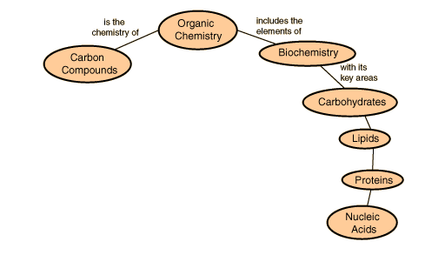
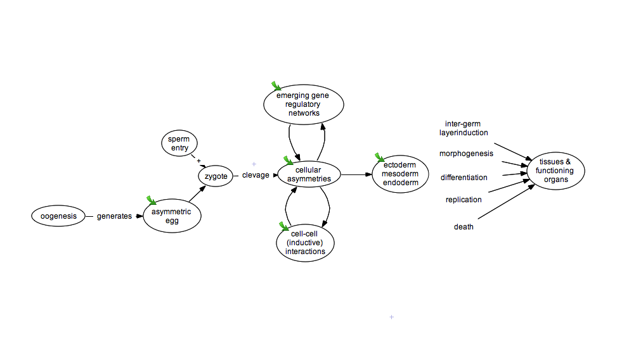
Organic Chemistry Concept Map
Developmental Biology
Concept Map
Notes:
To map something, you create a drawing or diagram, often articulating links, relationships and connections. This process can help you visualize, organize, structure and conceptualize ideas and information.

Slide 5
A Fishbone Map
An advantage of the herringbone technique is it helps you encode information in a manner that enhances your ability to answer essay questions. It is a very useful strategy for history courses and other courses that require remembering details for essay questions.
This technique is designed to show causal interactions of a complex event or phenomenon. It describes a main idea in terms of the following six questions: Who was involved? What happened? When did it happen? Where did it happen? How did it happen? Why did it happen?
A herringbone map is set up like a fish skeleton. The “backbone” of the map represents the main idea. The “spines” of the map represent the six questions about the main idea. Supporting information for each of the six questions is written next to each “spine”.
Notes:
The herringbone technique is designed to show causal interactions of a complex event or phenomenon. It describes a main idea in terms of the following six questions: Who was involved? What happened? When did it happen? Where did it happen? How did it happen? Why did it happen?
A herringbone map is set up like a fish skeleton. The “backbone” of the map represents the main idea. The “spines” of the map represent the six questions about the main idea. Supporting information for each of the six questions is written next to each “spine”.

Slide 6
Student Examples:

Slide 7
Student Examples:

Slide 8
Student Examples: (Not recommended for most people!)

