Slide 1
Immigrant Workers, Human Capital Investment and the Shape of Immigration Reform
Audrey Singer
The Brookings Institution
University of Nevada Las Vegas
February 27, 2013

Slide 2
U.S. Immigration: Current policy debates
How many immigrants should we admit?
Who should we prioritize?
How do we modify immigration policy to better meet national and local economic needs?
2
Notes:
2

Slide 3
Key Issues in Immigration Policy Reform
Enforcement, includes border and worksite, with an employer verification system
Legalization, includes Dreamers and others
Future Flow, includes reduction of backlogs and adjustments to family-based and employment-based visas
3
Notes:
3

Slide 4
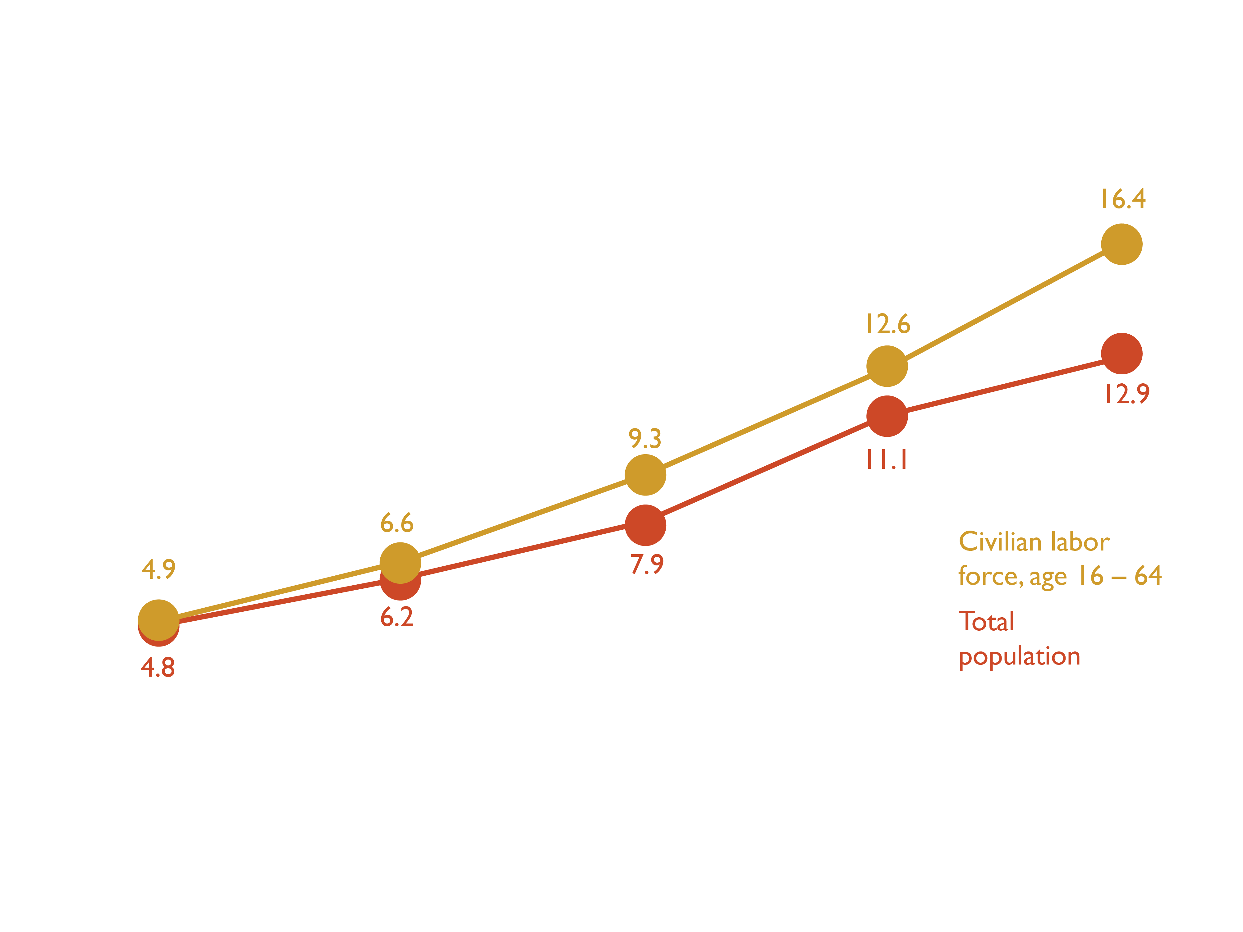
Immigrants are a growing part of the labor force
Skill ratio
Notes:
4

Slide 5
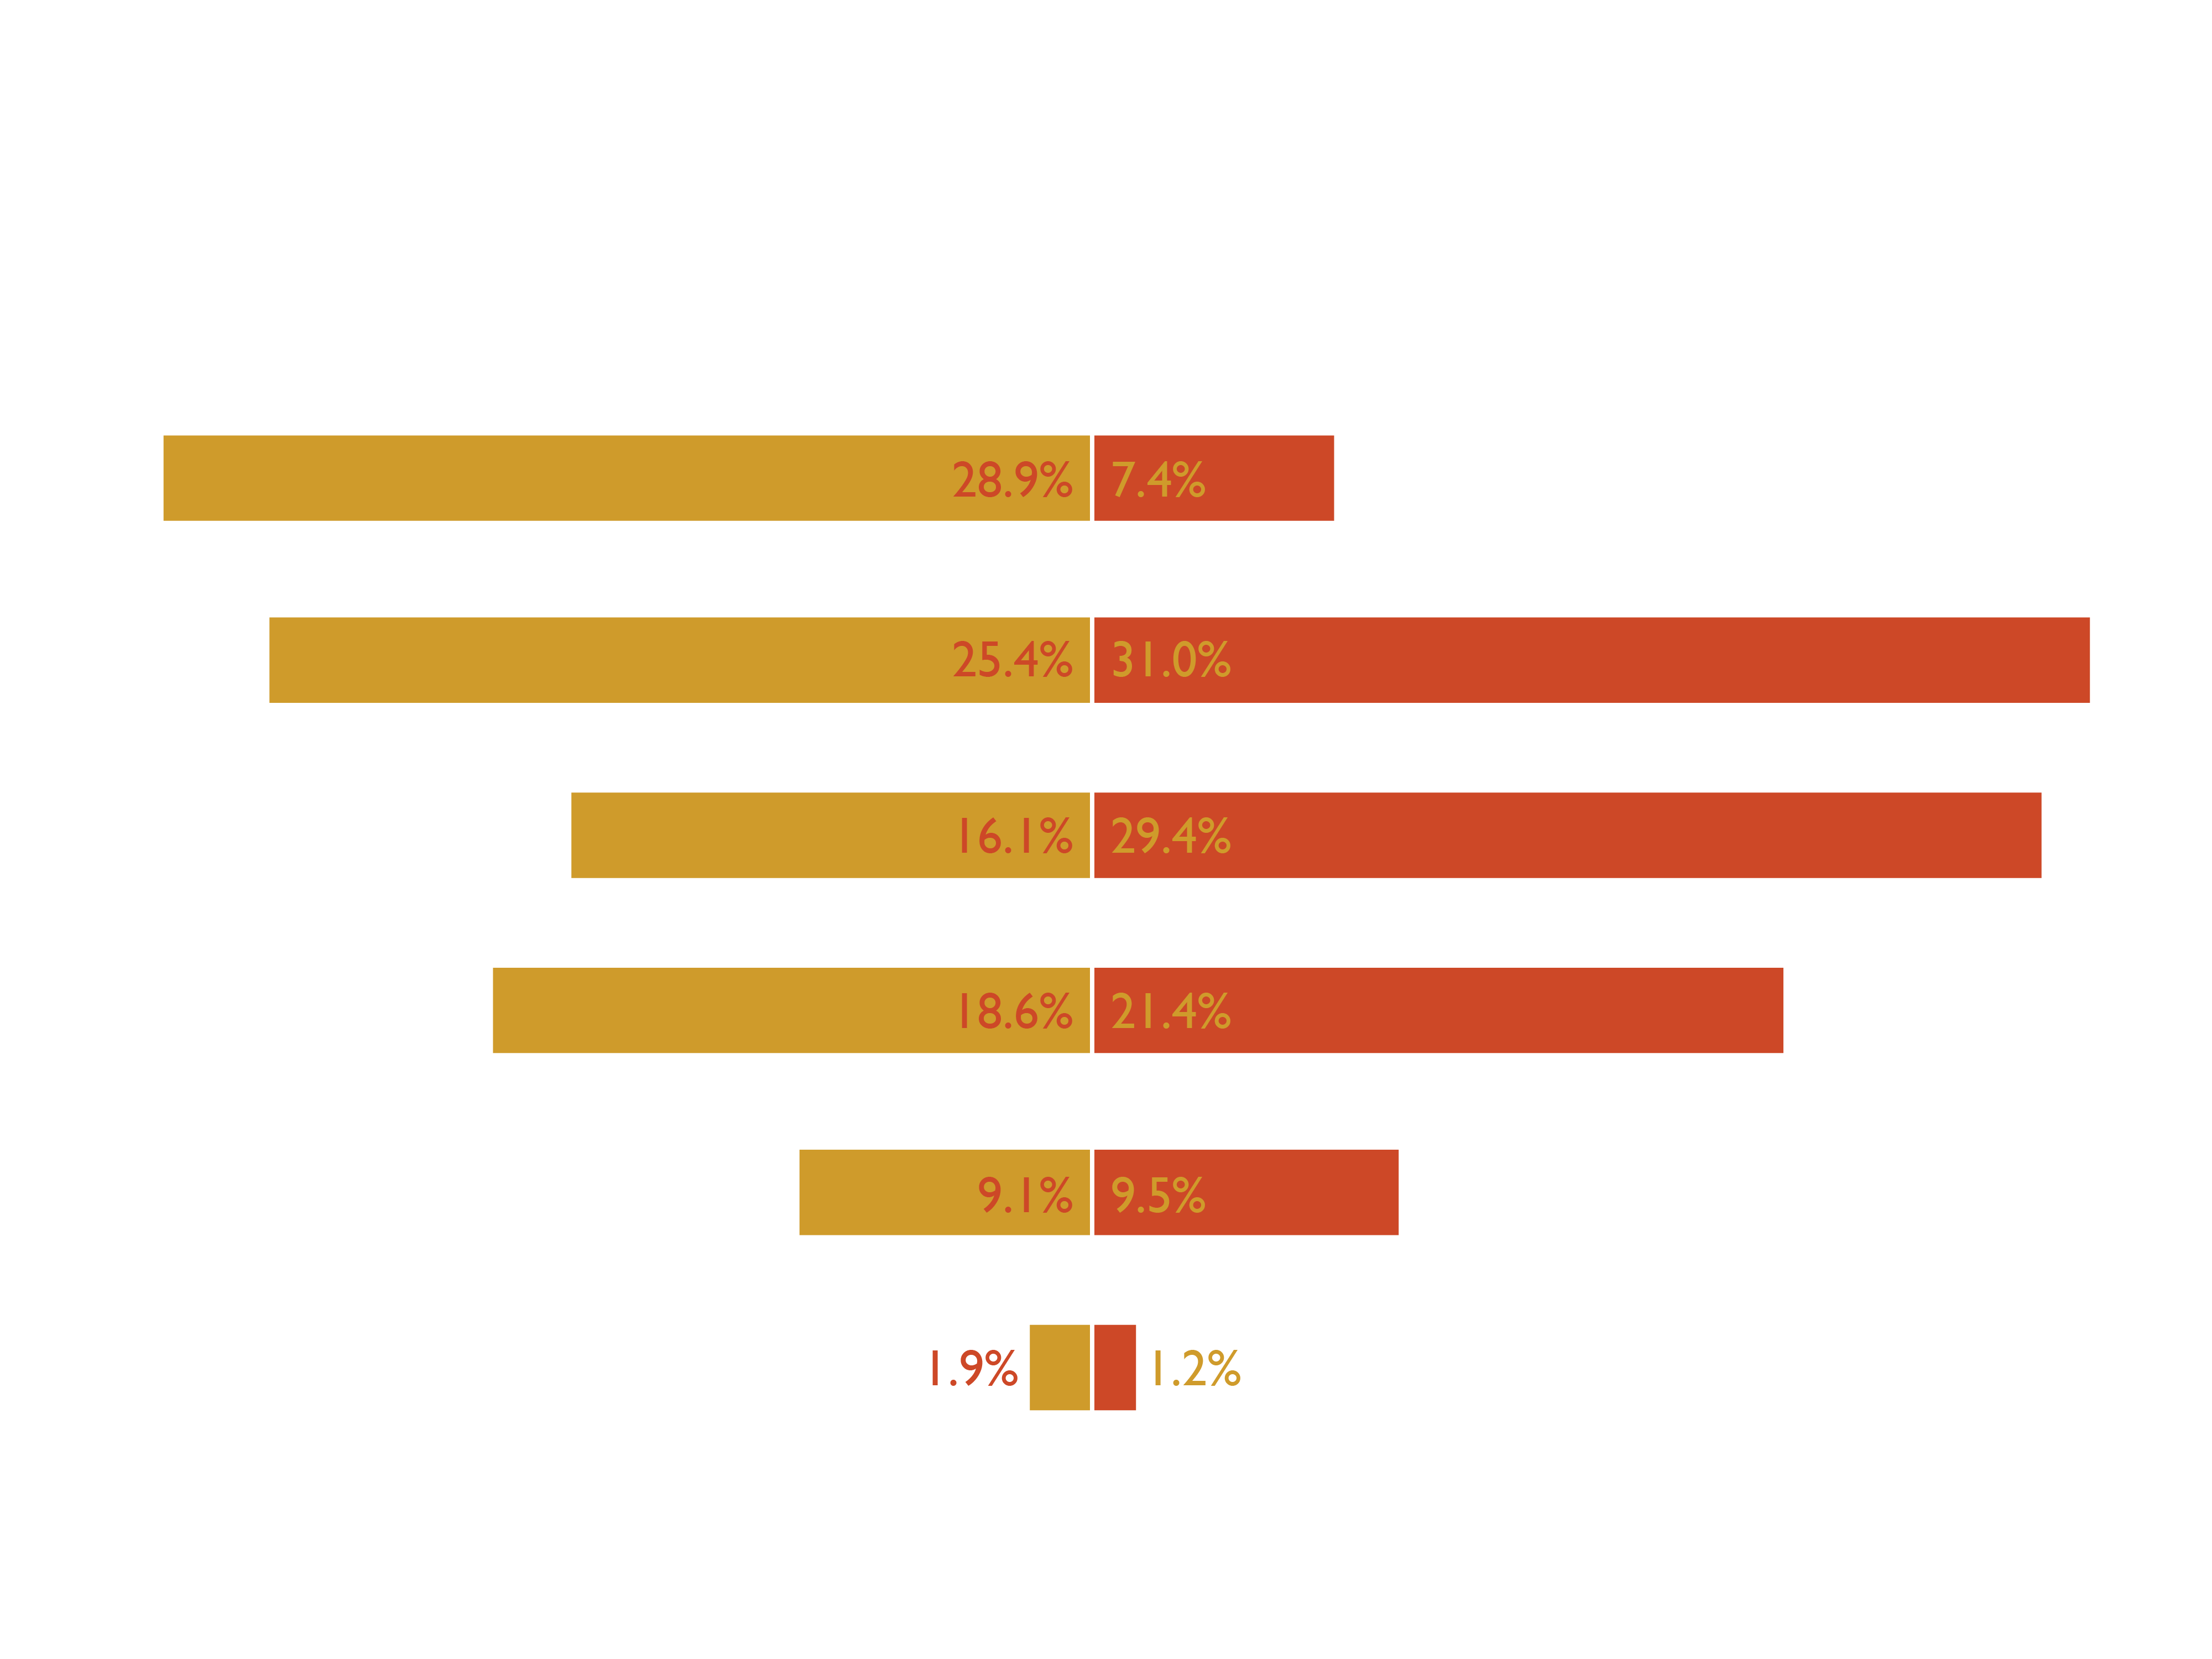
Nearly one-in-three immigrants lack a diploma
Skill ratio
Notes:
5

Slide 6
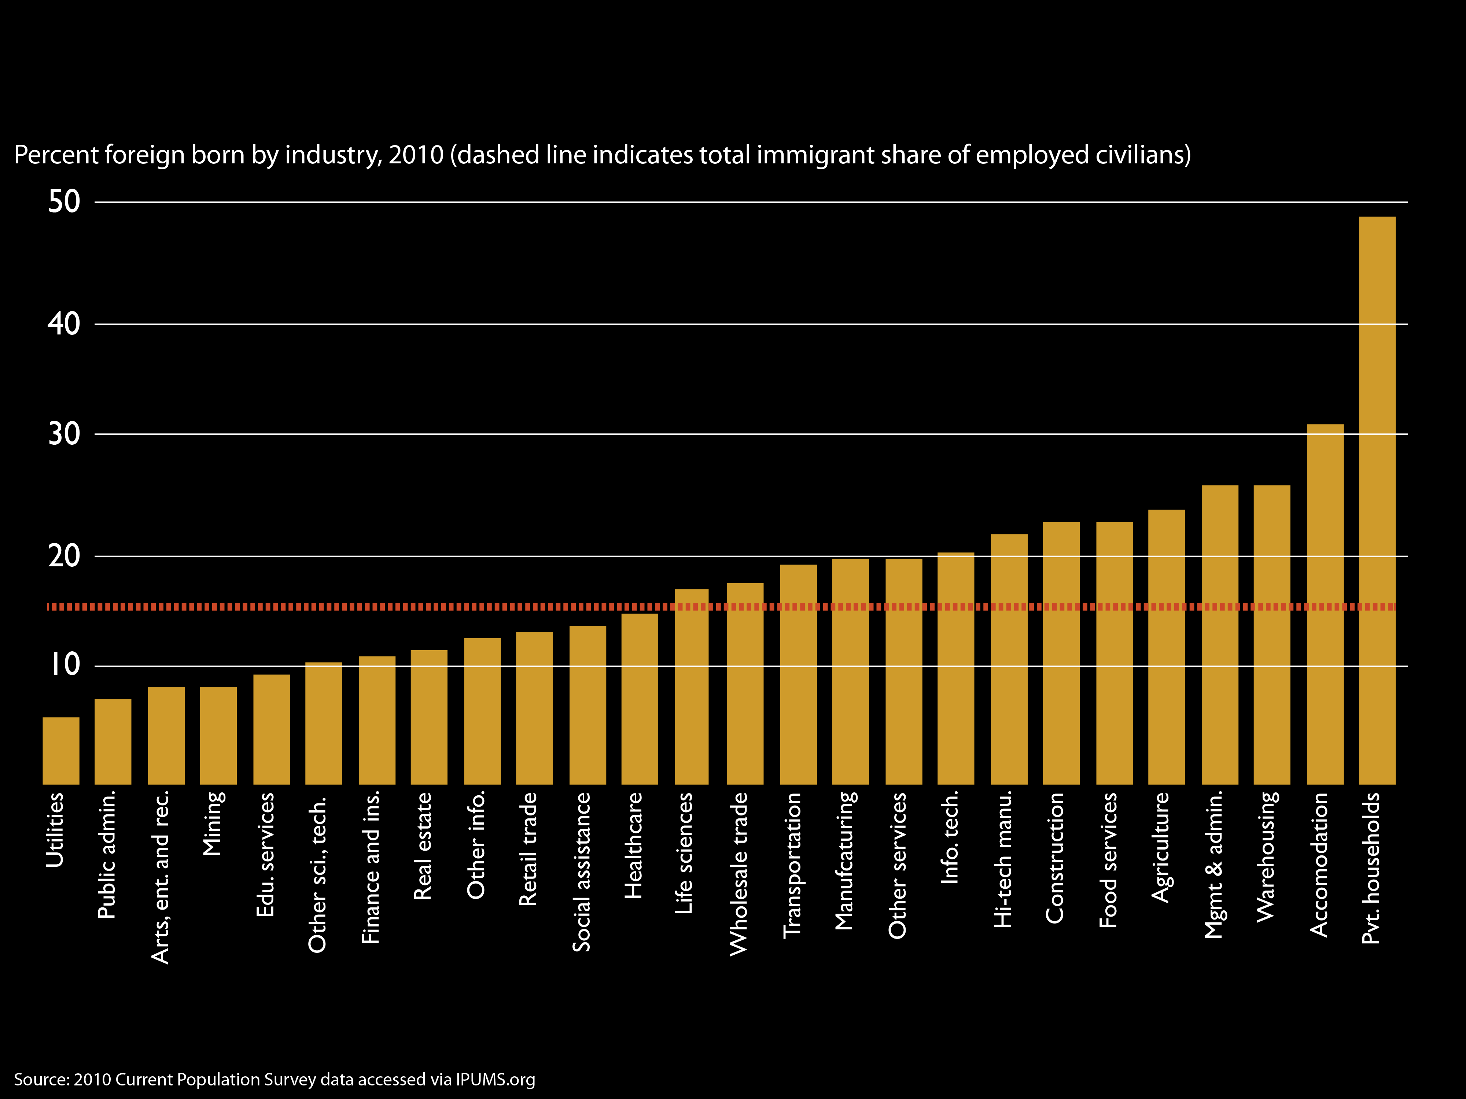
Immigrants are over-represented in certain industries
37% of workers in these industries are foreign-born
Notes:
6

Slide 7
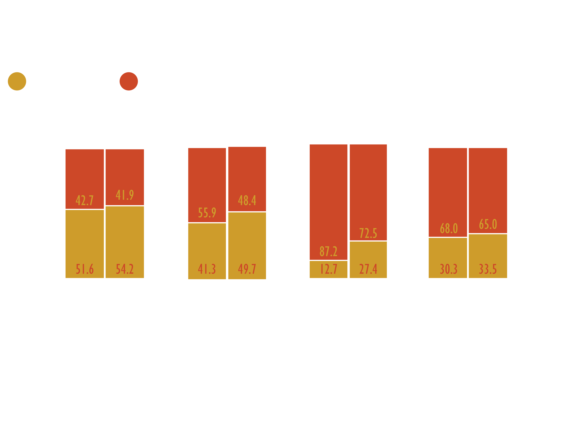
In high-skill industries, immigrant education keeps pace
Skill ratio
Notes:
7

Slide 8
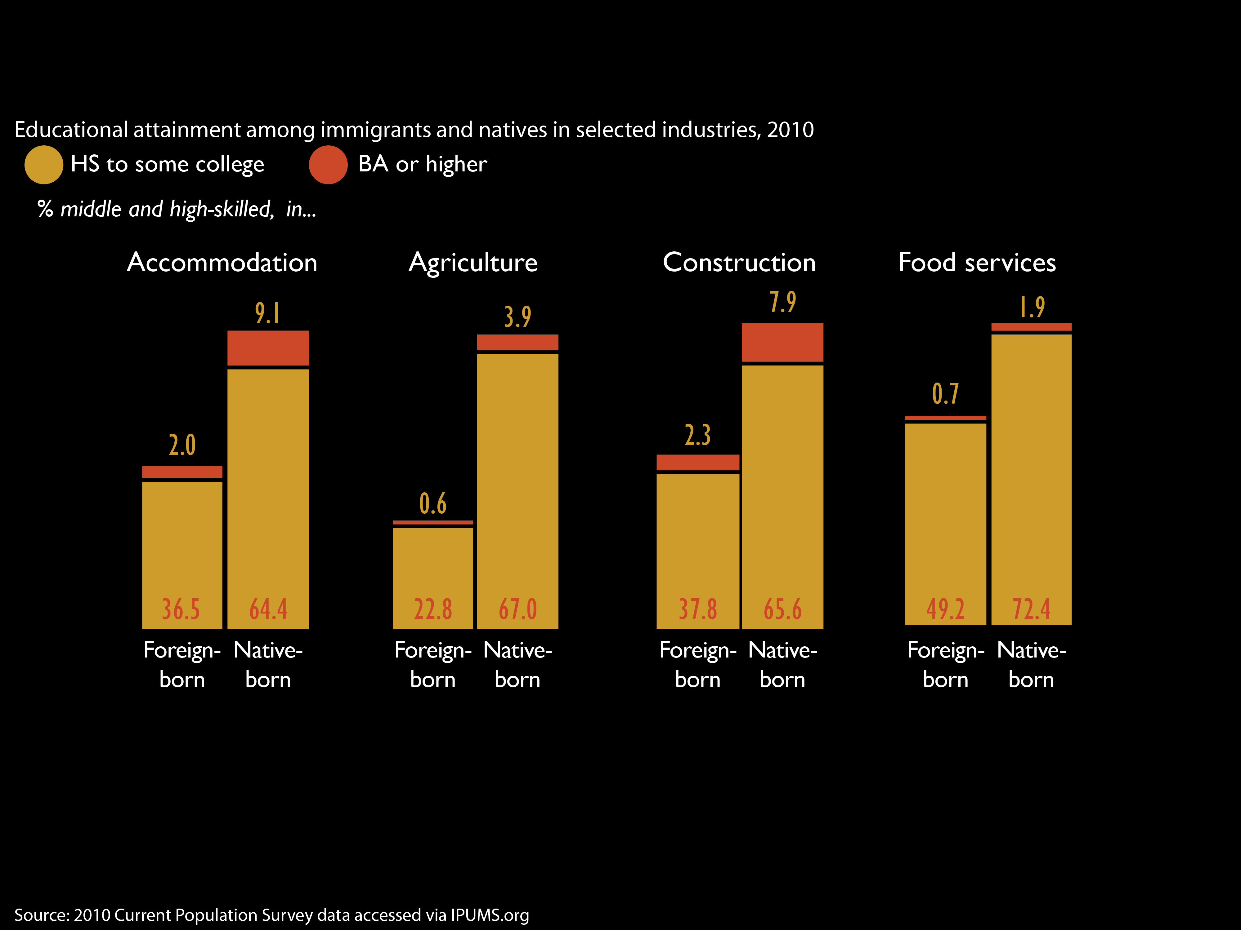
In low-skill industries, immigrant education lags
Skill ratio
Notes:
8

Slide 9
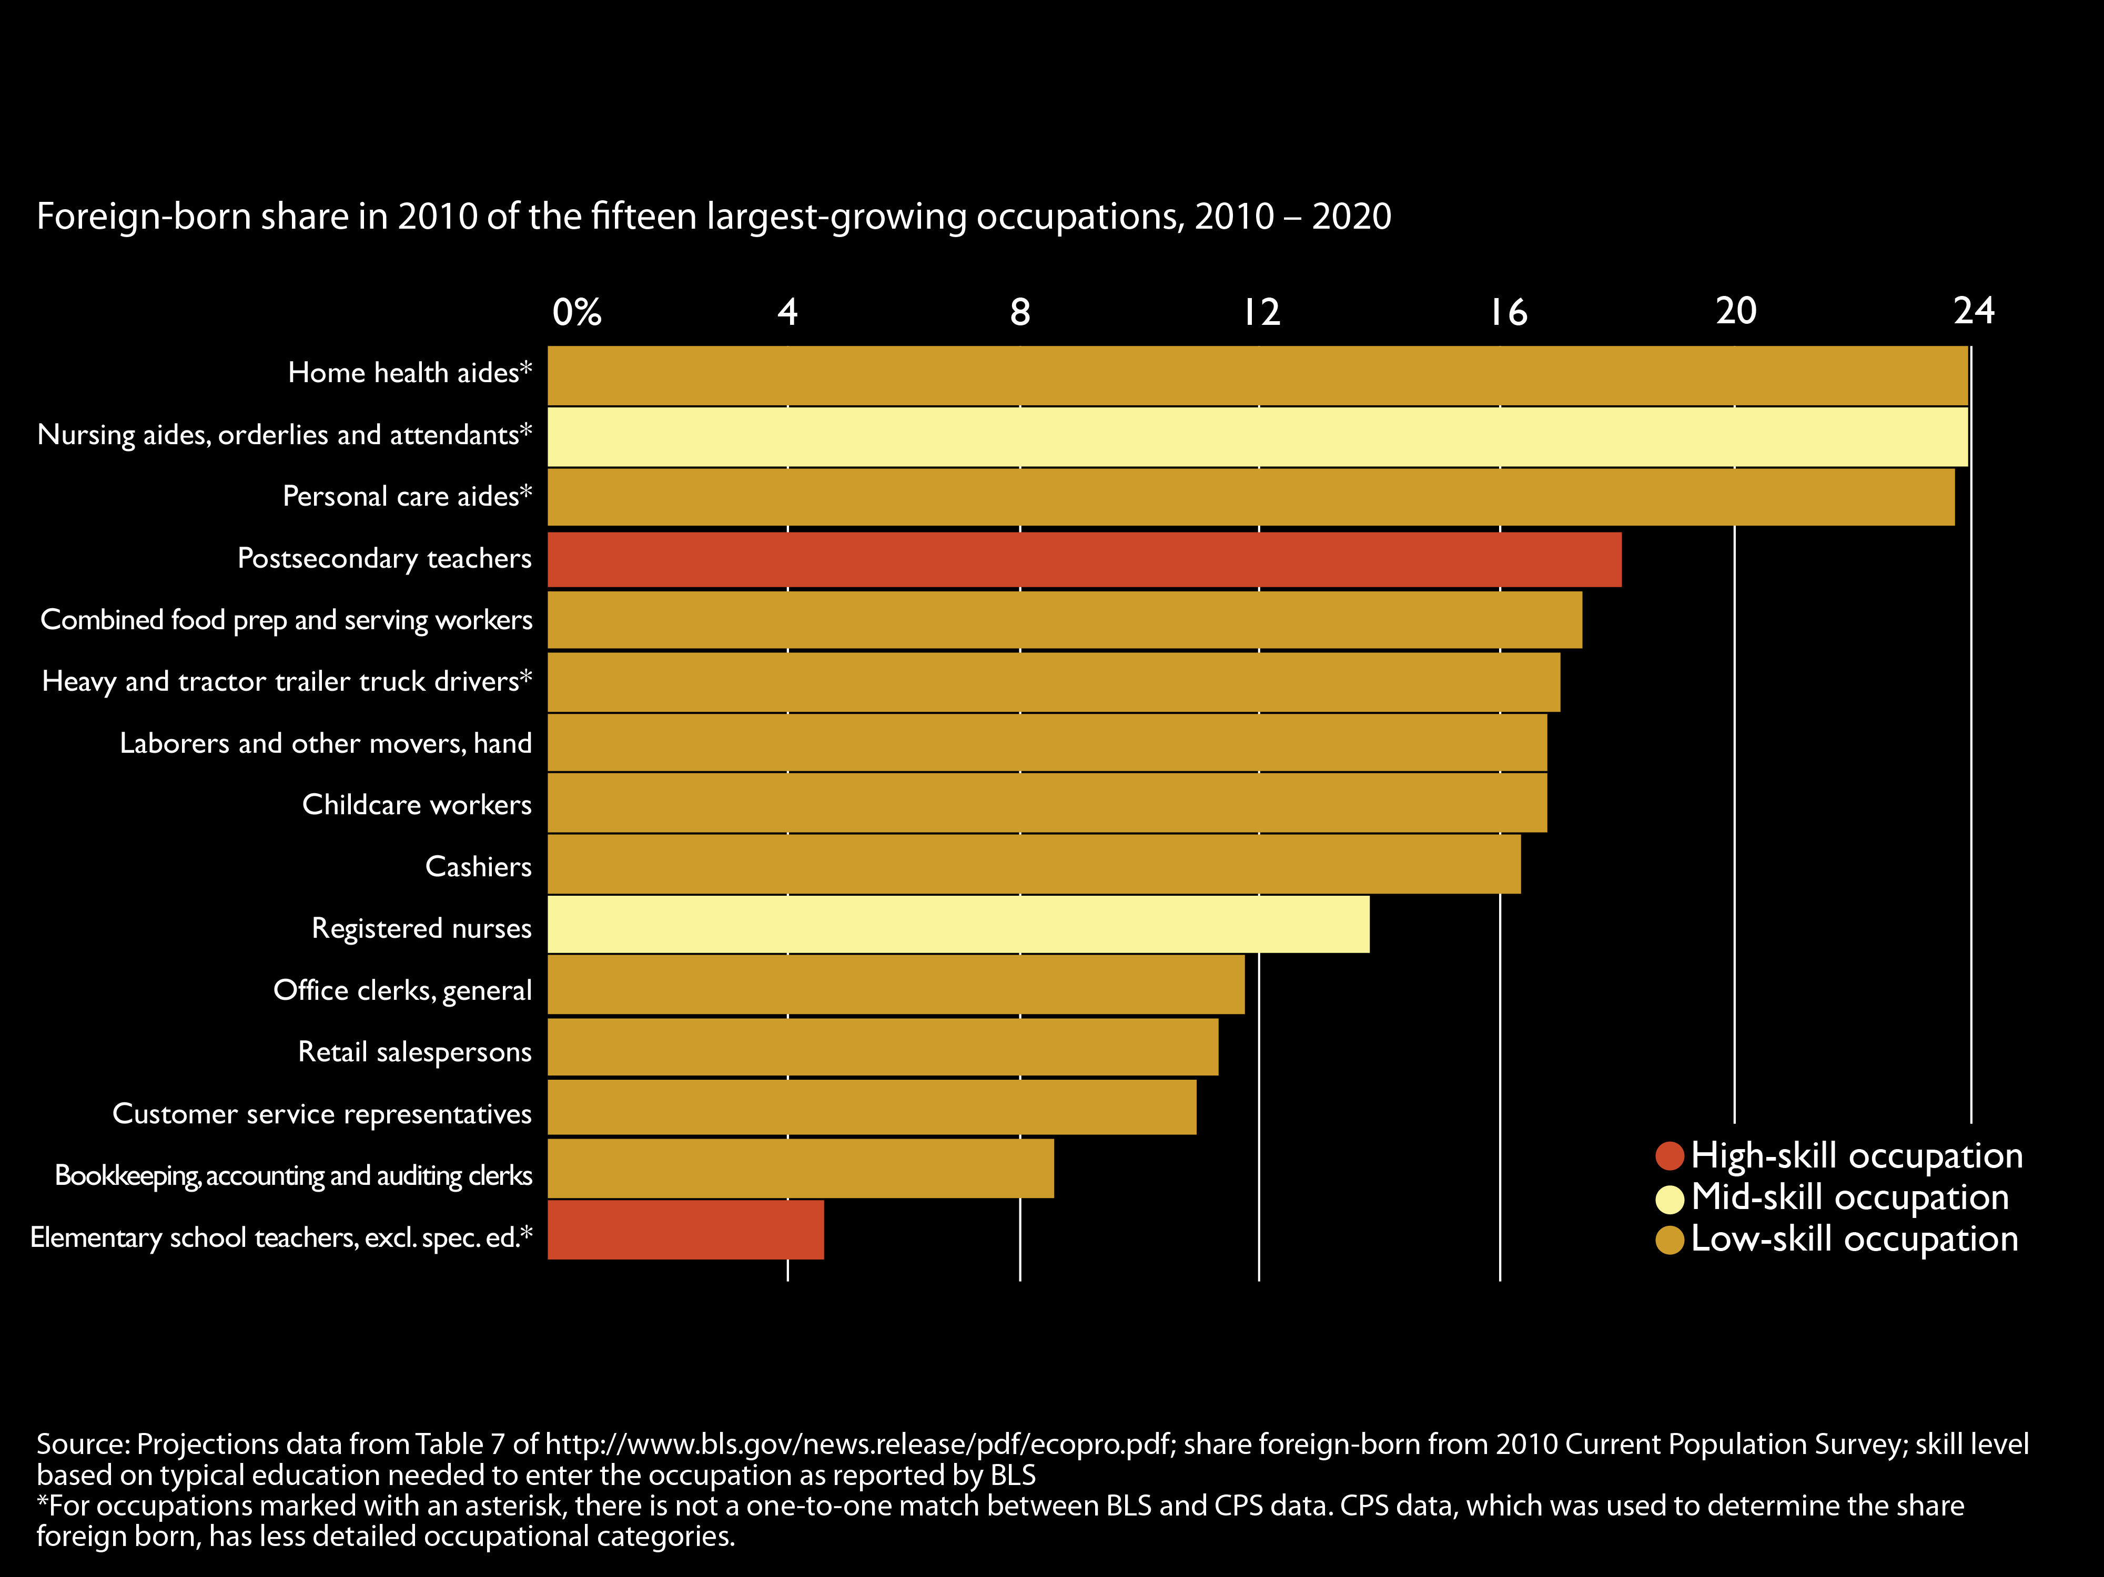
Immigrants are over-represented in largest-growing occupations, many in healthcare
Skill ratio
Notes:
9

Slide 10
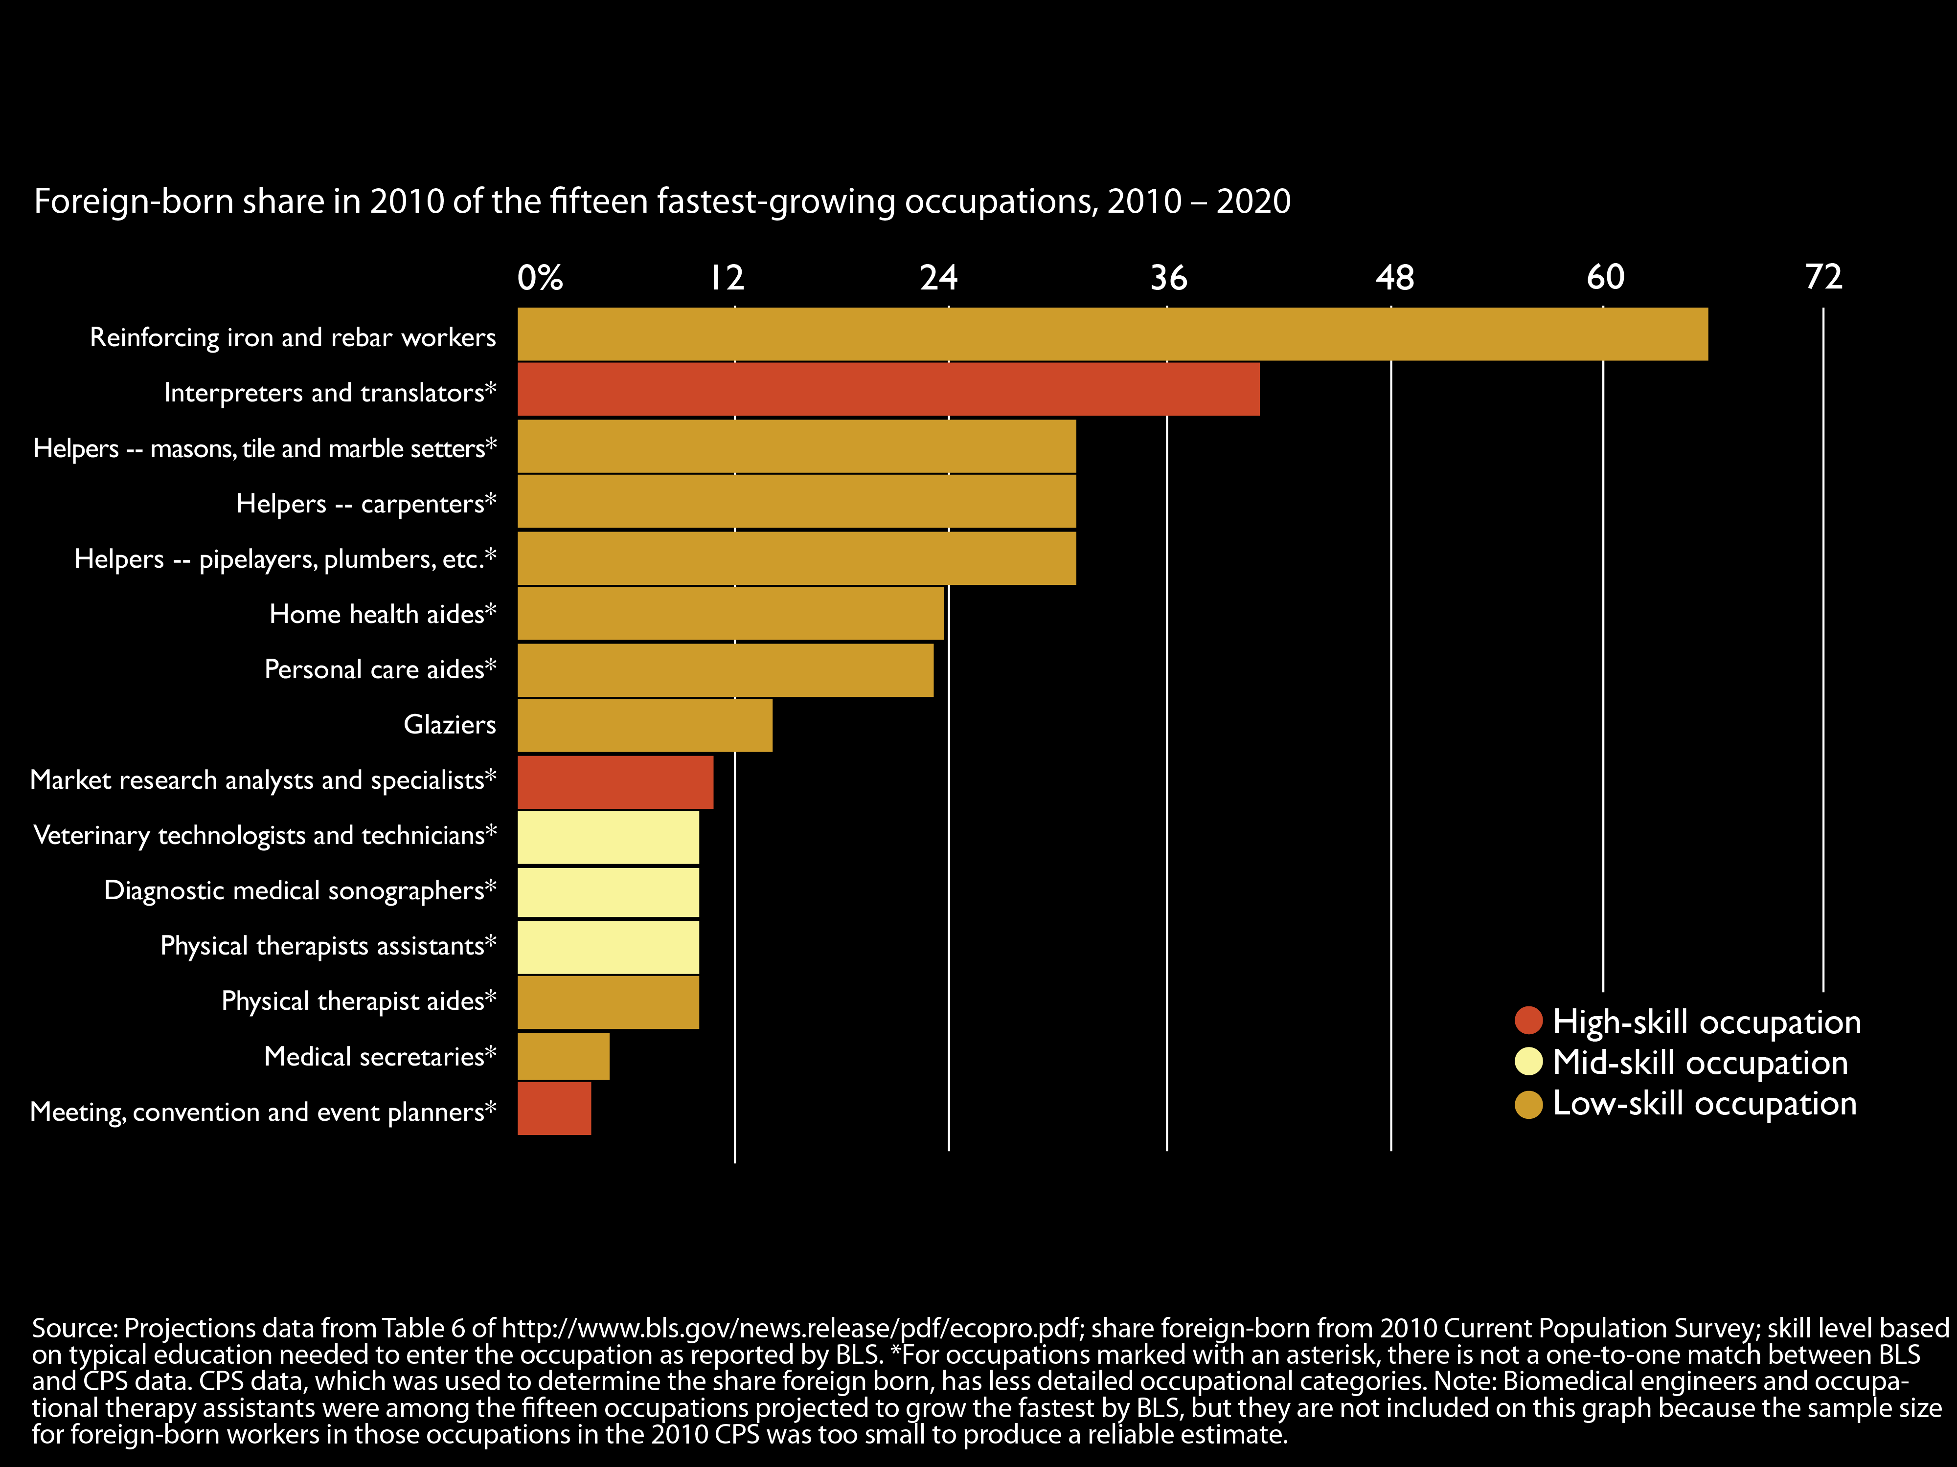
Immigrants over-represented in fastest-growing occupations: construction and healthcare
Skill ratio
Notes:
10

Slide 11
Immigration policy is set at the federal level, but the impact of immigration is at the local level
95% of immigrants live in metropolitan areas; 85% in the 100 largest
Metropolitan areas have a mix of immigrants across skill levels
Immigrant integration, including into the labor force (but also into schools, neighborhoods, healthcare systems) happens at the local level
11
Notes:
11

Slide 12
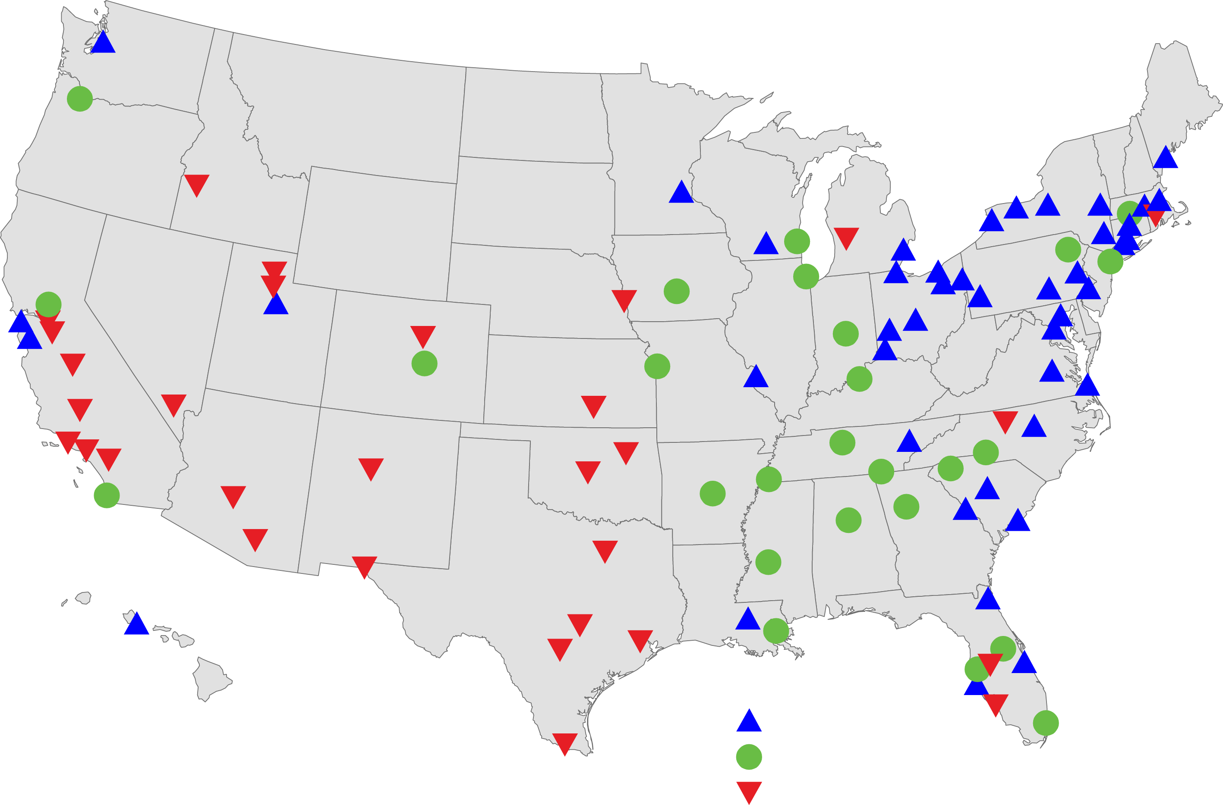
The Metropolitan Geography of Immigrant Skills
Immigrant Skill Ratio, 100 Largest Metropolitan Areas, 2009
Skill ratio
Source: Brookings Institution analysis of 2009 ACS data
Notes:
12

Slide 13
The majority of immigrants are concentrated in the prime working ages
Skill ratio
Source: Brookings analysis of 2010 ACS 1-year estimates; microdata, accessed via IPUMS.org
Notes:
13

Slide 14
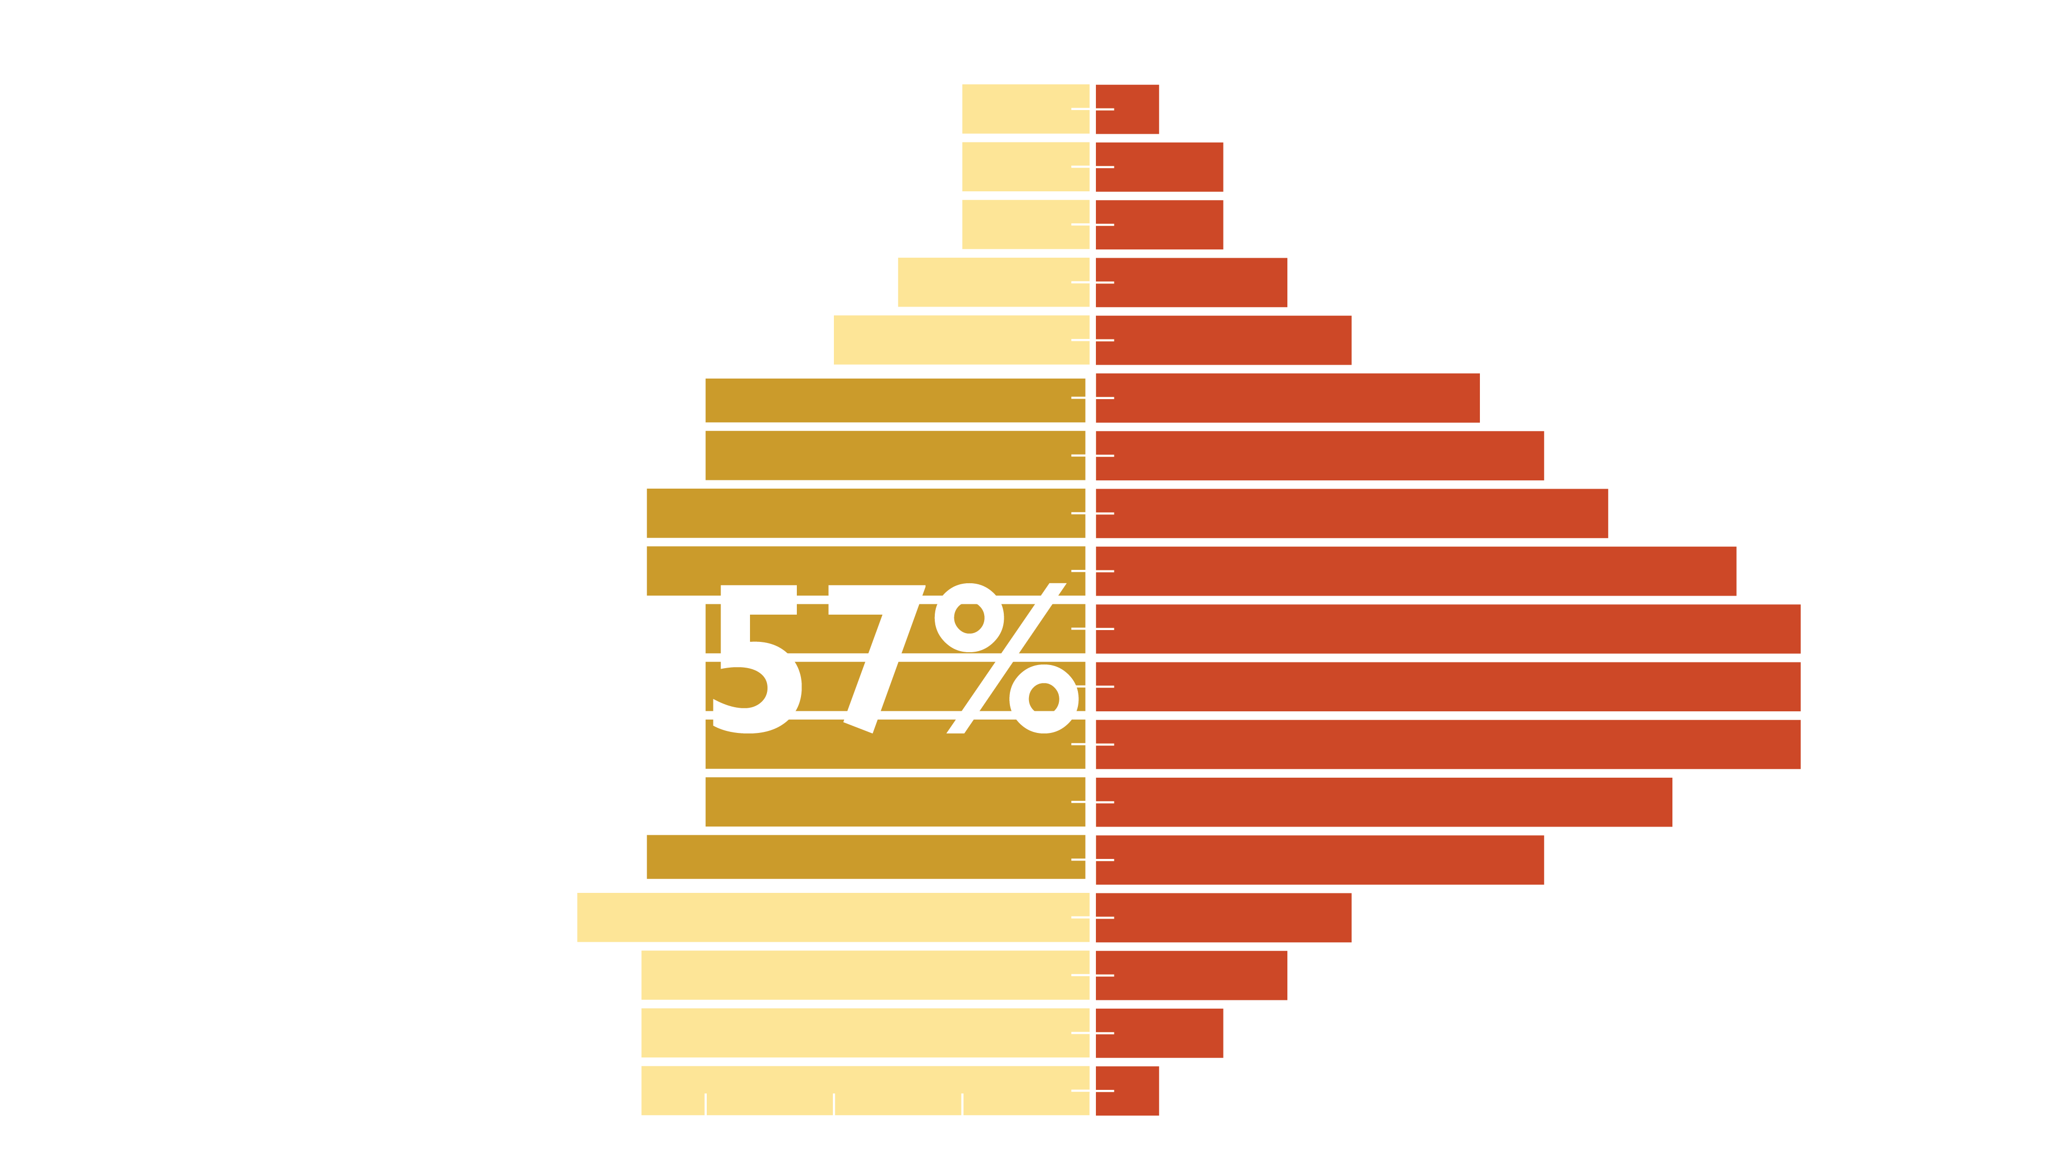
While slightly more than half of the native-born population are 20-64,
Skill ratio
Source: Brookings analysis of 2010 ACS 1-year estimates; microdata, accessed via IPUMS.org
Notes:
14

Slide 15
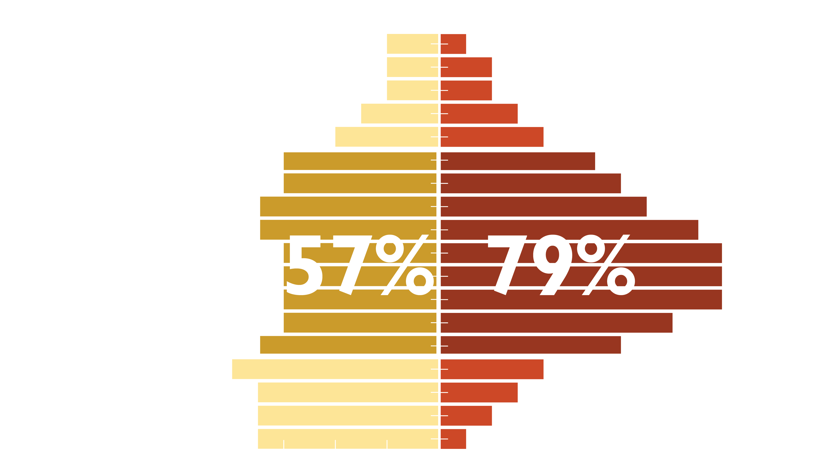
While slightly more than half of the native-born population are 20-64, 79 percent of the foreign-born are in that age group
Skill ratio
Source: Brookings analysis of 2010 ACS 1-year estimates; microdata, accessed via IPUMS.org
Notes:
15

Slide 16
Even among the high-skilled, 26 percent do not consider themselves to be proficient in English
Source: Brookings analysis of 2010 ACS 1-year estimates; microdata, accessed via IPUMS.org
Notes:
16

Slide 17
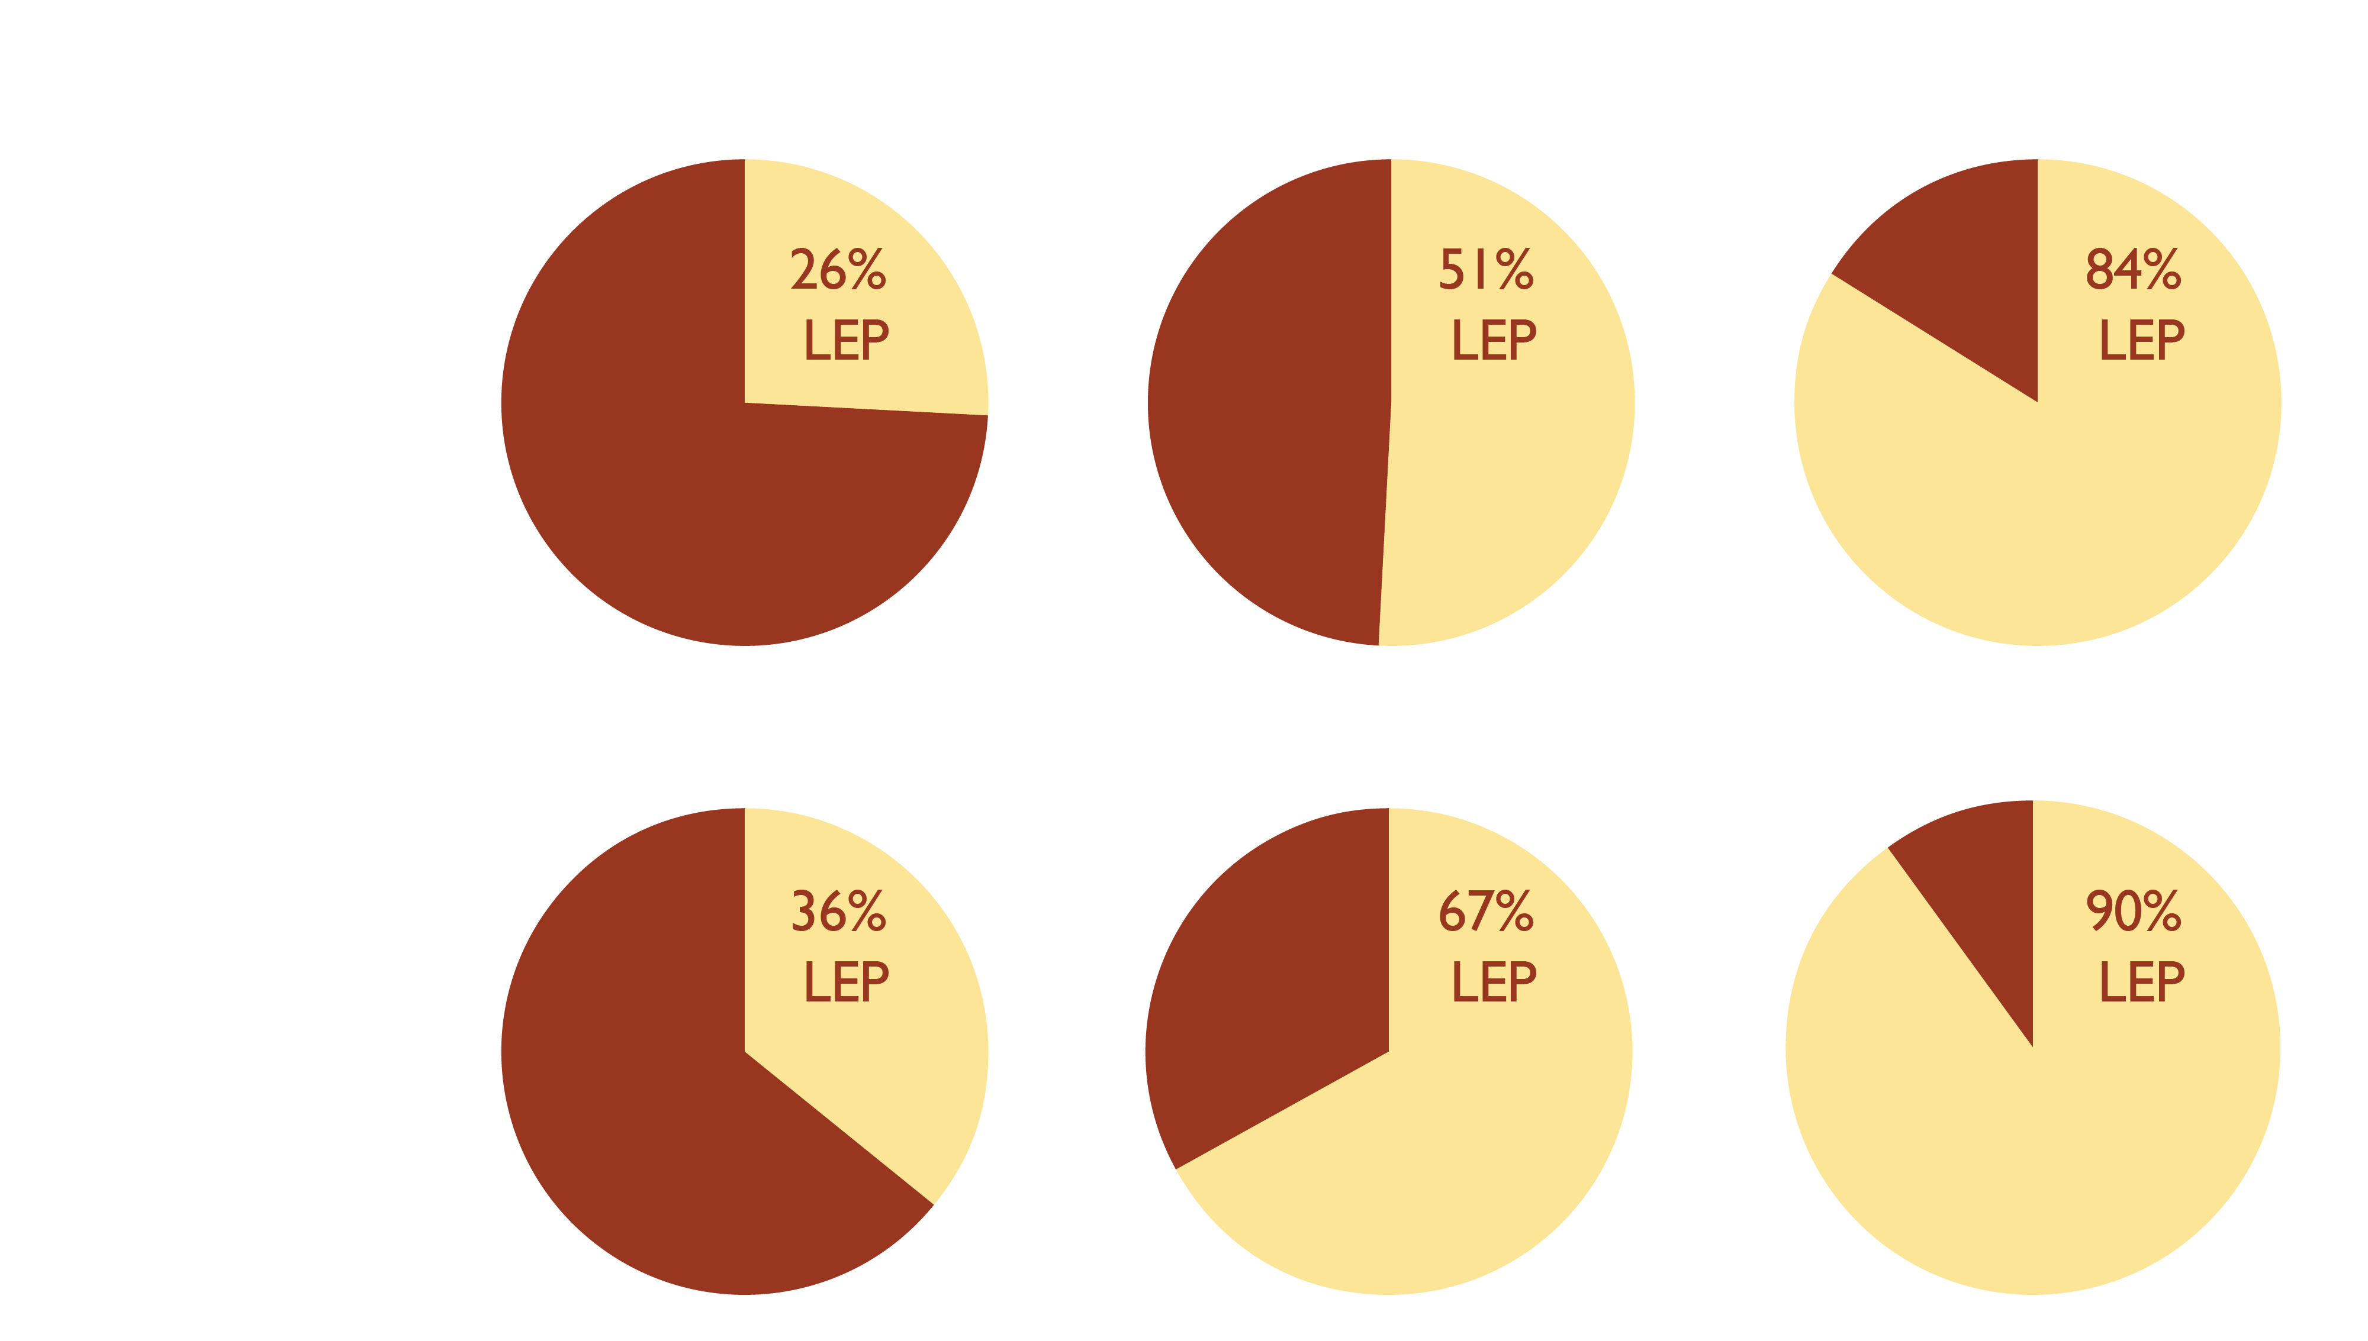
Among recent arrivals more than one-third of high-skilled and two-thirds of mid-skilled immigrants are not proficient in English
Skill ratio
Source: Brookings analysis of 2010 ACS 1-year estimates; microdata, accessed via IPUMS.org
Notes:
17

Slide 18
Nearly half of high-skilled immigrants are overqualified for their job
Skill ratio
Source: Brookings analysis of 2006-2008 estimates from the ACS. Overqualification is measured by comparing workers’ level of education compared to national occupation-specific means using data from the ACS. A worker is considered overqualified if their education attainment is one or more standard deviations above the mean education for their occupation. Newly arrived immigrants are those who came to live in the U.S. ten or fewer years ago.
Notes:
18

Slide 19
How should metro areas proactively support the economic integration of immigrants?

Slide 20
Building Immigrant Skills
Partnerships between nonprofits organizations, educational institutions and employers to build skills of immigrants and others to fill labor shortages
Programs that integrate skills acquisition along with English language training for jobs such as certified nursing assistants, pharmacy technicians, die setters, assembly workers and auto service technicians
Programs that create clear career pathways so that workers and employers see the benefit
20

Slide 21
Unlocking Immigrant Skills
Initiatives aimed at immigrant professionals that assist immigrants in understanding licensing requirements, teach US-specific professional language, and US-style job search
Programs work directly with employers to market immigrant professionals
21

