Slide 1
Grit and Dreams: Character Strengths, Social Mobility and the American Dream
Richard V. Reeves
Policy Director
Center on Children & Families
The Brookings Institution
UNLV, September 22nd, 2014

Slide 2
What is the American Dream?
Shared prosperity?
Rising living standards?
A strong middle class?
No poverty?
Fair treatment?
Meritocracy?
High rates of relative mobility?

Slide 3
Horatio Alger’s Dream
“In this free country poverty in early life is no bar to a man’s advancement. … Save your money, my lad, buy books, and determine to be somebody,” Mr Whitney to ‘Ragged Dick’, 1868

Slide 4
Pres. Obama (and of course every President before him)…
“I renew my commitment to the basic bargain that built this country – the idea that if you work hard and meet your responsibilities, you can get ahead, no matter where you come from…”

Slide 5
“That all men are created equal

Slide 6
“That all men are created equal and independent’

Slide 7
The State of the American Dream, Using Lego…
http://www.youtube.com/watch?v=t2XFh_tD2RA

Slide 8
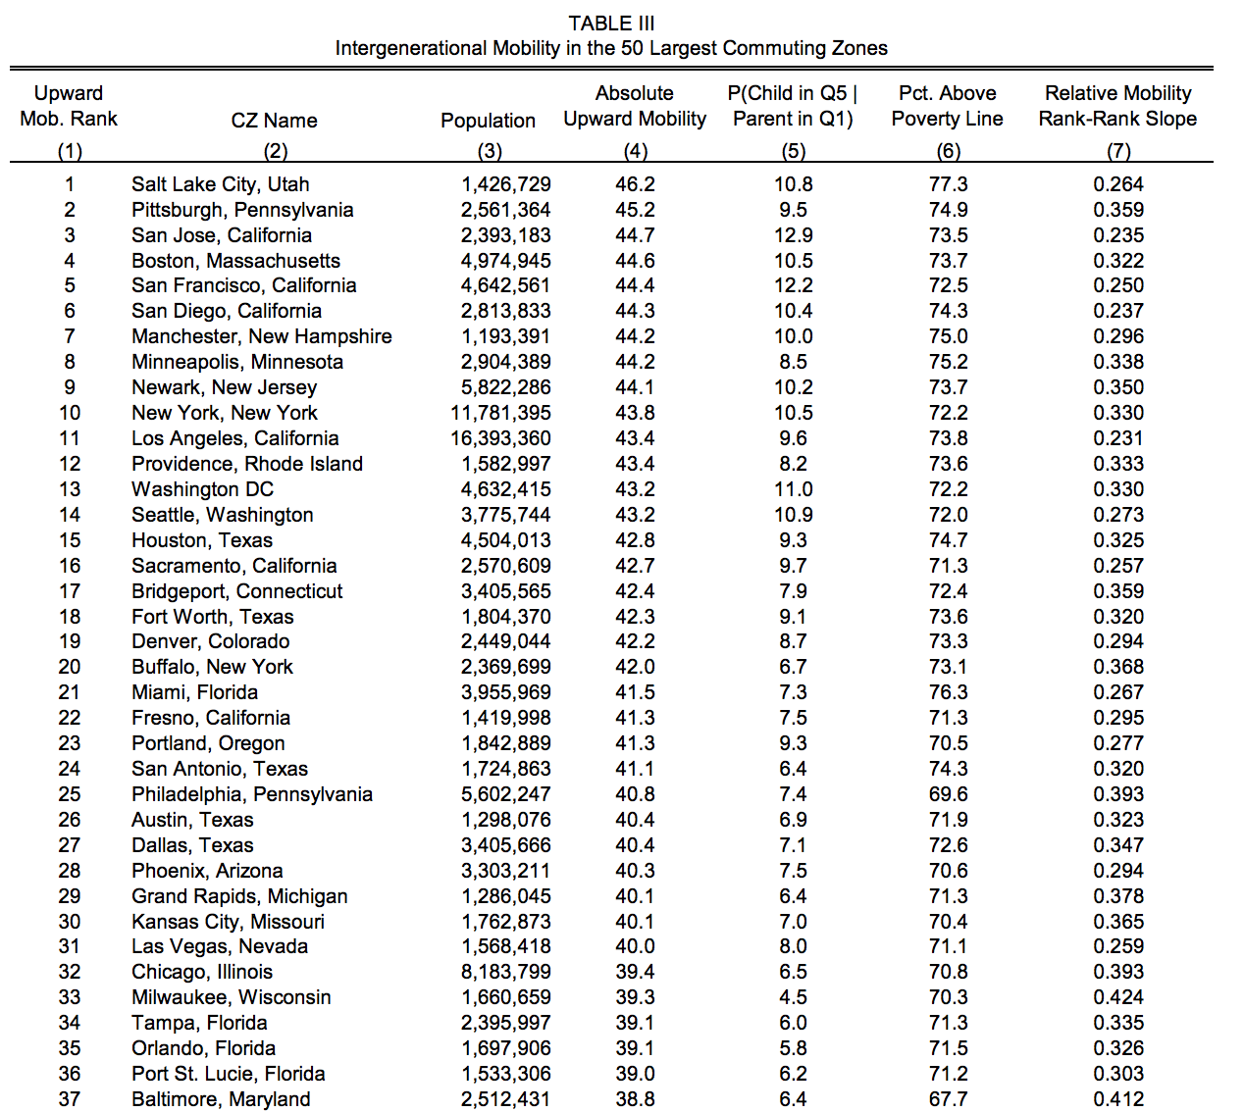

Slide 9
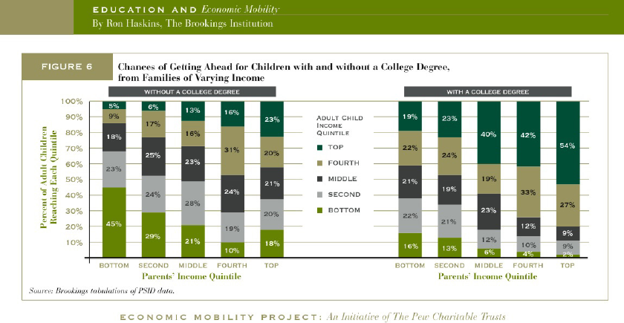
The (Mobility) Power of a BA

Slide 10
One Factor: Higher Education
Fraction of students completing college, projected
Source: Author’s tabulations and Martha J. Bailey and Susan M. Dynarski, “Inequality in Postsecondary Education,” in Whither Opportunity? Rising Inequality, Schools, and Children’s Life Chances, edited by Greg Duncan and Richard Murnane (New York: Russell Sage Foundation, 2011), p. 117-132.

Slide 11
One Factor: Higher Education
Fraction of students completing college, actual
Source: Author’s tabulations and Martha J. Bailey and Susan M. Dynarski, “Inequality in Postsecondary Education,” in Whither Opportunity? Rising Inequality, Schools, and Children’s Life Chances, edited by Greg Duncan and Richard Murnane (New York: Russell Sage Foundation, 2011), p. 117-132.

Slide 12
Prudence
“Men often reach for the nearer good, even though they know it be the less valuable.”
John Stuart Mill, Utilitarianism, 1861

Slide 13
Want this? Now, or More Later?

Slide 14
Want this now?

Slide 15
Or these in 15 minutes?

Slide 16
But then, add crayons…

Slide 17
‘Grit’ Perry Pre-K No Lasting Impact on IQ Scores

Slide 18
But Still Improved Outcomes…

Slide 19
‘Grit’: The Coding Speed Test
1. If Game = 2715 Chin = 3231 House = 4232
2. House = a) 4232 b) 2715 c) 3231 d) 4563 e) 2864?
Absurdly easy (for vast majority), but spine-crackingly dull.

Slide 20
‘Stick-with-it-ness’ & Mobility

Slide 21
‘Stick-with-it-ness’, by income

Slide 22
Are there class divides in character strengths? 3. 5th Grade Non-Cog. Scores by Family Income
Source: ECLS-K, data supplied by Jason Fletcher

Slide 23
Character Strengths: Our Measure ‘Hyperactivity’ subscale of the Behavioral Problems Index in the National Longitudinal Survey of Youth (NLSY) 1979: Children and Young Adults
Mother rates statements about her child as “not true,” “sometimes true,” or “often true”:
Has difficulty concentrating/paying attention
Is easily confused, seems in a fog
Is impulsive or acts without thinking
Has trouble getting mind off certain thoughts
Is restless, overly active, cannot sit still
We have measures for the early years (5/6) and middle childhood (10/11)

Slide 24
Character Strengths (BPI):Breakdown
 |  | Low Skills (<1 SD below mean) |  | Medium Skills (1SD below – 1SD above mean) |  |  | High Skills (<1 SD above mean)
Early Childhood |  | 15.61% |  | 59.29% |  |  | 25.09%
Middle Childhood |  | 16.84% |  | 55.06% |  |  | 28.10%
Composite Measure
Always Low | Sometimes Low |  | Always Middle |  | Sometimes High | Always High |  | Low/High
6.73% | 17.05% |  | 36.88% |  | 23.53% | 13.85% |  | 1.95%

Slide 25
Are there class divides in character strengths? Very Early BPI Gaps

Slide 26
Early Years Character Strengths: Key Outcomes

Slide 27
Middle Childhood Character Strengths: Key Outcomes

Slide 28
Composite Measure Character Strengths: Key Outcomes

Slide 29
Character Strengths v. Smarts: What matters most for HS Graduation?

Slide 30
Final Thoughts
American Dream based on meritocratic movement, circulation of elites
Individualist egalitarianism: born equal, but responsible for own destiny
US is falling short of its own Dream
Among the vital skills for mobility are character strengths as well as smarts
So, equal opportunity policy needs to incorporate these skills into analysis and policy, too

Slide 31
Really, Honestly Final Thought
Does the individualist egalitarianism underpinning the American ideal of equal opportunity rely not only upon ‘book smarts’, but also on character strengths such as prudence and grit?
OR
Does the American Dream require a certain dose of the Frontier Spirit?

