Slide 1

The Labor Market for STEM Skills
Jonathan T. Rothwell, PhD
Fellow
Brookings Institution
UNLV
September 10, 2014

Slide 2
Why does STEM matter?
Enhanced global, national, and regional consumer welfare via enhanced innovation and entrepreneurship
Greater prosperity through higher incomes of STEM workers and their colleagues and spending multipliers
Private benefits to those who acquire the skills and the owners of companies who employ them

Slide 3
Defining STEM as a set of skills

Slide 4
What is a STEM Job?
Conventional View:
  Definition uses no clear standard
  Professional jobs only
  5% of US workforce
  80 percent have a bachelor’s degree or higher

Slide 5
How Brookings defines STEM
  Based on O*NET survey of worker knowledge
  21% of US workforce
  50 percent have a bachelor’s degree or higher
  Higher correlation with wages and cognitive skill

Slide 6
Major Occupational Categories Sorted by STEM Score, with Share of Jobs that are STEM, 2011
 | High-STEM, Percentage of Jobs
Architecture and engineering | 100%
Life, physical, and social science | 87%
Healthcare practitioner and technical | 76%
Computer and mathematical science | 100%
Installation, maintenance, and repair | 53%
Management | 27%
Construction and extraction | 40%
Education, training, and library | 9%
Business and financial operations | 42%
Farming, fishing, and forestry | 8%
Production | 23%
Arts, design, entertainment, sports, and media | 16%
Sales and related | 0%
Legal | 0%
Source: The Hidden STEM Economy (Brookings Institution, 2013)

Slide 7
The US STEM Labor Market

Slide 8

The STEM Labor Market
Long-run shortage, temporarily ameliorated by the recession
Supply
Demand
Weak response in supply, even as salaries have increased

Slide 9
Analysis of data from Census Bureau via Integrated Public Use Microdata Series and O*NET. For methods, see Jonathan Rothwell, “Hidden STEM Economy,” (Brookings Institution, 2012).

Slide 12
From 2009-2013, 3 out of every 10 jobs created on net have been in computer and healthcare practitioner occupations
Source: BLS CPS

Slide 13
Index = job openings last month per hire this month

Slide 16
Median Duration
All STEM: 11 days
All Non-STEM: 5 days
Source: “Still Searching: Job Vacancies and STEM Skills” (Brookings)

Slide 19
Regional Variation in STEM Markets

Slide 20
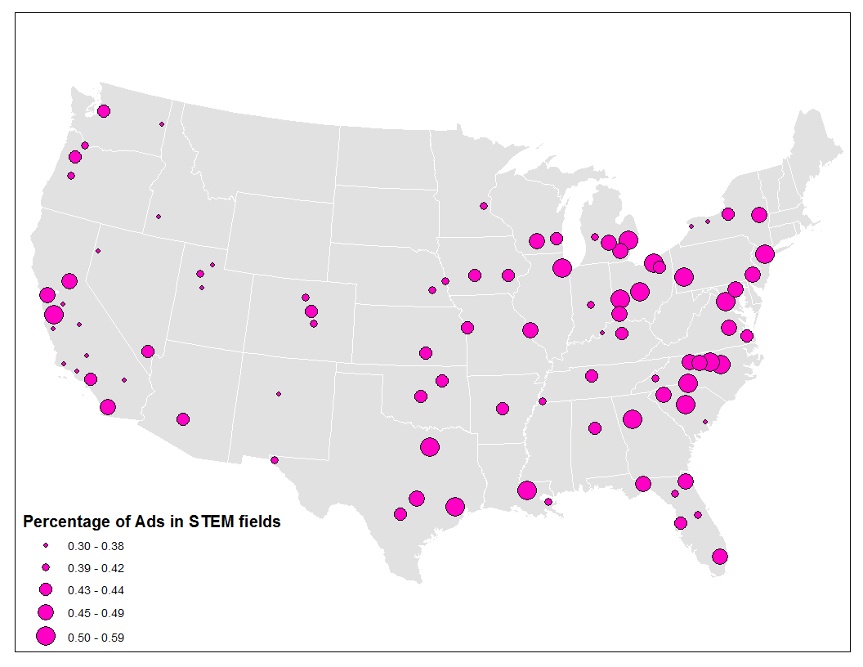
Percentage of Advertised Vacancies in STEM Occupations for metro areas with at least 50,000 vacancies, 2013
(Source: Brookings analysis of Burning Glass)

Slide 22
How does the STEM labor market look in Nevada?

Slide 24

In Nevada’s professional level STEM economy, relatively low demand is met with even lower supply
Share of total openings typically requiring bachelor’s degree or higher in STEM occupations (2013) versus STEM degree attainment for population 25 and older (2012), Las Vegas MSA,
Source: Brookings analysis of 2013Q4 Burning Glass data, O*NET, and 2012 American Community Survey

Slide 25
STEM jobs in Nevada pay higher salaries at high and low levels of education
Wages of STEM and non-STEM jobs by educational requirements of occupations, Nevada, 2013
Source: Brookings analysis of Bureau of Labor Statistics OES data and O*NET
Notes:
And at each level of educational attainment in Greater Orlando, workers in STEM jobs out-earn their non-STEM counterparts. This is especially true for those with only a high school education, or those with at least a bachelor’s degree.

Slide 26
STEM workers in Nevada experience lower unemployment at both high and mid levels of educational attainment
2012 Unemployment Rate in Nevada by STEM status of Occupation and Level of Education
(Source: Analysis of 2012 American Community Survey via IPUMS and O*NET)

Slide 28
2012 Unemployment by Occupation in Nevada vs the United States
Source: 2012 American Community Survey via IPUMS

Slide 30
Computer jobs advertised in Las Vegas require easier-to-find skills than those advertised in most metropolitan areas
Honolulu, 38.1

Slide 31
The Supply Problem

Slide 32
1987: Majors by field for STEM and non-STEM (Source: NSF)

Slide 33
2012: Majors by field for STEM and non-STEM (Source: NSF)

Slide 34
Engaging young women in STEM can help narrow the STEM gap in Nevada
Female share of bachelor’s degree holders by STEM field, ages 18 to 30, Nevada, 2010-2012
Source: Brookings analysis of 2010-2012 American Community Survey via IPUMS
Notes:
To narrow the gap, leaders will need to look in a couple specific directions. First, while young women appear to be studying in some STEM fields at above-average rates—particularly in science and health-related fields—they are under-represented in the engineering and technology fields that are most in demand today. Improving their entry into those sections of the STEM pipeline is one critical strategy.

Slide 35
Closing the STEM opportunity gap will also require elevating STEM completion rates for under-represented young populations, especially African Americans and Latinos
STEM bachelor’s degree attainment by field versus population share, by race/ethnicity, 18-30 year-olds, Nevada, 2010-2012
Source: Brookings analysis of 2010-2012 American Community Survey via IPUMS

Slide 36
Why don’t more people get STEM training?
Success in STEM depends on knowledge acquired as a child. High wage premiums for STEM degree holders don’t make parents and teachers better at teaching STEM subjects or children more committed to learning them
Switch-out rates are extremely high and correlated with math experience and skill, suggesting inadequate K-12 prep and higher-ed resources
Cultural and social barriers prevent many women, blacks, and Latinos from pursuing a STEM degree

Slide 37
How to boost STEM Skills
The to-do list
Who Needs to do it
Enrich infant/toddler home life
Improve pre-K to 10th grade quality across the board
Allow students to take post-secondary level classes during last two years of high school
Lower cost of college and adopt best practices in retention and completion in higher-education
Expand access to adult training & improve curriculum alignment with demand
Non-profits; state & local governments
Non-profits; state & local governments
Non-profits; state & local governments
Governments, non-profits and Higher Ed via innovation, tuition support, tutoring, and mentoring
Governments; Colleges; Businesses via philanthropic investments, apprenticeships, internships, and on-the-job training

Slide 38
For more information
Email:
  Jonathan Rothwell
  jrothwell@brookings.edu
Visit:
  www.brookings.edu/metro
  Hidden STEM Economy
  http://www.brookings.edu/research/reports/2013/06/10-stem-economy-rothwell
  Still Searching : Job Vacancies and STEM Skills
  http://www.brookings.edu/research/interactives/2014/job-vacancies-and-stem-skills#/M10420

