Slide 1

The Hidden STEM Economy
The Surprising Diversity of Jobs Requiring Science, Technology, Engineering, and Math Knowledge
Jonathan Rothwell, PhD
Associate Fellow
Metropolitan Policy Program
The Brookings Institution
Washington DC

Slide 2
Outline
STEM: The Conventional View
Redefining the STEM Workforce
The “hidden” STEM economy
The Las Vegas STEM Economy
Policies to boost STEM Demand and Supply

Slide 3
1. STEM: The Conventional View
“There must be a stream of new scientific knowledge to turn the wheels of private and public enterprise. There must be plenty of men and women trained in science and technology for upon them depend both the creation of new knowledge and its application to practical purposes.”
-Vannevar Bush, 1945
From “Science, the Endless Frontier: A Report to the President” (Washington: U.S. Government Printing Office, 1945).
Notes:
This view is right but incomplete

Slide 4
Innovative High-Patenting Industries are Driving even Measured GDP Growth
Tech share of GDP 1980 = 4%
2012 =10%
Source: Moody’s Analytics/BEA

Slide 5
STEM-knowledge drives innovation
Source: Brookings analysis of Georgia Tech Inventor Survey, Kauffman Foundation survey, and 2011 American Community Survey
Notes:
Top companies listed on NASDAQ with STEM-educated founders: Google, Amazon, Cisco, QUALCOMM, Intel, Amgen, eBay

Slide 6
The Returns to Skill Are Increasing
Salary Premium for Bachelor’s Degree vs. High School Diploma compared to Premium for Working in STEM Occupation, 1950-2010
Source: U.S. Census microdata from IPUMS. Regression of ln income on dummy variable for bachelor’s degree (or STEM occupation) controlling for cubic in age and sex for employed workers. Bachelor’s premium compares only BA earners to high school graduates.
Notes:
Top majors: Engineering, Bio, Physical, Math, Computer (lower unemployment)

Slide 7
There are many more job openings than graduates for computer, math, and engineering occupations

Slide 8
Notes:
11.3 million jobs lost for high school or less manuf workers; but 1.2 mil gain for ba+ and .3 mil gain for some college

Slide 9
2. Redefining the STEM Workforce

Slide 10
Problems with conventional STEM definitions
No agreement among federal agencies
  The NSF uses “Science and Engineering” labor force which roughly corresponds to occupations common to workers with a bachelor’s degree in science or engineering fields.
  2012 BLS task force adopted very similar approach
  Dept of Commerce used only part of the NSF definition and added a few occupations to it
Arbitrary standards.
  Not based on knowledge or skill requirements, otherwise doctors would be included
  Not based on research and development activity, otherwise most computer workers would be excluded, as would social scientists
Class bias?
  Computer machine programmers and all blue collar occupations are excluded, but any computer worker in an office settings is counted.
  Science lab technicians are often included, but not electricians
What about STEM community college programs, industry certifications, etc?

Slide 11
The cure is O*NET
Occupational Information Network Data Collection Program
Department of Labor funded data collection program
Provides the most comprehensive database of job attributes by occupation including education, training, experience, skill, knowledge, tools and technologies, interests, and activities

Slide 12
The Six Core STEM Domains in O*NET Knowledge Survey and Their Survey Anchors
Least Knowledge =1
Highest Knowledge = 7
Scales for Science (Physics, Chemistry, Bio), Computers, Engineering, and Math
Computers and Electronics
1 | 3 | 6
Operate a VCR to watch a pre-recorded training tape | Use a word processor | Create a program to scan computer disks for viruses
Notes:
Chem: 6=Develop a safe commercial cleaner; 4=Use the proper concentration of chlorine to purify a water source
Physics: 6=Design a cleaner burning gasoline engine; 4=Calculate water pressure through a pipe; BIO 4=Investigate the effects of pollution on marine plants and animals; 7=isolate/identify; new virus; MATH 6=Determine the mathematics required to simulate a space craft landing on the moon; 4=Decide how to calculate profits to determine the amounts of yearly bonuses
;

Slide 13
New Brookings definition of STEM
  A STEM occupation is one that requires an extraordinary level of knowledge in one or more core STEM fields.
      Extraordinary, here, is defined as at least 1.5 standard deviations above the mean knowledge score for that field (just over 90th percentile), where science fields are grouped together as one
    Advantages over standard approach
      Non-arbitrary and non-biased
      Non-binary
      Self-correcting
      Comparability to other skills

Slide 14
Notes:
Biomedical engineers; chemical engineers; biochemists and biophysicists, hydrologists

Slide 15
Results: More jobs, more career pathways to STEM
Source: 2011 BLS OES and O*NET

Slide 16
STEM knowledge is rewarded more than other types of knowledge
Marginal Effect of regression of median wages on standard deviation in STEM Knowledge for 719 detailed Occupations, controlling for Mode Education. Source: Brookings analysis of 2011 BLS OES and O*NET

Slide 17
3. The “hidden” STEM economy

Slide 18
Literature on Sub-bachelor’s STEM contribution to innovation
During industrial revolution:
  Ross Thomson, Structures of Change in the Mechanical Age: Technological Innovation in the United States, 1790 to 1865 (Johns Hopkins University Press, 2009);
  Kenneth L. Sokoloff and B. Zorina Khan, “The Democratization of Invention during Early Industrialization: Evidence from the United States, 1790-1846,” Journal of Economic History 50(2) (1990): 363-378;
  Jacob Schmookler, “Inventors Past and Present,” Review of Economics and Statistics 39(3) (1957): 321-333.
Presently in terms of lower product defects, higher capacity utilization and efficiency, and R&D quality:
  Philip Toner, “Workforce Skills and Innovation: An Overview Of Major Themes In The Literature” (Paris: OECD, 2011)

Slide 19
Selected Major Occupational Categories Sorted by STEM Score, with Share of Jobs that are STEM, and Share of U.S. STEM Jobs, 2011
 | High-STEM, Percentage of Jobs | Share of U.S. High-STEM Jobs
Architecture and engineering | 100% | 9%
Life, physical, and social science | 87% | 4%
Healthcare practitioner and technical | 76% | 22%
Computer and mathematical science | 100% | 13%
Installation, maintenance, and repair | 53% | 10%
Management | 27% | 6%
Construction and extraction | 40% | 8%
. . .
Production | 23% | 7%
. . .
Food preparation and serving related | 0% | 0%
Healthcare support | 5% | 1%
Large source of STEM jobs
Usually considered 0% STEM
Notes:
Chemical technicians; medical lab technicians; medical equipment repairers. Most common: Registered Nurses; electricians; carpenters; computer systems analysts; machinsts.
Most STEM intensive sectors are utilities/mining (energy) (44%), construction (38%), prof services (40%), manuf(30%), healthcare (29%), information (22%); accommodation 1%.

Slide 20
Both STEM Groups Enjoy a Substantial Skill Premium Beyond Education
Note: Mean Sub-BA STEM Wage is $53,000, vs. $33,000 for those non-STEM sub-BA workers
Source: Brookings analysis of 2011 BLS OES and O*NET

Slide 21
Sub-BA STEM jobs are hard-to-fill
Share of 2011 job openings re-posted after 30 days in 100 largest metropolitan areas
Brookings analysis of Conference Board Help Wanted On-Line and O*NET

Slide 23
As it happens, STEM metros are:
Richer
More innovative
More export-oriented
More resilient to economic downturn
Employ a larger share of their workers

Slide 24
5. Where Does Las Vegas Fit In?

Slide 25
Las Vegas MSA’s Ranking on Key STEM Metrics
 | Rank out of 356-358 Metro Areas
Patents per worker, 2007-2011 | 215
Growth rate in productivity, 1980-2010 | 237
STEM Bachelor's degree attainment rate, 2011 | 247
Average unemployment rate, 1990-2010 | 244
STEM knowledge of average occupation | 355
STEM Share of Employment | 328
Change in STEM Share of Employment, 2007-2011 | 333
Notes:
Nevada is lowest scoring state; DC: AL; WY; MD; WA; VA; MA; CO: NM; TX high. Low is NY, FL

Slide 26
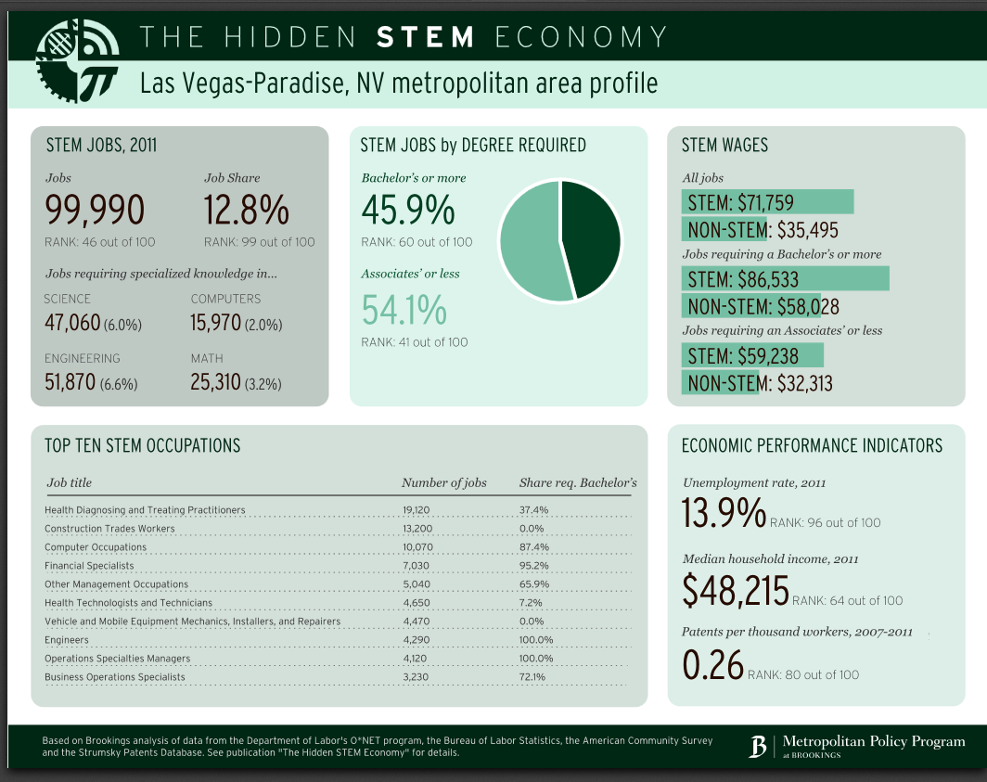
Profile on Brookings website: http://www.brookings.edu/research/reports/2013/06/10-stem-economy-rothwell/profiles

Slide 27
Las Vegas STEM Premium = 5th highest in largest 100 metros; 22nd of 348

Slide 28
Source: BLS OES. Groups are sorted by LQ (MSA Share/USA Share). Only occupations with location quotient greater than 1.2 or less than 0.8 are shown.

Slide 29
Industries in Las Vegas with Highest Number of STEM Jobs in 2011
Industry | Jobs | Percentage of Workers in STEM Occupation | Average Salary | Share of STEM Workers with Less than Bachelor's Degree
Construction | 81,220 | 42% | $27,072 | 90%
Hospitals | 27,198 | 62% | $55,355 | 33%
Professional, Scientific, and Technical Services | 56,867 | 29% | $44,893 | 44%
Ambulatory Health Care Services | 39,015 | 27% | $40,233 | 30%
Repair and Maintenance | 16,326 | 54% | $22,304 | 95%
Las Vegas Metropolitan Area | 1,135,137 | 15% | $30,422 | 65%

Slide 30
Industries with at least 500 Jobs in Las Vegas with Highest STEM Knowledge per Worker in 2011
Industry | Jobs | Percentage of Workers in STEM Occupation | Average Salary | Share of STEM Workers with Less than Bachelor's Degree
Data Processing, Hosting and Related Services | 701 | 73% | $75,000 | 76%
Mining (except Oil and Gas) | 2,116 | 33% | $67,100 | 67%
Utilities | 6,573 | 37% | $76,155 | 52%
Transportation Equipment Manufacturing | 2,559 | 52% | $63,470 | 72%
Repair and Maintenance | 16,326 | 54% | $22,304 | 95%
Construction | 81,220 | 42% | $27,072 | 90%
Las Vegas Metropolitan Area | 1,135,137 | 15% | $30,422 | 65%
Source: O*NET and American Community Survey, 2011 via IPUMS

Slide 31
5. Policies to boost STEM knowledge

Slide 32
How to boost demand for STEM
Adopt cluster focus on growing STEM industries
  Skills, finance, infrastructure
Foster entrepreneurship
  E.g. non-profit incubators
Attract FDI
  Tax policy, marketing
Research Universities
  R&D budget, SBIR, partnerships with industry
State Fiscal Incentives
  R&D tax credits, investment funds

Slide 33
How to boost the Supply of STEM
Improve K-12 Quality
  STEM targeted magnet schools (NYC, Chicago) or high school curriculum (Virginia Beach) or non-profit programs (MESA in California)
Expand capacity of universities and community colleges
  Adopt best practices in recruitment & retention
Attract STEM-oriented establishments and their workers
Improve workforce development
  Intermediation
  Public (WIBs) or private training (apprenticeships)

Slide 34
More for information
Email:
  Jonathan Rothwell
  jrothwell@brookings.edu
Tweet:
  @jtrothwell
Visit:
  Brookings homepage:
  www.brookings.edu
  Hidden STEM Economy report page:
  http://www.brookings.edu/research/reports/2013/06/10-stem-economy-rothwell

Slide 35
Supplemental data

Slide 36
Federal Government funding for STEM Education-related Programs by Primary Objective
 | Millions of Dollars, approximate | Share of Total
Bachelor's degree or higher STEM Education | $1,942 | 45%
Training or sub-bachelor's level degree education (upper limit*) | $940 | 22%
Education Research and Development | $519 | 12%
Pre- and In-Service Educators | $312 | 7%
Public Learning | $296 | 7%
Engagement of Children | $162 | 4%
Institutional Capacity | $137 | 3%
Total federal funding for STEM training or education | $4,308
Data is for fiscal year 2010, except the training and sub-bachelor's level degree funded, which is for 2012.Sources: National Science and Technology Council, Department of Labor's Trade Adjustment Assistance Community College and Career Training Grant and H1B Technical Skills Training Grants. *These funds are not exclusively dedicated to STEM degrees or careers.

Slide 37
Manufacturing Industries Ranked by STEM Score, by STEM Share of Jobs and Share of STEM Jobs held by those with bachelor's degree or higher
 | STEM Share of Jobs | Share of STEM workers with BA or higher
Computer and Electronic Product | 46% | 60%
Petroleum and Coal Products | 46% | 34%
Chemical | 35% | 54%
Transportation Equipment | 41% | 41%
Machinery | 40% | 26%
Fabricated Metal Product | 41% | 12%
Electrical Equipment, Appliance, and Component | 31% | 39%
Primary Metal | 31% | 20%
ALL | 35% | 9%
Plastics and Rubber Products | 21% | 23%
Miscellaneous | 24% | 37%
Paper | 24% | 29%
Beverage and Tobacco Product | 20% | 36%
Nonmetallic Mineral Product | 22% | 24%
Wood Product | 19% | 12%
Food | 15% | 24%
Printing and Related Support Activities | 16% | 27%
Furniture and Related Product | 18% | 19%
Leather and Allied Product | 13% | 30%
Textile Mills | 18% | 19%
Textile Product Mills | 12% | 18%
Apparel | 8% | 27%
Brookings analysis of O*NET and American Community Survey via IPUMS.

Slide 38
STEM degree holders are the most likely to be working in jobs related to their field of study
Source: Brookings analysis of 2010 National Survey of College Graduates

Slide 39
STEM occupations earn high and growing wages
8% growth for Computer/Math Occupations
Source: Bureau of Labor Statistics Current Population Survey and Consumer Price Index

Slide 40
Students drop out of STEM majors at higher rates
National longitudinal survey data show 36% of students who start as STEM majors switch to other fields
Data from Ohio Board of Regents show 57% of students who select a STEM major when taking the ACT do not finish as STEM majors
One explanation is that grades are lower than expected
References: Xianglei Chen and Thomas Weko, “Students Who Study Science, Technology, Engineering, and Mathematics (STEM) in Postsecondary Education” (National Center for Education Statistics, 2009); Eric Bettinger, “To Be or Not to Be: Major Choices in Budding Scientists” In Charles T. Clotfelter, ed., American Universities in a Global Market, Chapter 2 (Chicago: University of Chicago Press, 2010); Todd Stinebrickner and Ralph Stinebrickner, “Math or Science? Using Longitudinal Expectations Data to Examine the Process of Choosing a College Major,” Working Paper (The University of Western Ontario, 2012).
Notes:
1) Students Who Study Science, Technology, Engineering, and Mathematics (STEM) in Postsecondary Education
Eric Bettinger, “To Be or Not to Be: Major Choices in Budding Scientists” In Charles T. Clotfelter, ed., American Universities in a Global Market, Chapter 2 (Chicago: University of Chicago Press, 2010).
3) Todd Stinebrickner and Ralph Stinebrickner, “Math or Science? Using Longitudinal Expectations Data to Examine the Process of Choosing a College Major,” Working Paper (The University of Western Ontario, 2012).

