Slide 1
Changing Policy without Changing Law: Addressing Climate Change under the Clean Air Act
Philip Wallach
Fellow, Governance Studies
Brookings Institution
March 20, 2013

Slide 2
Policymaking according to High School Civics
Legislative branch makes laws
Executive branch carries them out
Judicial branch interprets them, decides controversies
Notes:
Click to get picture of Schoolhouse Rock

Slide 3
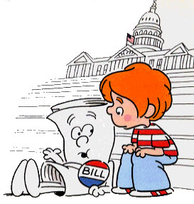
Policymaking according to High School Civics
Legislative branch makes laws
Executive branch carries them out
Judicial branch interprets them, decides controversies
Notes:
The canonical idea of policymaking is introducing a bill into Congress and negotiating to make it law

Slide 4
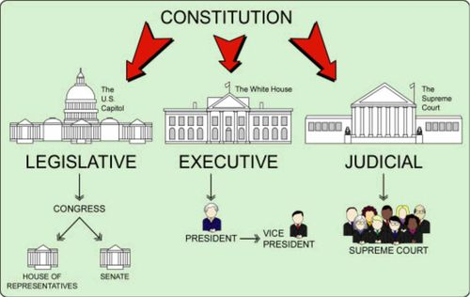
Mysteries of High School Civics Model
Is bureaucracy directly under President, or independent 4th branch?
When executive branch goes to carry out law, how does it know its meaning?
Why are there controversies requiring judicial resolution?
Why isn’t all real action in Congress?

Slide 5
The Anti-High School Civics Model
Laws are just bunches of words that the executive and judiciary branches have to make something of
The world is very complicated and doesn’t neatly match words
Laws are often vague and indeterminate, both unintentionally and intentionally
Notes:
This would perhaps be a discouraging lesson for impressionable young high school students to be taught, and wouldn’t make for nice standardized test answers in any case. Many lawyers also don’t like this answer: it makes it seem like they are just making it up, rather than “following the law, and thus doing their duty.”
The relationship between law and policy is a complex one; that “just” is a bit unfair, as laws do work.
But Anti-High School Civics model might be closer to the truth for a number of crucial issues these days, and we should think about the implications of that.
Rather offering complicated, abstract discussion, I’ll illustrate with a real world policy issue of great importance: addressing global climate change.

Slide 6
Does the U.S. have a climate change policy?
In terms of high school civics model: barely
National Climate Program Act of 1978
Global Climate Protection Act of 1987
Bush 41 signed, and Senate ratified, 1992 United Nations Framework Convention on Climate Change, a nonbinding agreement to mitigate
But Senate rejects Kyoto Protocol negotiated by Clinton administration; no binding regulation
Lots of bills in late 1990s, early 2000s, but no laws
Cap and Trade bill sought during unified Democratic control of Congress defeated
Notes:
Some measures promoting research, planning to plan
When time comes to commit to anything definite, only some aborted efforts

Slide 7
Does the U.S. have a climate change policy?
In reality: yes, a strange and patchy one
Pursued outside of Congress by states
Federal greenhouse gas (GHG) regulations derived through judicial and executive reinterpretations of existing law, the Clean Air Act (CAA)
Notes:
As these regulations continue to be implemented, you’ll be hearing more and more about them; President Obama has made big promises about tackling global climate change through executive action if he can’t get a deal with Congress
So at the risk of getting a little deep into the weeds, let me quickly try to explain how our current regulatory regime came about

Slide 8
Brief History of Clean Air Act
First passed in 1970, amended 1977
§ 108 requires Administrator to regulate “each air pollutant–[…] emissions of which, in his judgment, cause or contribute to air pollution which may reasonably be anticipated to endanger public health or welfare”
Notes:
By leaving it to the EPA to designate which “air pollutants” would be regulated, Congress intentionally effected a huge delegation of authority to the agency—rather than targeting particular pollutants, legislators aimed to create an enduring institutional capacity to deal with whatever pollutants could be scientifically shown to be hurting the public.
[Click changes key words to red]

Slide 9
Brief History of Clean Air Act
First passed in 1970, amended 1977
§ 108 requires Administrator to regulate “each air pollutant–[…] emissions of which, in his judgment, cause or contribute to air pollution which may reasonably be anticipated to endanger public health or welfare”
Notes:
By leaving it to the EPA to designate which “air pollutants” would be regulated, Congress intentionally effected a huge delegation of authority to the agency—rather than targeting particular pollutants, legislators aimed to create an enduring institutional capacity to deal with whatever pollutants could be scientifically shown to be hurting the public.

Slide 10
Key Definitions
§ 302(g) defines “air pollutant”:
“The term ‘air pollutant’ means any air pollution agent or combination of such agents, including any physical, chemical, biological, radioactive … substance or matter which is emitted into or otherwise enters the ambient air.”
§ 302(h) defines “welfare”:
Includes effects on weather and climate
Notes:
Those three sections together will provide basis for regulating greenhouse gas emissions.
You might think—well, that’s natural enough, what is going to be so strange about applying this statute to the problem of climate change?

Slide 11
Difficulties in Applying CAA to GHGs
CAA designed to address localized pollution problems, force states to improve air quality until prescribed standards attained
1990 Amendments added emissions trading program to combat acid rain, implementation of Montreal Protocol to protect stratospheric ozone layer, but doesn’t include anything addressing climate change
Notes:
Nobody in 1990 suggests that the CAA already covers greenhouse gases.
Nothing in the CAA is well-suited to address a problem of globally increased concentrations of any pollutant—let alone of a chemical, such as Carbon Dioxide, which is what we all breathe out and which has no direct negative effect on what is usually thought of as “air quality.”

Slide 12
Turning the CAA on Greenhouse Gases
Environmentalists frustrated with lack of congressional progress petition EPA to use Clean Air Act in 1999, arguing that climate change is damaging and therefore covered
Clinton leaves office without action; finally, EPA rejects petition in 2003, saying it will wait and see
Environmentalists (joined by states) turn to litigation
Notes:
Well-structured or no, intended or no, some people believed that statutory language forced the EPA to act
Administrative petition: before you can sue an agency, you have to ask them nicely.
Damage they chose to focus on, eventually, was the loss to rising sea levels of Massachusetts’ coastal land.

Slide 13
Massachusetts v. EPA
D.C. Circuit rules EPA has discretion, and its reasonable interpretation due deference (2005)
Supreme Court splits 5-4 (2007), with majority ruling that CAA unambiguously requires EPA to make a determination (and essentially requiring regulation of GHGs)
Dissents argue that alleged harms did not merit standing, and that on merits EPA’s interpretation a reasonable one
Notes:
I’m someone who believes politicization of Supreme Court is often very much exaggerated; but in this case, division was distinctly political (Stevens, Souter, Ginsburg, Breyer + Kennedy, vs. Roberts, Scalia, Thomas, Alito) and the arguments quite heated
On standing: question of harm resulting directly from agency decision, and being redressible by court decision
On merits: petitioners’ and majority’s understanding of “air pollutant” so inclusive as to demand regulation of “everything airborne, from Frisbees to flatulence.”
(Click for pictures – frisbees and flatulence)

Slide 14


Frisbees and flatulence?

Slide 15
Difficulties in Applying CAA to GHGs
Once GHGs defined as pollutant for one part, not clear how all of CAA’s many parts won’t apply
Permitting requirements: § 111 for all new industrial sources; § 165 for ~40,000 sources; and Title V for ~6 million sources (!)
Local actions not capable of directly improving local conditions or “attaining” any standard
Notes:
CO2 emissions very high volume/weight compared to traditional pollutants, so many kinds of establishments easily clear the thresholds that apply only to heavy industry and power generation for other pollutants

Slide 16
EPA Regulations under CAA
Advanced notice of proposed rulemaking (2008)
Endangerment finding, triggering many requirements in statute (12/09)
Stricter “tailpipe” emissions standards for cars, by modifying CAFE standards (5/10)
Energy efficiency requirements for new power plants, which would effectively prevent construction of new coal plants (proposed 3/12)
Most potentially problematic, controversial applications currently in legal limbo, probably leading to more litigation
Notes:
Heavy trucks, airplanes, existing power plants and industrial sources

Slide 17
What of Changes in the Law?
Main reaction after Massachusetts v. EPA handed down was that Congress would be forced into action, one way or the other, by inefficient use of statute
Did create pressure as cap-and-trade bill sought in 2009, but coalition fractured
Nearly six years later, still waiting… Why?
Notes:
Given that the difficulties with the law seem so profound, why hasn’t there been more action?
Choice isn’t between no law and sensible law; it’s between status quo of extremely flawed regulation and something more sensible
Well, one reason is because EPA has been doing its best to minimize flaws

Slide 18
EPA Tailoring and Timing: Policy against Law
EPA issues “Timing Rule” and “Tailoring Rule” saying that it will depart from CAA requirements in some respects:
Will delay creation of permitting process
Will change applicability thresholds
Justified on grounds of administrative necessity, need to avoid absurdity, and EPA’s ability to

Slide 19

If policies don’t come from laws, how can lawmakers be convinced to act?
Petitioners challenging EPA regulations say that by ignoring the law, the agency destroys motivation for Congress to fix it
D.C. Circuit rejects this argument, citing Schoolhouse Rock to say that harm is entirely speculative
Notes:
Congressional inaction is just part of the system now

Slide 20
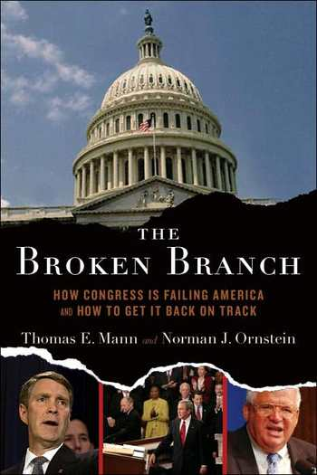
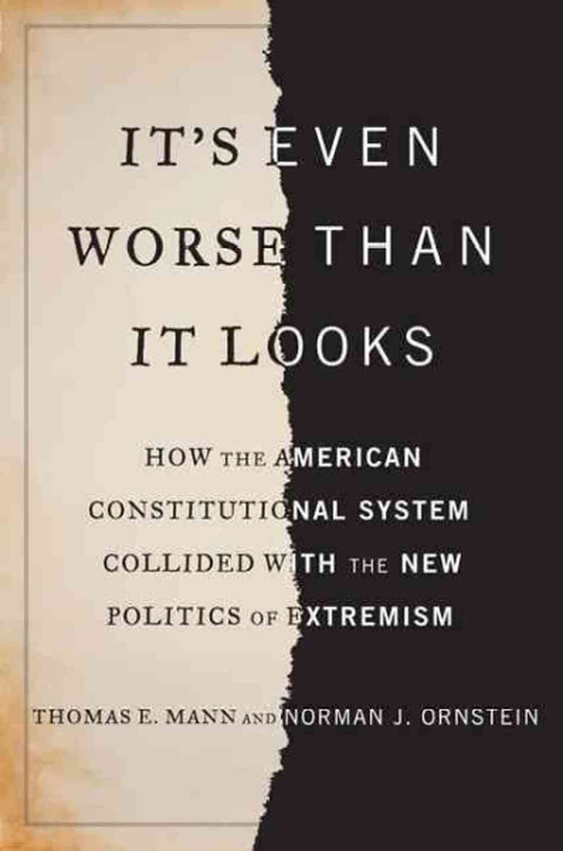
Well, that’s what happens when you have a dysfunctional Congress
Notes:
Brookings colleague Tom Mann and his counterpart at AEI

Slide 21
Coping with a dysfunctional Congress… by cutting it out of the loop?
As naïve and optimistic as high school civics model was about Congress, story of GHG regulation as it stands today goes to opposite extreme
Executive prerogative: bureaucrats do the best they can with legislative tools they have, rather than being first and foremost agents carrying out congressional will
Notes:
Shutting down coal industry without Congress ever meaning to do such a thing– not as crazy as it sounds, given the rise of natural gas, but still really rather dramatic

Slide 22
Other Policy Areas where Executive Creativity Leads
No Child Left Behind
Law’s requirements (designed to become increasingly strict) often waived by agreements between Secretary of Education and states
BP Oil Spill
Negotiated huge settlement and distributed funds
Instituted drilling moratorium
Immigration Reform
DREAM Act goals effectively pursued through changes in enforcement policy

Slide 23
Hyperventilating Generalizations
Are we in a new era of administrative government, in which policy is generated of its own accord?
Whither democracy?
Whither the rule of law?
Notes:
House Majority Leader Eric Cantor’s office listed these and many, many more in an electioneering document entitled, “The Imperial Presidency,”

Slide 24
Can it work?
How far can existing laws really go in solving problems?
Do inefficiencies of jerry-rigged regime discredit regulatory objectives?
Will there be a revenge of the voters?

Slide 25
Philip Wallach
Fellow, Governance Studies
Brookings Institution
pwallach@brookings.edu

