Slide 1
Conducting Funding Searches
Conducting Funding Searches
Presented by:
Stephanie Page
UNLV Office of Sponsored Programs
December 4 and 5, 2012

Slide 2


Overview
Planning Your Search
Finding Funding Opportunities
Sample Searches
Understanding the Solicitation
Practice Time

Slide 3
Finding the Right Match
Takes Time and Effort
  Must find a sponsor whose goals match your expected project results
  Trying to force a project into a funding opportunity that is not a good match is a waste of effort

Slide 4
Planning Your Search
Start early
Identify your goals and needs
Tap into all available resources
Talk to the program officer
Notes:
(single words and combination that are both specific and broad disciplinary terms)
Tap into all available resources – institutions, colleagues, internet, etc.
Look for awarded grants in your field to identify funding sources
Talk to other researchers to see who supports their work.
Professional journals – article usually identify sponsor “This research has been funded by DOE”.
Ask yourself, What is my goal? What type of support are you looking for? A Training grants, a fellowship, a research grant, a conference grant.

Slide 5

Sample Searches
Where Can I Find Funding Opportunities?

Slide 6
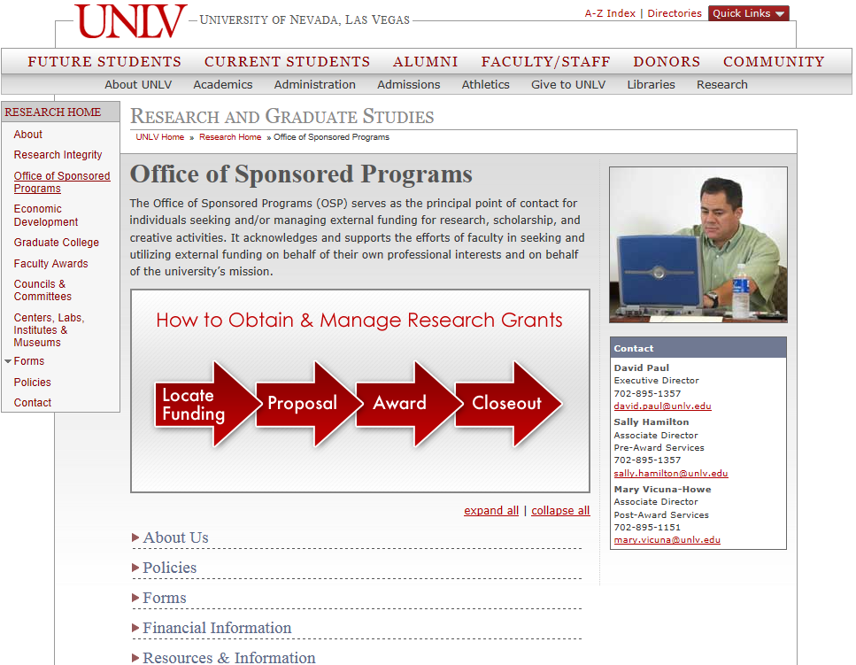
Searchable Sites
OSP Website
http://www.unlv.edu/research/osp

Slide 7
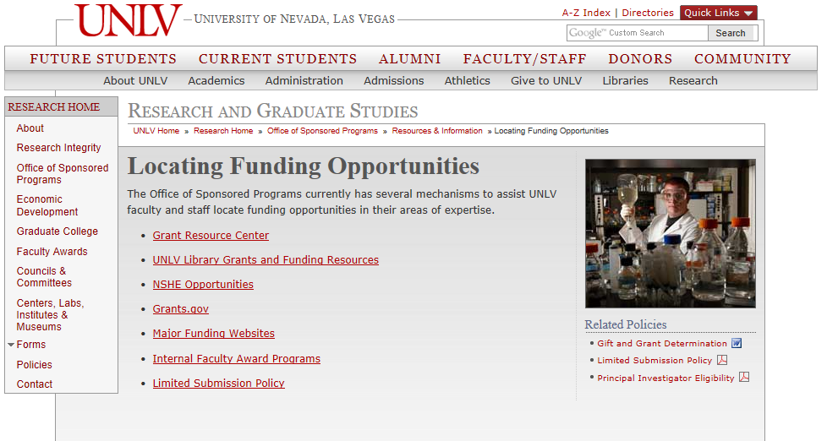
Searchable Sites
OSP Website

Slide 8
Searchable Sites
Searchable Sites
Grants Resource Center (GRC) http://www.unlv.edu/research/osp-locating-funding-opportunities
  American Association of State Colleges & Universities
  GrantSearch database
Library
http://www.library.unlv.edu/
  Foundation Directory Online (FDO)
  IRIS
Grants.gov http://grants.gov/applicants/find_grant_opportunities.jsp
Notes:
These are some of the big websites. Later in the class we will do a demonstration of each of the websites.
GRC: Access is protected – OSP pays an annual membership fee for access to their database. It includes federal announcements and major foundations.
Foundation Director and IRIS (Illinois Researcher Information Service) can be accessed through the UNLV library website. The Foundation Directory not only lists open funding announcements from foundations, but also lists foundation assets, giving records, and major focus areas.
Grants.gov is the major portal for federal application packages. It is a central storehouse for information on over 1,000 grant programs and provides access to approximately $500 billion in annual awards.

Slide 9
Agency Websites
Major Funding Websites
Health Resources and Services Administration (HRSA)
National Endowment for the Humanities
National Science Foundation
National Institutes of Health
U.S. Department of Education
U.S. Department of Energy
U.S. Environmental Protection Agency
Individual Foundation Sites
Notes:
If you have a specific sponsor you are interested in, using their website might save some time. Some federal agencies list a lot of information about the funding opportunities on their individual websites, though often you are directed to Grants.gov for the full application package.

Slide 10
Sign Up for Notifications
Sign Up for Notifications
Grants Resource Center (GRC)
  Faculty Alerts - Sign up online
  Grants.gov
    http://grants.gov/applicants/email_subscription.jsp
Individual Sites
  Email Notifications
  RSS Feeds
Notes:
If you are interested in signing up for email notifications from GRC, access the GRC website, click on resources, faculty alert system and complete form and submit. You will start receiving email notification within a few weeks. Grants.gov: Daily notices of new grant opps, Select notifications based on specific criteria, by Funding Opp Number or Stay informed through RSS (Really Simple Syndication) Feeds – new opp by agency – by category. You can also sign up for updates through individual site RSS feeds. FDO: has a app for your smartphone. NIH: “Get Connected” link where you can: RSS Feeds, Weekly Table of Contents of announcement published during the week.

Slide 11
Sample Searches
Sample Searches

Slide 12
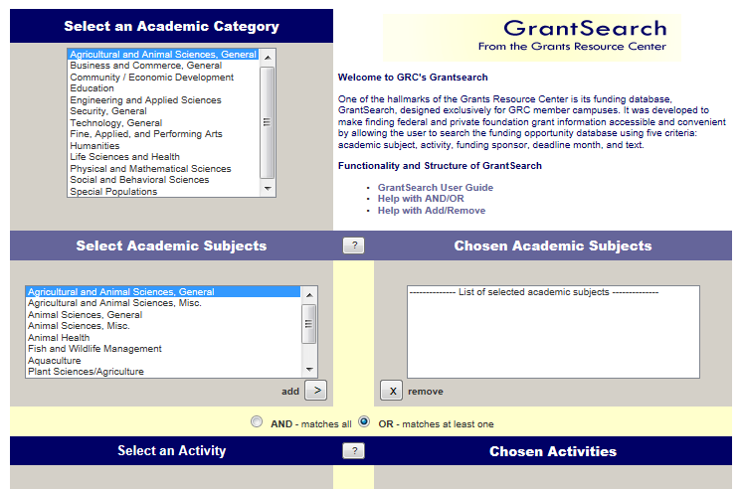
Grants Resource Center
Grants Resource Center
http://www.aascu.org/grc/gs/
Topic #1: Art History Dissertation Assistance
Topic #2: Reading Comprehension
Notes:
Choose as many search categories as you like. It is sometimes best to start off with a rather broad range to capture all of the funding opportunities out here, then narrow down if you need to later. Example to find breast cancer research, try “breast, cancer, lobules, estrogen
Try different combinations of the keywords such as “breast and cancer” “ductal and carcinoma” “estrogen and receptor” “women and issues”
Vary your search terms to increase your odds of getting a hit
Art history – Fine, Applied, Perf Arts – Fine/Applied/Perform - Graduate and dissertation support – 42 - change to Fine Arts General – 17 – Want to apply in spring (Jan-April) 8 results
Education – 481 matches too general – Research in Education 97 matches – OR Elementary/Secondary – 157 AND- 33 #35 Reading/Writing DoED

Slide 13
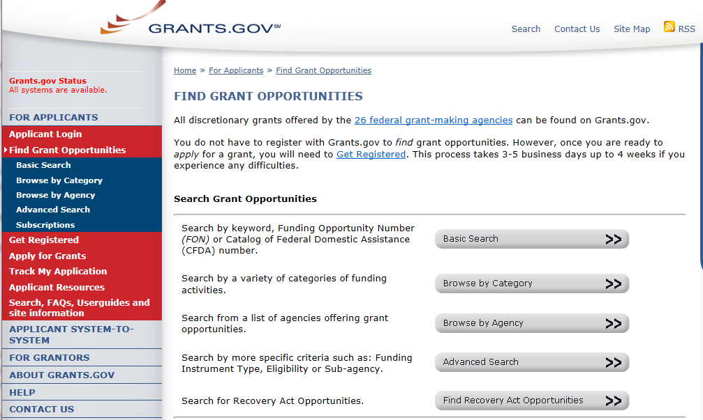
Grants.gov
Grants.Gov
http://www.grants.gov/applicants/find_grant_opportunities.jsp
Topic #1: Nanotechnology
Topic #2: Childhood Obesity
Notes:
The basic search option can work if you have a specific topic. Use the advanced search if your topic is more broad. You can indicate eligibility type, certain funding agencies, and time periods.
Nanotechnology – basic search – 24 come up
Childhood obesity – Food and Nutrition/Health = 992. Basic search – 64 come up, refine, Obesity and Food and Nutrition/Health you get 29 – that is doable.
Physical Activity – Food/Nutrition/Health = 22.

Slide 14
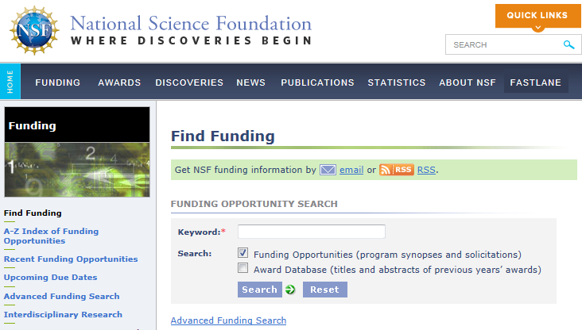
National Science Foundation
National Science Foundation
http://www.nsf.gov/funding/
Topic #1: Faculty Early Career Development
Topic #2: STEM
Notes:
Different ways to search on left screen. A-Z and type in Faculty Early Career Development STEM: 72 options Click the link to see a synopsis of the program (12-552 – 5th one) Click the solicitation link to see the full program solicitation. NSF also information about previous awards (Advanced Search – click on award database - turtles) which can be really helpful in determining if they are already funding a project similar to your idea. Please contact the NSF Program Officer if you have any questions about the suitability of your project for that specific solicitation.

Slide 15
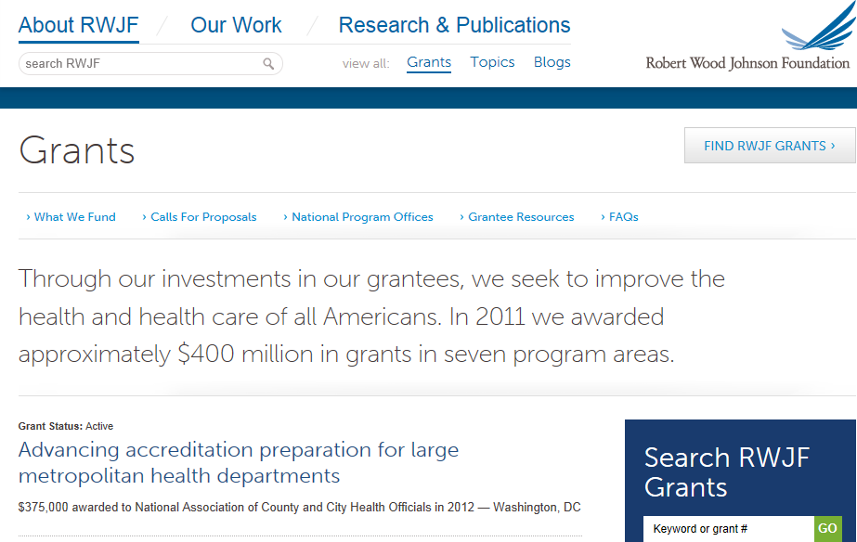
Robert Wood Johnson Foundation
Robert Wood Johnson Foundation
http://rwjf.org/grants/
Topic: Nursing Workforce Development
Notes:
Call for proposals - Are there current opportunities? If not, check past opportunities to see if your idea meets what they have funded in the past. Check awardee reports as well.
What We Fund – shows what they fund and can also sign up for email alerts and RSS Feeds
Health Care Policy and Childhood Obesity

Slide 16
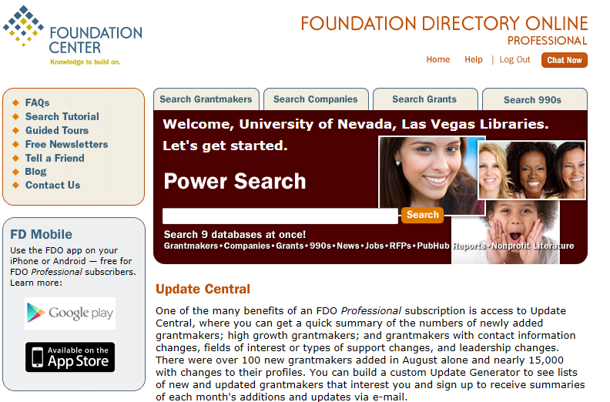
Foundation Directory Online
Foundation Directory Online
http://library.unlv.edu/ (Through UNLV Lied Library)
Topic #1: Autism Spectrum Disorders
Topic #2: Food Services
Notes:
Go to the main library page. Click on “A-Z list of databases”. Choose Foundation Directory. Click on “Search Grantmakers”. Can narrow the focus by topic area, and by geographical region. Some foundations only fund projects in their local area. It is probably not worth your time to contact a foundation in Connecticut that only funds in the Hartford area. Look at Nevada or nationwide sponsors. The Foundation Directory profile will give you some great detail about that specific foundation. What are their assets? How much did they give last year? What are their major focus areas. Most of the time there is a link to the foundation’s website, so you can then see what RFPs they have open at this point in time. Choose Autism – national and Nevada - Autism Speaks. 1 Go to website - Research, scroll to Grants, click on first one. Browse through and if any interest click on access RFA here. And look, (Future Announcements) they have the option to sign up for email notifications. They also have a list of all of the funding opps, so you can look through those are not currently open to see if your idea might fall into their focus areas when those funding opps open again.
Local One: Nevada – Clark County – Food Services – 4 grantmakers - Next: How many local grantmakers in the area? 358 - Ceasars Foundation – Aging, Environment, Food Services, Health Care, Nutrition - look at site: accept proposals on a rolling basis

Slide 17
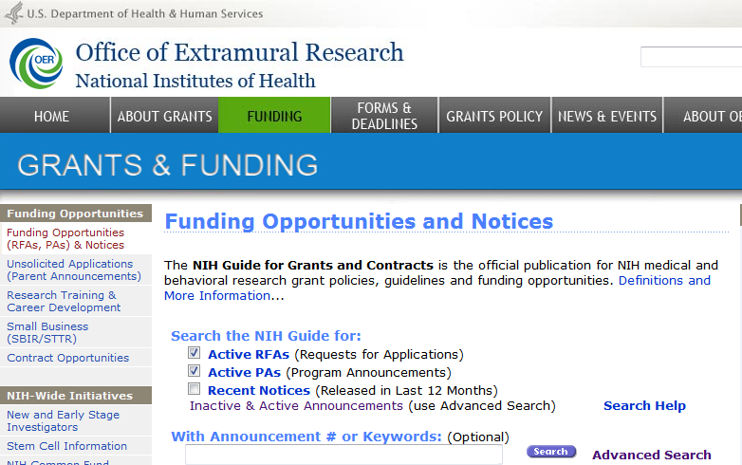
National Institute of Health
National Institute of Health
http://grants.nih.gov/grants/guide/
Topic: Depression
Notes:
Go to Funding Scroll down to signups - and on left – NIH Reports (Awards) You have a research idea about how the neighborhood environment might affect depression in persons of low socio-economic status. So you go straight to NIH to review their funding opportunities. You type in “depression” and get over a hundred responses. So it is time to refine. Type in “neighborhood” in the search within these results and you get 12. That is doable. You review the names, open dates, and look at a few to see which one might be your best bet. We will discuss how to do that next. Once you decide on a funding opp, you will contact OSP. Submitting to NIH is a two step process, so you want to start well in advance.

Slide 18
Understanding the Solicitation or Program Announcement
Understanding the Solicitation or Program Announcement
Notes:
Few tips on basic fundamental principles as this section could be a separate presentation since it can be very involved.
Also want to direct you to the OSP website under the Proposal Link – provides resources to assist your through the proposal process including links to some agency websites

Slide 19
Eligibility
There will always be a section stating what types of organizations are eligible to apply
UNLV is:
  A public or state controlled institution of higher education
  501(c)3 nonprofit
Always check with OSP if you have any questions on eligibility before you start writing a proposal
Notes:
Examples of RFA’s

Slide 20

Deadlines or Target Dates
Deadlines or Target Dates
A deadline is a set date by which your proposal must be submitted or it will be rejected
  Check the time due. Some FOAs list EST, so we might need to turn in by 2:00 p.m. PST to meet a 5:00 p.m. EST deadline.
Target dates are more flexible
  If you go too far past the target date you might miss the review period, and your proposal will not be reviewed until the next review panel meets.
Notes:
Examples of RFA’s

Slide 21
Sponsor Guidelines
Sponsor Guidelines
Almost every funding source provides a
set of parameters such as:
  Funding Ceiling
  Limitations on allowable costs
  Cost sharing requirements
  Required format, forms, proposal content
Where do we find these guidelines?
Federal - grants.gov/agency websites
State - websites or hardcopy documents upon request
Private - websites/calls for proposals/hardcopy
Notes:
Examples of RFA’s

Slide 22
Standard Proposal Components
  Title/Cover Page
  Abstract
  Project Description
    Needs statement - hypothesis
    Goals & Objectives
    Methodology
    Evaluation
    Dissemination
  Budget and Justification
  References Cited
  Biographical Sketch
Constructed according to guidelines established by sponsor
Follow forms and format required by sponsor
Notes:
I am not going to get into detail on this, because I want you to have time to do some practice searches. Just be aware that these are the components you will need for most proposals.

Slide 23
Review Criteria
Review Criteria
Generally the review criteria is listed after the proposal instructions.
  Write to the review criteria!
What end result is expected?
Does your project fit into the goals of the funding announcement?
Notes:
The review criteria is generally listed at the end of the program announcement. Read through how the sponsor will evaluate your proposal BEFORE you start writing. Be sure your proposal can meet all of their requirements.

Slide 24
Assistance
Your Senior Research Administrator in OSP
  Refer to the OSP Website
The sponsor’s Program Officer for your topic area
  Prepare a brief review of your proposed project
    Might recommend you look at other funding opportunities
    Might have suggestions to strengthen your idea
Notes:
OSP Website: About Us – College/Dept Assignments

Slide 25
PRACTICE TIME!
Conduct a search of your choice . . .
Practice Time!

Slide 26
Office of Sponsored Programs
  OSP Website: http://www.unlv.edu/research/osp/
Research Administration Building (RAB)
Phone: 895-1357

Slide 27

QUESTINS
Questions

