Slide 1
America’s New Demography
Rising Minorities, Aging Boomers and Emerging Cultural Gaps
William H. Frey
The Brookings Institution
April 23, 2013

Slide 2
US: Population by Race: 2000 and 2050
46.6%
69.1%

Slide 3
US: Population by Age: 2000 and 2050
21.0%
12.4%

Slide 4
Race Ethnic Shares
2010 Population
2000-10 Growth

Slide 5
Median Ages of Race-Ethnic Groups

Slide 6
US Adult and Child Populations, 1990-2010
Adults
Children

Slide 7
2000-2010 Change in Child Population by Race-Ethnicity

Slide 8
New Demographic Regions
Melting Pot America
The New Sunbelt
The Heartland

Slide 9
Melting Pot, New Sunbelt
and Heartland States
Melting Pot
New Sunbelt
Heartland
Source: William H. Frey analysis
Notes:
9

Slide 10
Share of U.S. in Melting Pot States
Native Born 37%
Foreign Born 66%
Spanish at Home 72%
Asian Language at Home 65%

Slide 11
Demographic Components, 2000-2009
(Rates per 1000)

Slide 12
Born in Same State
GT 63%
LT 63%
Source: William H. Frey analysis

Slide 13
Domestic Migration Magnets, 2000-09
1 | Phoenix | 530,579
2 | Riverside, CA | 457,430
3 | Atlanta | 412,832
4 | Dallas | 307,907
5 | Las Vegas | 299,027
6 | Tampa | 254,650
7 | Charlotte | 243,399
8 | Houston | 242,573

Slide 14
Immigrant Magnet Metros, 2000-09
1 | New York | 1,079,016
2 | Los Angeles | 803,614
3 | Miami | 506,423
4 | Chicago | 363,134
5 | Dallas | 323,941
6 | Washington DC | 310,222
7 | Houston | 289,648
8 | San Francisco | 257,318

Slide 15
Greatest Domestic Out-Migration, 2000-09
1 | New York | -1,920,745
2 | Los Angeles | -1,337,522
3 | Chicago | -547,430
4 | Detroit | -361,632
5 | San Francisco | -343,834
6 | New Orleans | - 298,721
7 | Miami | -284,860
8 | San Jose | -233,133

Slide 16
_______ ________ _____
Greatest Immigrant Growth 2000-2010
Source: William H. Frey analysis
Notes:
16

Slide 17
Migration Slowdown
1947-8 to 2009-10

Slide 18
Race –Ethnic Profiles of Regions 2010
Melting Pot
New Sunbelt
Heartland

Slide 19
Hispanic Concentrations 2010
Percent of County Population
Data source: William H. Frey analysis of Census2010

Slide 20
Largest Hispanic Gains 2000-2010
 | State | Gains
1 | California | 3,047,163
2 | Texas | 2,791,255
3 | Florida | 1,541,091
4 | Arizona | 599,532
5 | New York | 549,339
6 | Illinois | 497,316
7 | New Jersey | 437,953
8 | North Carolina | 421,157

Slide 21
Greatest Hispanic Growth Rates 2000-2010
 | State | Growth
1 | South Carolina | 148%
2 | Alabama | 145%
3 | Tennessee | 134%
4 | Kentucky | 122%
5 | Arkansas | 114%
6 | North Carolina | 111%
7 | Maryland | 106%
8 | Mississippi | 106%

Slide 22
Asian Concentrations 2010
Percent of County Population
Data source: William H. Frey analysis of Census2010

Slide 23
Largest Asian Gains 2000-2010
 | State | Gains
1 | California | 1,126,210
2 | Texas | 393,981
3 | New York | 370,268
4 | New Jersey | 242,815
5 | Florida | 183,523
6 | Virginia | 177,021
7 | Illinois | 160,670
8 | Washington | 156,233

Slide 24
Greatest Asian Growth Rates 2000-2010
 | State | Growth
1 | Nevada | 116%
2 | North Dakota | 92%
3 | Arizona | 91%
4 | North Carolina | 84%
5 | Georgia | 82%
6 | Arkansas | 79%
7 | New Hampshire | 79%
8 | Delaware | 76%

Slide 25
Black Concentrations 2010
Percent of County Population
Data source: William H. Frey analysis of Census2010

Slide 26
Largest Black Gains 2000-2010
 | State | Gains
1 | Florida | 586,832
2 | Georgia | 579,335
3 | Texas | 522,570
4 | North Carolina | 296,553
5 | Maryland | 209,494
6 | Virginia | 147,326
7 | Pennsylvania | 124,654
8 | Tennessee | 121,187

Slide 27
White Concentrations 2010
Percent of County Population
Data source: William H. Frey analysis of Census2010

Slide 28
Largest White Gains 2000-2010
 | State | Gains
1 | North Carolina | 576,840
2 | Texas | 464,032
3 | Florida | 426,213
4 | Arizona | 421,389
5 | Colorado | 317,913
6 | Utah | 317,454
7 | South Carolina | 310,449
8 | Tennessee | 294,852

Slide 29
Largest White Losses 2000-2010
 | State | Losses
1 | California | -860,537
2 | New York | -456,734
3 | New Jersey | -342,331
4 | Illinois | -256,387
5 | Michigan | -236,752
6 | Pennsylvania | -227,803
7 | Massachusetts | -213,559
8 | Ohio | -178,848

Slide 30
Metro-NonMetro Race Changes, 1990-2010
Source: William H. Frey analysis

Slide 31
City and Suburb Populations, 1990-2010
Cities
Suburbs

Slide 32
2000-10 Change in City and Suburb
Population by Race/Ethnicity

Slide 33
City Suburb Race-Ethnic Profiles Selected Metros
Los Angeles
Atlanta
Detroit
Source: William H. Frey analysis

Slide 34
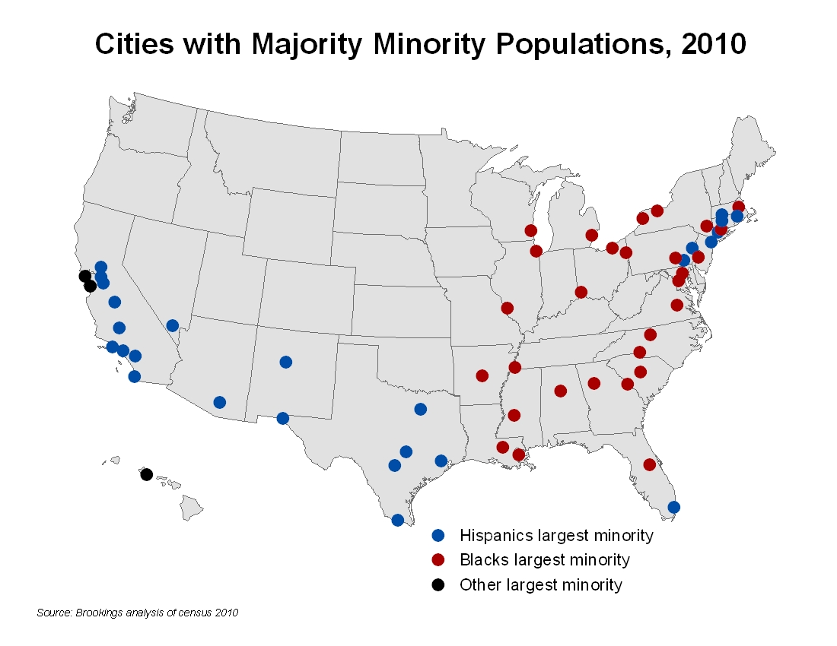

Slide 35
Cities with Greatest Black Losses 2000-2010
 | City | Black Loss
1 | Detroit | -185,393
2 | Chicago | -181,453
3 | New York | -100,859
4 | Los Angeles | -54,606
5 | Washington DC | -39,035
6 | Oakland | -33,502
7 | Cleveland | -33,304
8 | Atlanta | -29,746

Slide 36
Metro Residents Living in Suburbs
1990-2010

Slide 37
US Growth by Age 2000-10

Slide 38
State Growth in Child Population*, 2000-10
Growth 5% and over
Growth under 5%
Decline under 5%
Source: William H. Frey analysis
Decline 5% and over
Under age 18
Notes:
38

Slide 39
Percent Minority Children, 2010
GT 50%
40% - 50%
25% - 40%
Source: William H. Frey analysis
Under 25%

Slide 40
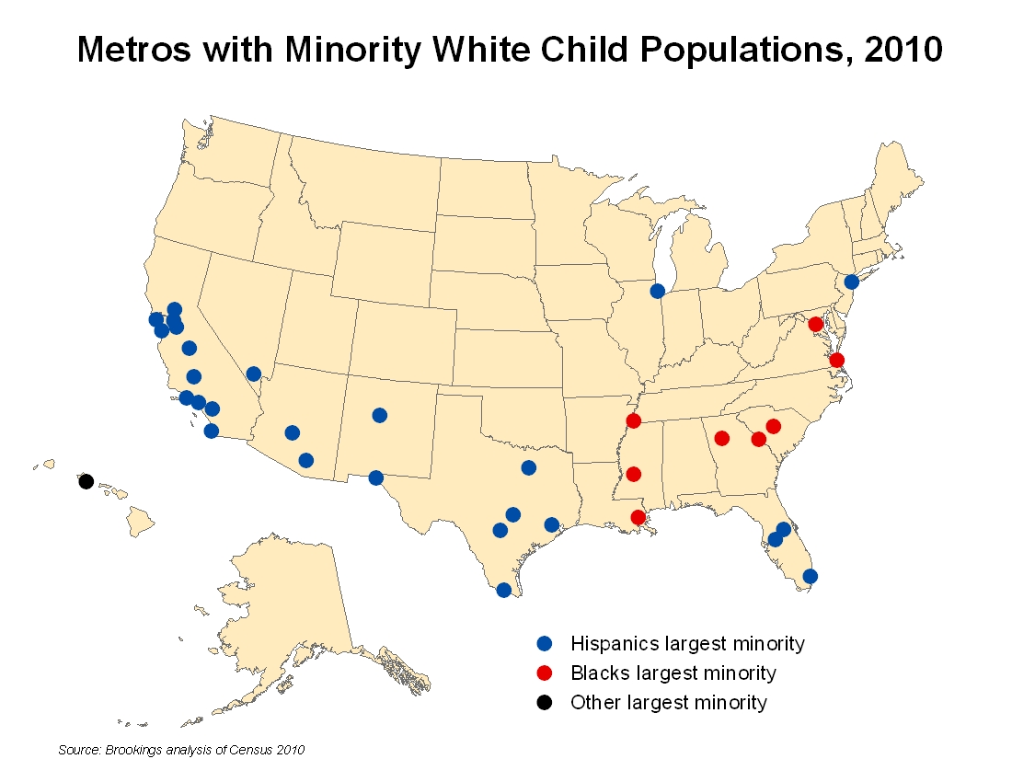

Slide 41
Percent Children with Immigrant Parents
51%
35%
35%
34%
32%
31%
31%
23%

Slide 42
Children Speaking Other than English
GT 20%
10% - 20%
6% - 10%
Source: William H. Frey analysis
Under 6%
* Ages 5 - 17

Slide 43
English Proficiency- Children and Adults
Source: William H Frey analysis

Slide 44
Education by Race-Ethnicity
Pew Hispanic Center

Slide 45
HS Dropout Rates: Hispanics Age 16-24
Source: Pew Research Center
Notes:
45

Slide 46
Percent College Graduates for States
GT 30%
25% -30%
Under 25%
Source: William H. Frey analysis

Slide 47
Largest Percent College Grads
1 | Washington DC | 47%
2 | San Jose | 45%
3 | Bridgeport | 44%
4 |  | 43%
5 | Madison | 43%
6 | Boston | 43%
7 | Raleigh | 41%
8 | Austin | 39%
9 | Denver | 38%
10 | Minn-St.Paul | 38%
San Francisco
Alaska

Slide 48
Ratio of College Grads to High School Dropouts
3.0 and above
2.0 – 3.0
Below 2.0
Source: William H. Frey analysis
Source: William H. Frey analysis
Notes:
48
48

Slide 49
US Growth by Age 2000-10

Slide 50
Median Ages for States, 2010
40 and over
38 to 40
36 to 38
Source: William H. Frey analysis
Below 36

Slide 51
Age 65 + Growth 2000-10
GT 25%
15% -25%
10% -15%
under 10%
Source: William H. Frey analysis

Slide 52
Greatest 65+ Growth, 2000-2010
1 | Raleigh | 60%
2 | Austin | 53%
3 | Las Vegas | 50%
4 |  | 46%
5 | Atlanta | 44%
6 | Provo | 42%
7 | Colorado Springs | 40%
8 | Houston | 39%
9 | Dallas | 38%
10 | Charlotte | 36%
Boise City
Alaska

Slide 53
Population Changes in the
First Three Decades, 21st Century
(65 - 74)
(75 +)
Source: William H. Frey

Slide 54
Projected Age 65+ Growth
2000-30, US States
140% & above
100% -139%
70% -99%
under 69%

Slide 55
Projected Age 65+ Growth, 2000-40
percent growth
Florida
California
New York

Slide 56
Percent Age 65+, Central and Suburban Counties, Projected 2000-2040: Selected Metro Areas
New York
Philadelphia
Chicago
Los Anglos
Source: William H. Frey analysis

Slide 57
Boomers vs. Parents at Midlife

Slide 58
Projected Race-Ethnic Shares, 2000-30
Children
Seniors
white
Black
Asian/Other
Hispanic
Source: William H. Frey analysis

Slide 59
Contributions to Labor Force Growth 2010-2020 (in millions)
Source: William H. Frey analysis

Slide 60
Race for Age Groups: US

Slide 61
Race for Age Groups: California

Slide 62
Race for Age Groups: Minnesota

Slide 63
Race for Age Groups: Arizona
Source: William H. Frey analysis

Slide 64
Racial Generation Gaps
Difference in White Percent: Seniors minus Children
25 and above
20 to 25
15 to 20
Source: William H. Frey analysis
Below 15

Slide 65
State Growth, 2000-2010
Below 0%
0% -4%
5% - 9%
10% - 20%
20% +

Slide 66
Changes in Congressional Seats
from 2010 Census
1
-1
-2
-1
-1
-1
-1
-1
1
-1
-2
1
-1
1
1
1
4
-1
2
Source: William H. Frey analysis

Slide 67
Hispanic Share of Population, 2010
Below 5%
5% - 9%
10% - 19%
20% - 34%
35%+

Slide 68
Hispanic Percent of Growth in States Gaining Seats from 2010 Census

