Slide 1
Could a State-Level Carbon Tax Work in the Intermountain West?
Adele C. Morris, Ph.D. Fellow
Policy Director, Climate and Energy Economics Project
The Brookings Institution
Matt Kinzer
UNLV October 8, 2013

Slide 2
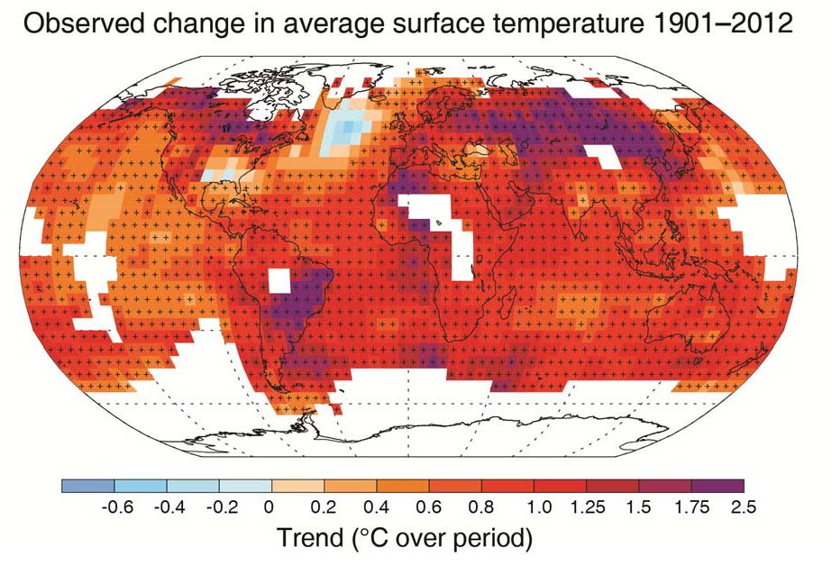
IPCC: “Warming is unequivocal
…since the 1950s, many of the observed changes are unprecedented over decades to millennia. The atmosphere and ocean have warmed, the amounts of snow and ice have diminished, sea level has risen, and the concentrations of greenhouse gases have increased.”
“Human influence on the climate system is clear.”
Working Group I Contribution to the IPCC Fifth Assessment Report
Climate Change 2013: The Physical Science Basis
Summary for Policymakers

Slide 3
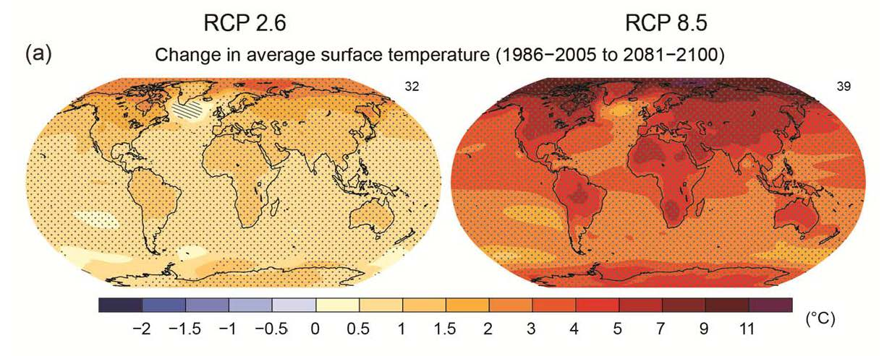
“Continued emissions of greenhouse gases will cause further warming and changes in all components of the climate system. Limiting climate change will require substantial and sustained reductions of greenhouse gas emissions.”
Cumulative CO2 emissions 2012-2100 in Gigatonnes of Carbon
RCP 2.6: Most stringent policies RCP 8.5: No emissions constraints

Slide 4
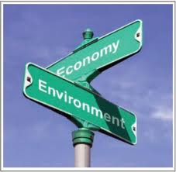
Premises
Greenhouse gas emissions result in damages.
Prices don’t reflect those damages.
A carbon tax or cap-and-trade system can internalize external costs and efficiently lower emissions.
We now have a complex set of local, state, and federal incentives/standards/mandates/subsidies, with more pending regulations.
Federal action to price carbon is stalled.
EPA starting a long road of regulation…

Slide 5
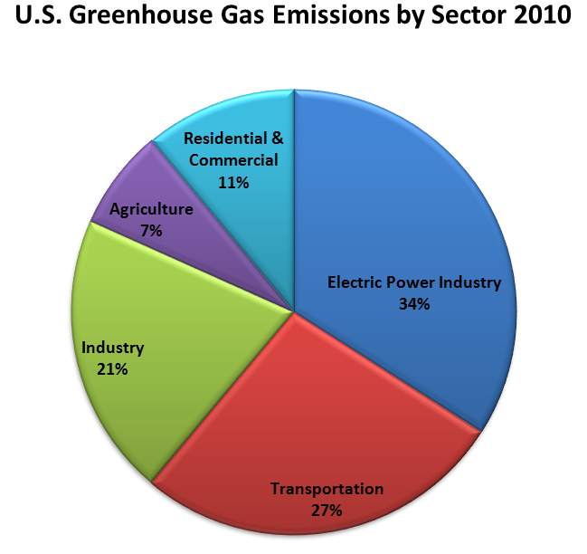
What’s pending at the federal level?
Clean Air Act (EPA) regulation of new power plants
Proposed rule is out
Next summer…
Final rule for new sources
Proposed rule for existing power plants
Then final rule and state implementation plans.

Slide 6
States can step in…
Reduce emissions
Drive new technologies
Provide leadership and examples for Federal policymakers
But…
Could be costly
Could distort investment across states and create leakage and competitiveness issues

Slide 7
What are current state climate/energy policies?
Mandatory measures
Renewable/clean energy portfolio standards
Net metering
Building codes
Efficiency standards for energy-using goods
Financial incentives
Tax rebates for “green” goods
Loan programs

Slide 8
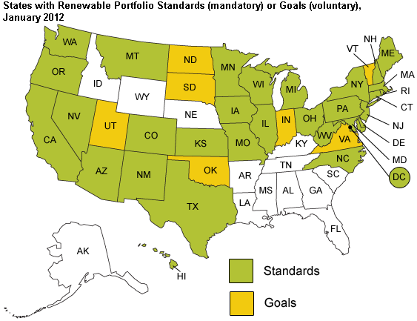
15% by
2020
18% now,
25% by
2025,
and 6% of
that must
be solar
20% by 2013,
25% by 2016,
33% by 2020
Source: US EIA, http://www.eia.gov/todayinenergy/detail.cfm?id=4850&amp;src=email

Slide 9
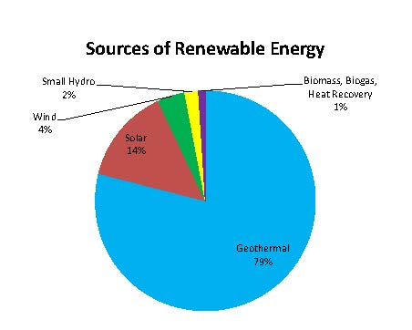
What are Nevada’s policies?
Renewable/clean energy portfolio standards
International Energy Conservation Code
90% compliance by 2017
Retrofit Grants
Nevada Energyfit
Loan and grant programs to help older homes and businesses improve their energy efficiency to current standards

Slide 10
Nevada Clean Energy Tax Expenditures
2.25 % sales tax on renewable energy transactions
25 to 35% property tax abatement for LEED Certified Buildings
55 % property tax abatement for new renewable energy providers (20 years)

Slide 11
Tax Abatements | Total Sales Tax Expenditure (over 3 years) | Total Property Tax Expenditure (Over 20 years)
Geothermal Jersey Valley | $1,290,825 | $9,203,790
Solar PV Boulder City | $3,587,650 | $10,552,193
Wind Spring Valley | $10,954,125 | $30,477,305
Solar PV, Near Primm | $6,143,177 | $10,870,445
CC Landfill Energy | $726,232 | $2,682,753
Ormat McGinness Hills | $4,935,600 | $0
Ormat Tuscarora | $789,225 | $553,807
Crescent Dunes | $25,999,997 | $93,316,458
Stillwater Solar | $2,809,532 | $6,608,521
ON Line | $4,416,035 | $54,026,119
Copper Mountain Solar | $42,206,932 | $48,427,509
Spectrum Solar | $4,119,252 | $7,619,299
Gradient Resources | $5,897,940 | $19,640,885
ORNI 47 LLC | $2,917,062 | $0
Mountain View Solar, LLC | $2,006,989 | $5,316,242
K Road Moapa Solar* | $22,847,301 | $0
Silver State Solar South* | $19,764,577 | $38,493,024
Total Tax Expenditure | $161,412,451 | $337,788,350

Slide 12
Why might states impose a carbon tax?
Reduce emissions cost effectively
Obviate more costly ways to reduce emissions
Raise revenue
Lower deficits/debt
Reduce other taxes: “tax shift” or “tax swap”
Comply with EPA rules?

Slide 13
Some carbon tax design challenges
Set the tax base
Set the tax rate and trajectory
Decide on the use of the revenue
Manage distributional outcomes
Avoid competitiveness problems/emissions leakage
Coordinate across borders
Decide what to do with other energy/environment/tax policies

Slide 14
Which states are talking about a carbon tax?
Washington
Proposal by carbonwa.org: $30/ton
revenue neutral, rising at 5% per year,
on all fossil carbon and carbon implicit in imported electricity
Aiming for Nov. 2014 ballot
http://www.carbonwa.org/2013.4.8-RevNeutral.pdf
Oregon
Passed bill to do a feasibility study
Massachusetts: Bill for $5/ton tax, mostly a swap

Slide 15
One Model: British Columbia
Ramped up to $30/ton CO₂ -- Revenue neutral
According to one study (Elgie & McClay “BC’S CARBON TAX SHIFT AFTER FIVE YEARS: RESULTS: An Environmental (and Economic) Success Story”
Since July 1, 2008, BC’s fuel consumption has fallen by 17.4% per capita (and fallen by 18.8% relative to the rest of Canada).
These reductions have occurred across all the fuel types covered by the tax
BC’s GDP kept pace with the rest of Canada’s over that time
The tax shift has enabled BC to have Canada’s lowest income tax rates (as of 2012).
Cuts to income and other taxes have exceeded carbon tax revenues by $500 million from 2008-12.

Slide 16
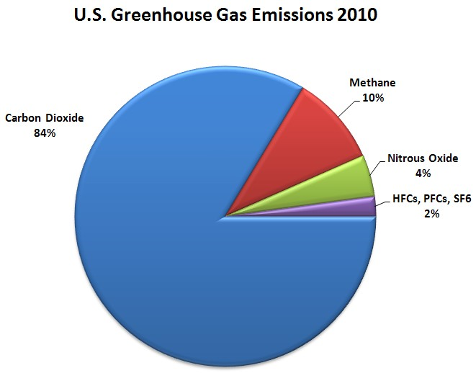
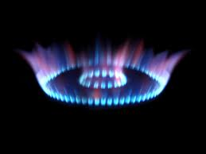
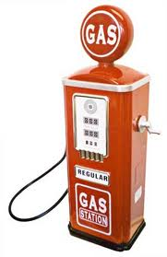
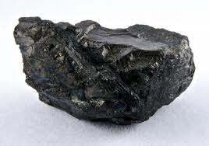
Excise tax on carbon shifts relative prices of different fuels.

Slide 17
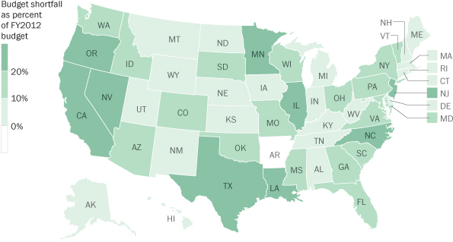
Which states need revenue?
Source: Washington Post

Slide 18
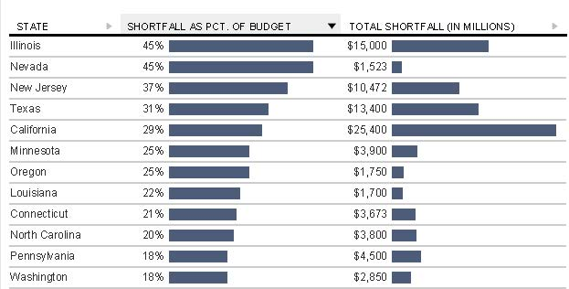
At least 4 western states have tough budget situations…

Slide 19
Nevada GHG Emissions: What could be taxed? (past and projected, million ton CO2 equivalent)
$10/ton tax ≈$400 million
Nevada Dept. of Environmental Protection

Slide 20
Nevada Revenue Sources
Includes Modified Business Tax, a payroll tax
about $370 million/year

Slide 21
My federal carbon tax proposal:
Start at $16/ton of CO₂
Imposed upstream at chokepoint of fossil fuel distribution
Include other GHG emissions as feasible
Increase at 4% over inflation each year
Reduce other clean energy spending.
Suspend Clean Air Act rules over existing stationary sources

Slide 22
My Proposal: Use of Federal Revenue
15% targeted to poor
Shore up social safety net programs
Electronic benefit transfers
Lower marginal statutory corporate income tax rate from 35% to 28%
Reduce the deficit.
No other earmarks.

Slide 23
Carbon Price Benchmarks | Price per ton of CO₂-equivalent (2012 US$)
My proposal’s starting tax rate | 16.00
U.S. 2015 Social Cost of Carbon, 5% discount rate ($2011) | 12.00
U.S. 2015 Social Cost of Carbon, 3% discount rate ($2011) | 40.00
December 2012 trading price of allowances in the EU Emissions Trading System | 8.77
Carbon tax in British Columbia, Canada | 29.40
Carbon tax in Australia | 24.21
Carbon tax in Sweden | 156.00
EPA projection for CO₂ allowance trading price under H.R. 2454 in 2015, Scenario 3 | 14.95
Settlement price of California’s GHG cap-and-trade allowances, advance auction of 2015 vintage | 10.00
Regional GHG initiative, Auction 18 clearing price for CO₂ allowances, December 5, 2012 | 1.93

Slide 24
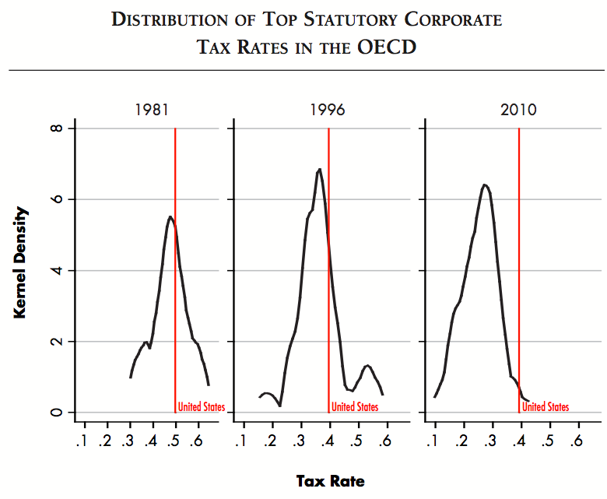
Why corporate income tax rates?
Hassett and Mathur, February 2011

Slide 25
Total Budget Effects (Undiscounted) | Over 10 years | Over 20 years
Revenue | $1.1 trillion | $2.7 trillion
15% Set-aside for low-income individuals | ($161 billion) | ($405 billion)
Lower marginal statutory corporate tax rate from 35 % to 28 % | ($800 billion) | ($1.6 trillion)
Savings from reduction in clean energy spending | $60 billion | $120 billion
Net deficit reduction | $199 billion | $815 billion
Also: Environmental and regulatory benefits.

Slide 26
So if there’s not a federal carbon price…
States can coordinate
Develop model legislation
Handle revenue as they each see fit

Slide 27
What if the federal govt taxes carbon later?
States can rescind carbon tax, but then lose revenue
States can seek fed revenue from their state
Ask for exemption
Layer taxes

Slide 28
What if the EPA regulates?
Depends on what EPA does
States may be able to write a carbon tax into their state implementation plans
States can layer a carbon tax onto emissions standards
States can rescind carbon tax, but then lose revenue

Slide 29
Conclusion
Carbon tax could work at state level
Provides two good fiscal options:
Reduce capital taxes and raise output
Reduce deficits with relatively little lost output
Would significantly reduce CO₂ emissions and obviate less efficient regulation and spending
Coordinate with other states to limit leakage
Possibly supplant EPA emissions standards

