Slide 1
Three African Futures
John Page
The Brookings Institution
University of Nevada at Las Vegas
7 April 2014

Slide 2
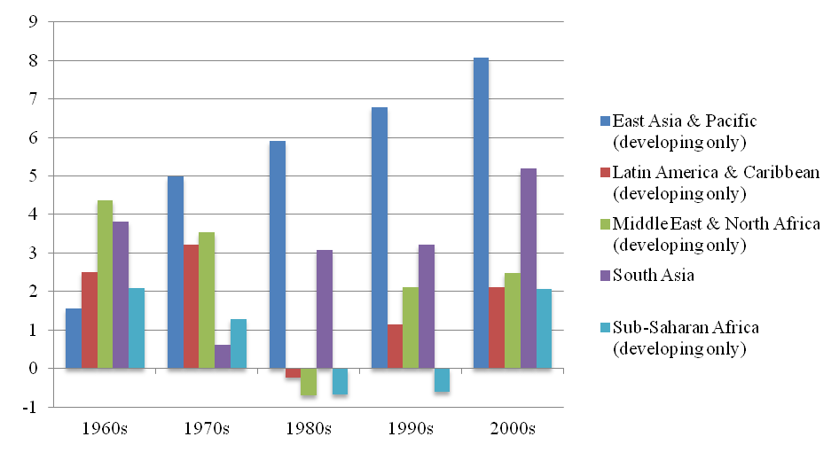
The Next Frontier? Growth of GDP Per Capita
Africa has become the new “frontier market”
“Africa is the world’s fastest-growing continent just now.” (The Economist, 2013)
More than 5% growth for 15 years
A growing middle class
But predictions of Africa’s imminent economic success have proved wrong on numerous occasions
Africa’s Adjustment and Growth in the 199Os (Word Bank and UNDP, 1989)
Adjustment in Africa: Reforms, Results, and the Road Ahead. (World Bank, 1994)
Can Africa Claim the 21st Century? (Alan Gelb, 2000)
Africa at a Turning Point? (John Page, 2008)

Slide 3
Some Worrying Signs Extreme poverty in the developing world
Growth has been driven by “fewer mistakes” and a commodities boom
People living on less than $1.25 per day have declined
From 58 percent of people in 2000
To 48.5 percent in 2010
But not at the same rate as in other parts of the developing world

Slide 4
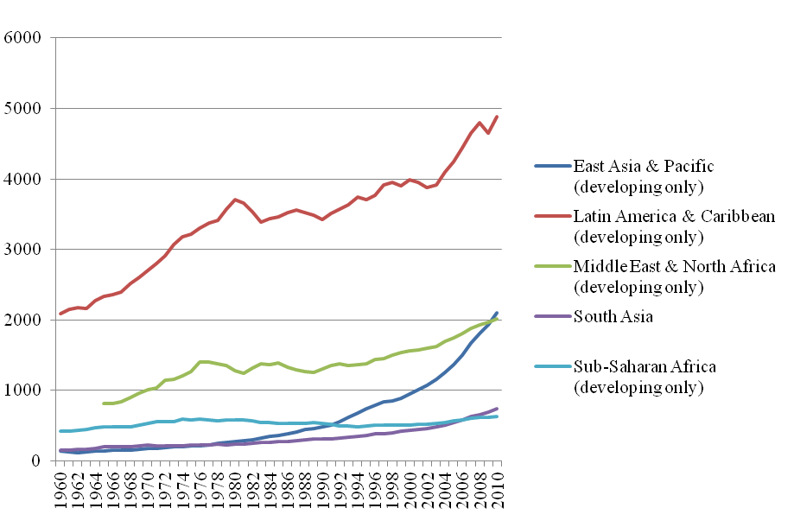
And Africa Remains Very Poor Real GDP Per Capita in US$ (2000)

Slide 5
Three African Futures
African Spring
Nigeria Big Time
Leopards and Laggards

Slide 6
African Spring Too Few Jobs for Too Many Workers
Africa faces a demographic dividend or threat
Rapid labor force growth (10-12 million new entrants)
A growing youth bulge
Africa’s fastest growing economies are creating the fewest jobs

Slide 7
African Spring Too Few Jobs for Too Many Workers
Countries with low unemployment have large and growing informal sectors (Ethiopia, Ghana, Tanzania)
In North Africa and Southern Africa informality is lower and unemployment is high
Both situations are cause for concern

Slide 8
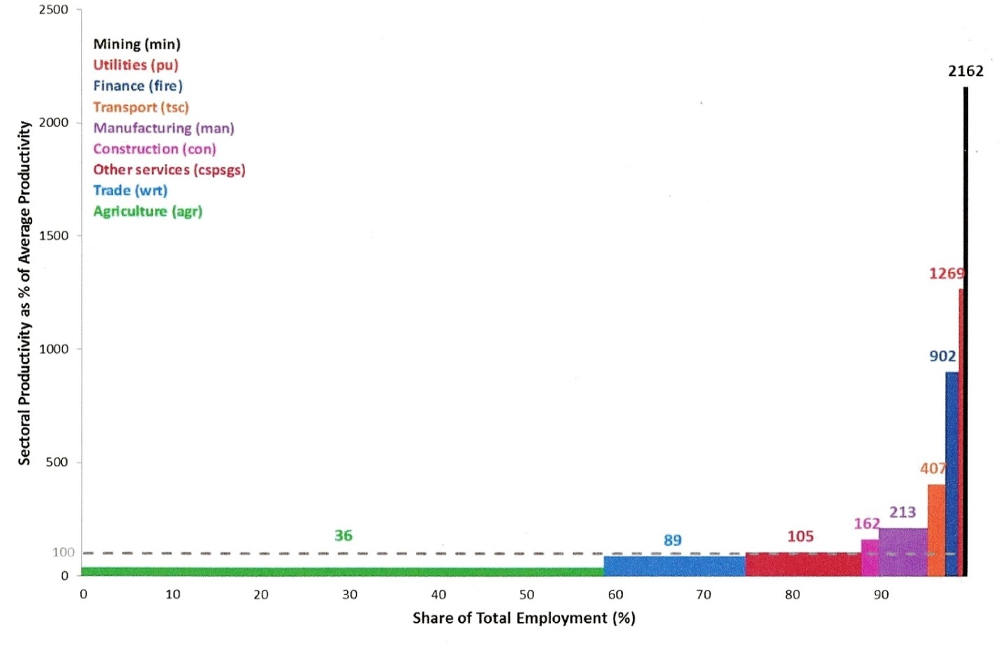
African Spring “Working Hard, Working Poor”
Three out of four jobs in sub-Saharan Africa are “vulnerable” (ILO)
In 2011 81.5 percent of workers were classified as working poor, compared to the world average of 39.1 percent
Less than 20 percent of Africa’s young workers find places in wage employment.
The parallels with the Middle East are disturbing

Slide 9
African Spring Avoiding an African Spring Private Investment as a Share of GDP
The solution to the employment problem cannot be found in employment policies alone
Domestic private investment has remained the same since 1990’s
It is well below the levels needed for rapid growth of good jobs
Boosting private investment is essential
 | 1990-94 | 1995-99 | 2000-04 | 2005-09
Africa LIC | 10.2 | 11.2 | 11.1 | 11.8
Africa MIC | 14.6 | 14.5 | 13.8 | 15.8
East Asia | 24.9 | 19.9 | 12.4 | 16.8
Low Income Countries | 10.0 | 11.5 | 12.9 | 15.4
All Developing Countries | 13.7 | 14.5 | 14.0 | 16.6

Slide 10
African Spring Avoiding an African Spring
Africa is still a high cost place to do business
“Indirect costs” lower competitiveness and discourage investment
Reform regulations and institutions
Identify which regulations and institutions constrain investment
Engaging the private sector and avoiding capture
More and better infrastructure
Firm level studies in Africa highlight infrastructure as a significant constraint to more investment
Africa lags at least 20 percentage points behind the average for low income countries on almost all major infrastructure measures
Build relevant skills
Increase the emphasis on post-primary education
Improve quality at all levels
Teach the skills needed for the global marketplace

Slide 11
Nigeria Big Time Natural Resources: A Promise or a Threat?
Africa has about 30 percent of the world's mineral reserves.
And much of the continent is still unexplored
New discoveries are happening almost daily (Ghana, Kenya, Mozambique, Tanzania, Uganda)
For a growing number of countries natural resources offer a huge opportunity…but one that is accompanied by considerable risks.
Oil revenues per person in Nigeria increased from US$33 in 1965 to US$325 in 2000, but…
…income per person has remained the same since 1960!

Slide 12
Nigeria Big Time A Poor Track Record
Mineral dependent economies in Africa have:
Higher poverty rates
Greatly income inequality
Less spending on health care
More child malnutrition
Lower literacy and school enrollments
Than non-mineral economies at the same income level.
Not surprisingly this has become known as the “resource curse”

Slide 13
Nigeria Big Time Some Popular Explanations
Dutch disease:
resource rich economies produce too few internationally competitive goods
Volatility:
resource rich countries tend to spend when times are good and borrow (and spend) when times are bad
Bad institutions:
resource rich countries with bad institutions typically are poor and remain poor
Corruption:
a natural resource bonanza brings out more rent seekers
Conflict:
higher resource income makes warfare more attractive

Slide 14
Nigeria Big Time Geology Is Not Destiny Income Growth in Three Resource Rich Economies
Because they are the owners of the resource governments must play an active and constructive role in managing natural resources for development
Avoiding the “resource curse” is about making good public policy choices
In Africa there is a high potential pay-off to investing resource revenues in future growth and jobs

Slide 15
Nigeria Big Time Avoiding the Resource Curse
The sequence of choices for governments related to resource extraction can be thought of as a decision chain.
Finding the resource
Getting a good deal
Collecting revenues
Save or spend?
Where to spend?
Bad decisions anywhere along the chain can derail development
Good decision making requires minimum standards of accountability and transparency

Slide 16
Nigeria Big Time Avoiding the Resource Curse
Investing in agriculture
About two thirds of Africans still depend on agriculture
Agricultural yields have stagnated or declined for 40 years.
Improving competitiveness
Trade-related infrastructure
Education access and quality
Leveraging the resource
Linking domestic firms to foreign investors
Using resource-focused infrastructure for regional development

Slide 17
Leopards and Laggards Breaking from the Pack
Unlike Asia, Africa has had few regional “champions” to serve as models of success
The next 15 years are likely to reveal some “leopards”: countries that grow much faster than the regional average
The basis for that success will be rapid structural change
Growth will falter in economies that fail to transform: these will become the “laggards”

Slide 18
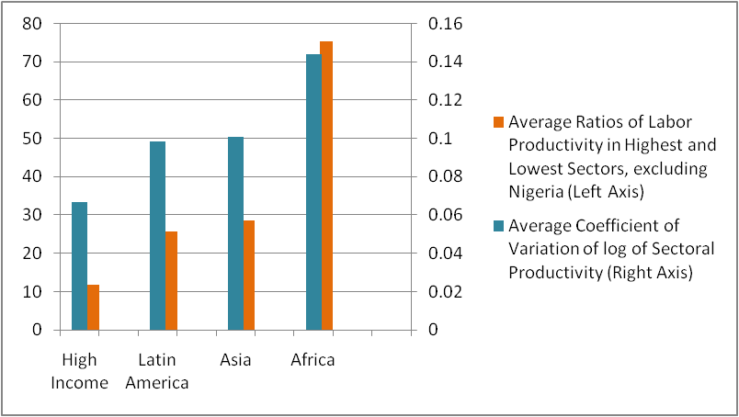
Leopards and Laggards Why Structural Change?
In countries at low levels of income productivity differences between sectors are large
The movement of resources from low productivity to high productivity employment drives growth
As incomes rise, productivity differences among sectors (and enterprises) tend to converge
Africa has the greatest differences in productivity among sectors, and therefore the greatest potential for structural change

Slide 19
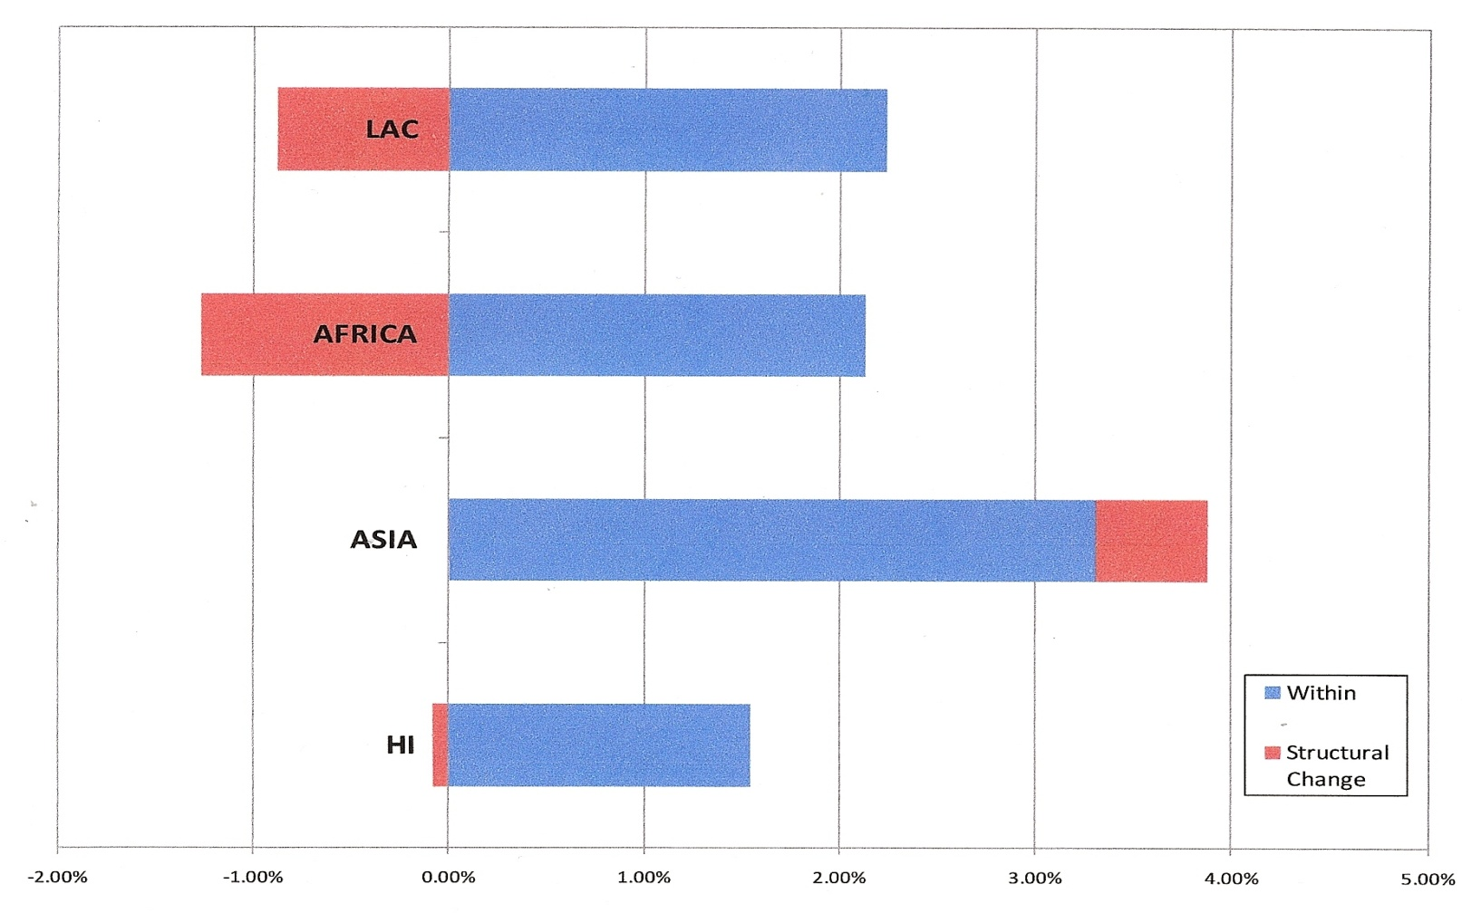
Leopards and Laggards Going Up the Down Escalator
But in Africa structural change is going in the wrong direction
An increasing share of the labor force is in lower productivity sectors
“Growth reducing” structural change is slowing overall growth and employment creation

Slide 20
Leopards and Laggards Africa Needs Industry
Industry – including agro industry and tradable services -- is a high productivity sector
Industry is also employment intensive
But Africa has “deindustrialized” over the last 40 years
 | Mfg Exports PC 2005 (US$) | Growth PC Exports 00-05 (%) | Mfg. Value Added PC 2008 (US$) | Share of Mfg in GDP 2008 (%)
Africa Average | 39.0 | 1.65 | 138.6 | 9.4
Developing Countries | 487.2 | 10.05 | 412.9 | 21.7

Slide 21
Leopards and Laggards Can Africa Break In?
New entrants to global markets are competing with Asia
A window of opportunity?
Rising costs in Asia
Growing domestic demand in Asia
Industry no longer need smokestacks
Leopards will have to master the drivers of industrial location

Slide 22
Leopards and Laggards What Determines Industrial Location?
Trade in tasks
Technical change has brought about “vertical disintegration” of production
A chance for a foothold, but many low wage economies have not attracted task-based production
Agglomerations
Manufacturing and service industries tend to cluster
Starting a new industrial agglomeration is a form of collective action problem
Firm capabilities
Capabilities are the tacit knowledge and working practices needed for production and product development
High capability firms are those that can compete globally on price and quality

Slide 23
Leopards and Laggards A Strategy for the Leopards
Creating an “Export Push”
A “whole of government” initiative to promote non-traditional exports
Linking trade policy, infrastructure, skills and geography to macroeconomic management
Spatial industrial policy
Special Economic Zones (SEZs): world class infrastructure, skills and institutions
Growth corridors: link natural resources and coordinated investments
Attracting and building capabilities
Strengthening policies and institutions for attracting FDI
Removing obstacles to the transfer of capabilities in value chain relationships

Slide 24
A New Role for Aid Under Five Mortality
Africa is the world’s most aid dependent region
Between 10 and 30 percent of national budgets are financed by ODA
Since the mid-1990s aid donors have focused on human development – with considerable success
But the failure to create good jobs is a major risk to further progress

Slide 25
A New Role for Aid
Supporting job creation
Investing in agriculture
Building infrastructure and skills
Strengthening firm capabilities
Linking aid and trade
Improving coherence of trade and aid policies
Making “aid for trade” a reality
Supporting regional integration
Avoiding the resource curse
Geological information
Evening up the sides
New approaches to institution building

Slide 26
Which Future?
By 2030 Africa will have become more diverse in terms of economic performance
Some economies will industrialize and become leopards
Some resource rich economies will avoid the resource curse… and some will not
Those economies that fail to transform – either through industry or natural resources – will become the laggards
And for the laggards the prospects of an “African Spring” will become very real

Slide 27
So, Which Future?
All of the Above!
Thank You

