Slide 1

President/President-Elect/VP
UNLV Alumni Association
Leadership Development Day
March 3, 2012

Slide 2
Effective Leadership
Build an effective team
Set reasonable goals and plan accordingly
Empower your board
Train future leaders
Run meeting efficiently
Keep good minutes and records
Make friends and have fun

Slide 3
Where Do I Start?
SWOT Analysis
Strengths
Weaknesses
Opportunities
Threats
Chapter Board Retreat
Two months before fiscal year begins
Outline Priorities (2-3 achievable items)
Review budget and relevant finances

Slide 4
Developing Your Board
Poll your board
Prior to retreat
Gather input for chapter priorities
Outline Priorities
What should we start, stop and continue?
What adds value for our members?
What’s the best use of our resources?
Keep Your Plan Short and Concise!

Slide 5
Surveys
Survey Your Membership
Good way to enhance brainstorming
Use with planning and benchmarking
Survey Monkey is an easy tool
When surveying, don’t ask for too much information
Other Resources
2007 Alumni Survey
Future Surveys to be developed

Slide 6
Chapter Board Retreat
Organizational Chart
Outline rules, responsibilities, and expectations
Board members oversee committees
Provide org chart, contact info
Outline Priorities
Review of chapter performance from previous year
Pull from best practices from other chapters
Share your goals and visions for the year with the association

Slide 7
Outlining Your Plan
Chapter goals aligned with the association’s goals
Consider key audiences (alumni, faculty, students)
Outline objectives
Develop strategies, tactics, budgets, and a timeline

Slide 8
Value of Board Membership
Always Reinforce Value of Board Service
Be prepared at board meetings
Start on time, stick to agenda, finish in time
Volunteer time in valuable, whether in person or on a conference call
Board Members Serve as Ambassadors
New members look to board members to gauge if the organization is welcoming
Veterans identify and train new leaders
Succession planning is important

Slide 9
Constructing a Strong Board
Pursue Active Board Members
Actively pursue people who get things done
Recruit co-chairs, this allows senior and junior members to work together (mentor/protégé)
Identify new members who are eager to work
Policy for Inactive Board Members
Do you have a policy in place? If they miss two or more meeting, are they out?
Offer board members a chance to step aside if they are “too busy”

Slide 10
Communicate With Your Board
Strive for Effective Meetings
Confirm board meetings (set date and time well in advance)
Collect RSVPs (ensure a quorum)
Send agenda and minutes in advance (one week allows board to prepare)
Collect committee reports prior to the meeting
Rotate order of reports
Accountability
Don’t ever embarrass board members, but insist on accountability

Slide 11
Governance
Bylaws
Know Chapter bylaws
Have them with you at all meetings
Should be in sync with association bylaws
Must be approved by the association
Robert’s Rules of Order
Important for running an effective meeting
Keep a copy with you (read and bookmark)

Slide 12
Be Responsive
As President, You’ll Be Very Popular
Answer all correspondence
Return all phone calls
Delegate responsibility whenever possible
Updates and Communication
Keep your Chapter Web site updated
Demonstrate value of association membership
Make sure members see all that you do
Consider sending a member letter with coming year activities, and year-end letter to list accomplishments

Slide 13
Find Someone to Lean On
Immediate Past President
Good resources with experience in the role
Can serve as a buffer as necessary
Spearhead nominating committee process
Leadership Succession
Board should reflect diversity of membership
Delegate, Delegate, Delegate
The best leaders delegate effectively
Part of your rule is to train future leaders
You must involve others to avoid becoming overwhelmed with the workload

Slide 14
Find Someone to Lean On, cont.
Other Chapter Presidents
Good resource experiencing similar issues
Can provide outsider’s perspective
Chapter Liaison
Alumni Relations Staff
Chapters Committee
Alumni Association Board

Slide 15
Enjoy Your Leadership
This Will Be an Exciting Time for You
You can put your stamp on the Chapter
Do 2-3 things very well during your tenure
Delegate to your board and committee chairs
First Step to Bigger Leadership Roles, if You Choose
Many people are here to help make your leadership a success
Communicate with other Chapter presidents, Chapters Committee, association board, UNLV staff
Service is Voluntary
Make it worthwhile for volunteers
Be sure to recognize work of board members

Slide 16
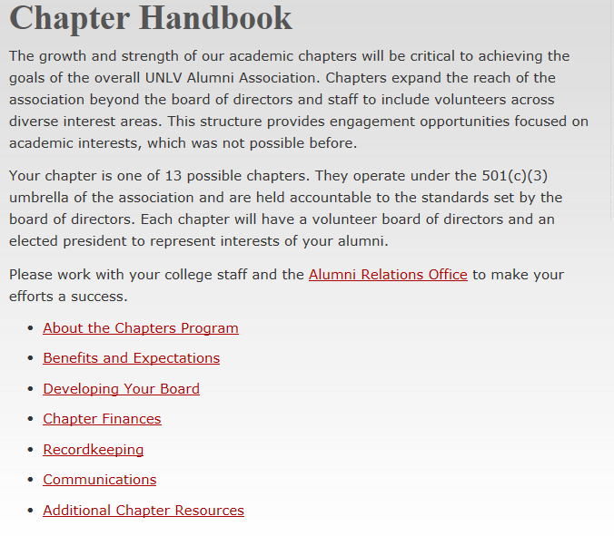
Chapter Handbook
http://go.unlv.edu/alumni/handbook

