Slide 1
Capitalizing in the Nation’s Capital: Matching State and Regional Resources to Administration Funding Priorities
John Hudak
The Brookings Institution
12 March 2013
Presented for Brookings Mountain West/UNLV
Research Assistance Provided by Ashley Gabriele
Graphic Design Provided by Emily Parsons

Slide 2
Overview of Federal Funding Opportunities
Types of Funding
Areas of Funding
Magnitude of Funding
1996-2011 (including stimulus funding)
$1,361,887,259,507
4,237,951 Grants
Focus Here: Federal Discretionary Grants
Traditional and Non-traditional Grants

Slide 3
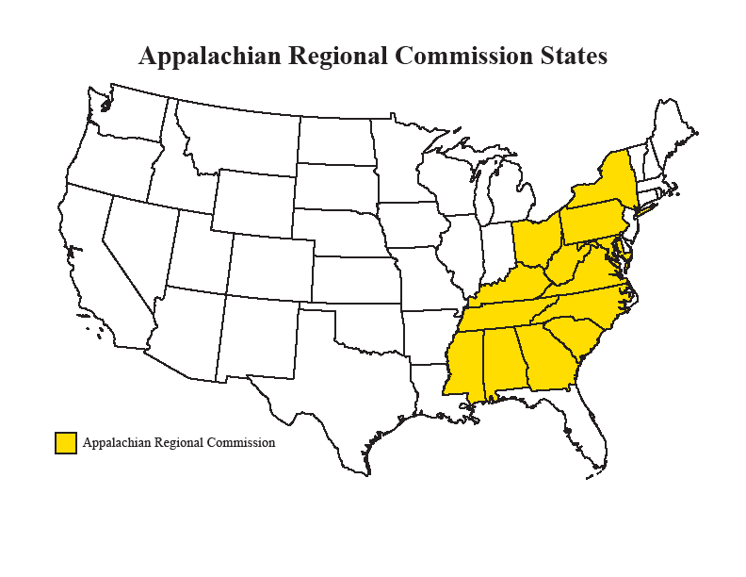

Slide 4
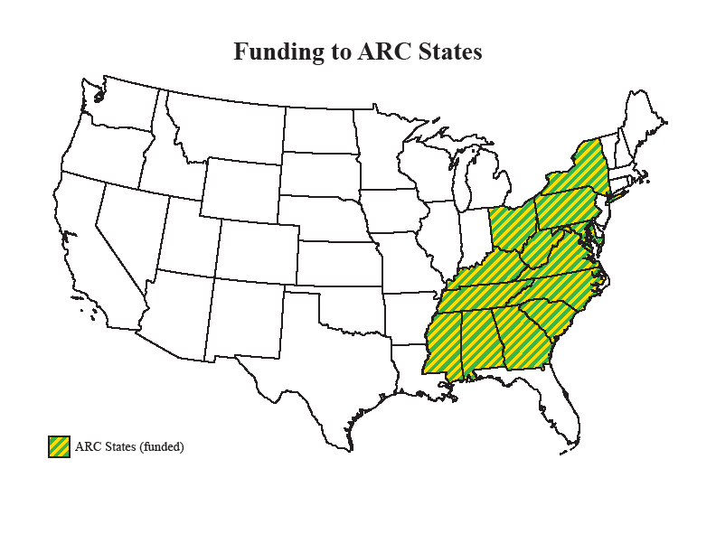

Slide 5
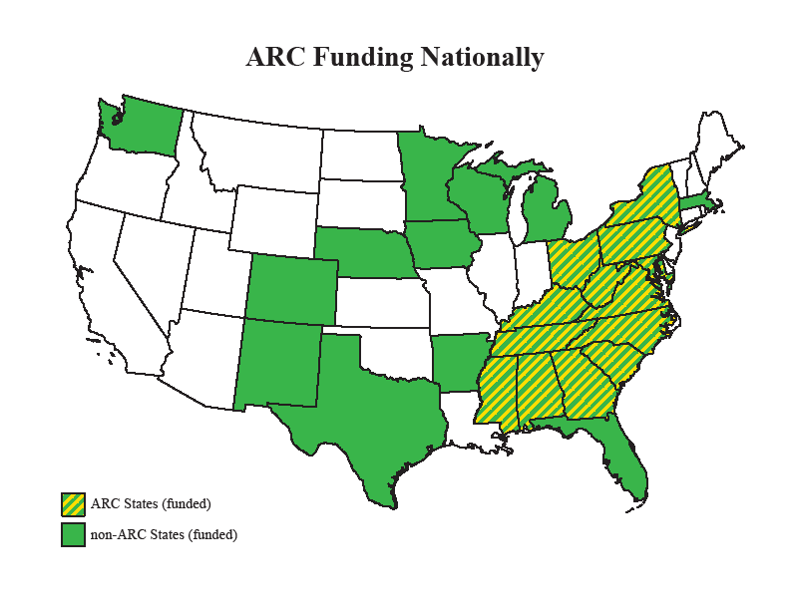

Slide 6
Why Federal Grant Funding?
Provides Needed Services, Public Goods
Generates Job Creation
Balances State and Local Budgets
Very Low Levels of Waste, Fraud, & Abuse
Satisfies Political Needs

Slide 7
Why Nevada/Mountain West?
Growing Populations
Growing State, County Municipal Needs
Facing Lingering Effects of Recession
Political Forces Allow Profound Benefits

Slide 8
The Politics of Federal Spending
The Case for Need
The Realities of Budgetary Politics
Congressional Pork & Earmarking
Presidential Pork & Earmarking
Notes:
Reality of Budgetary Politics—about failure to take funding doesn’t lower budgets

Slide 9
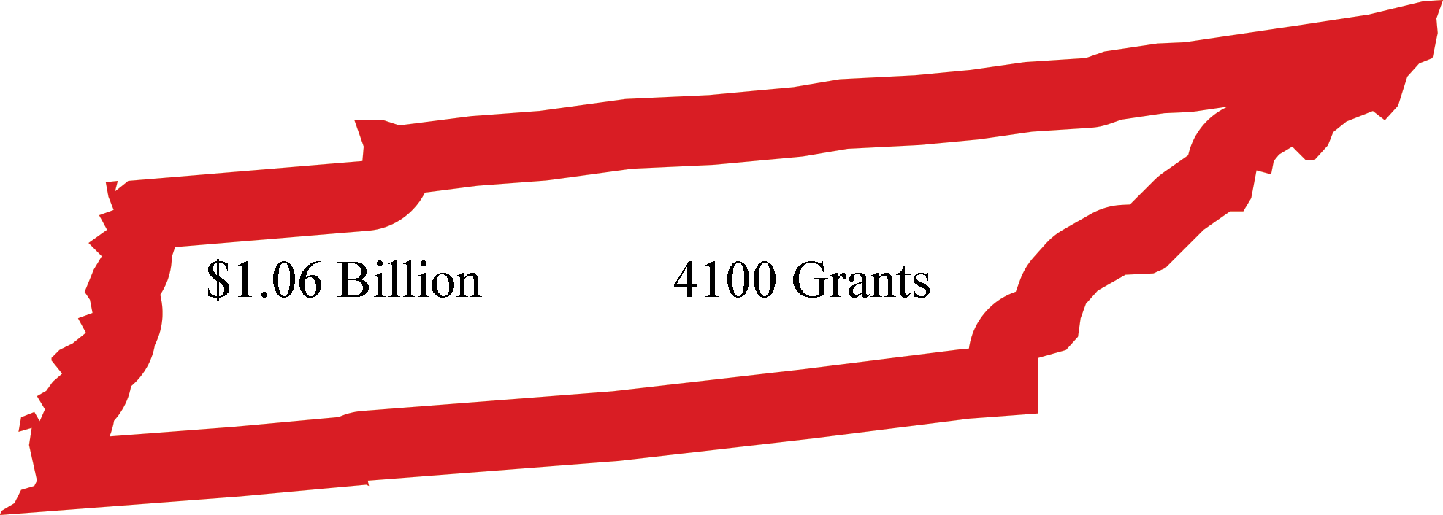
Tennessee Grants Funding, 2007

Slide 10
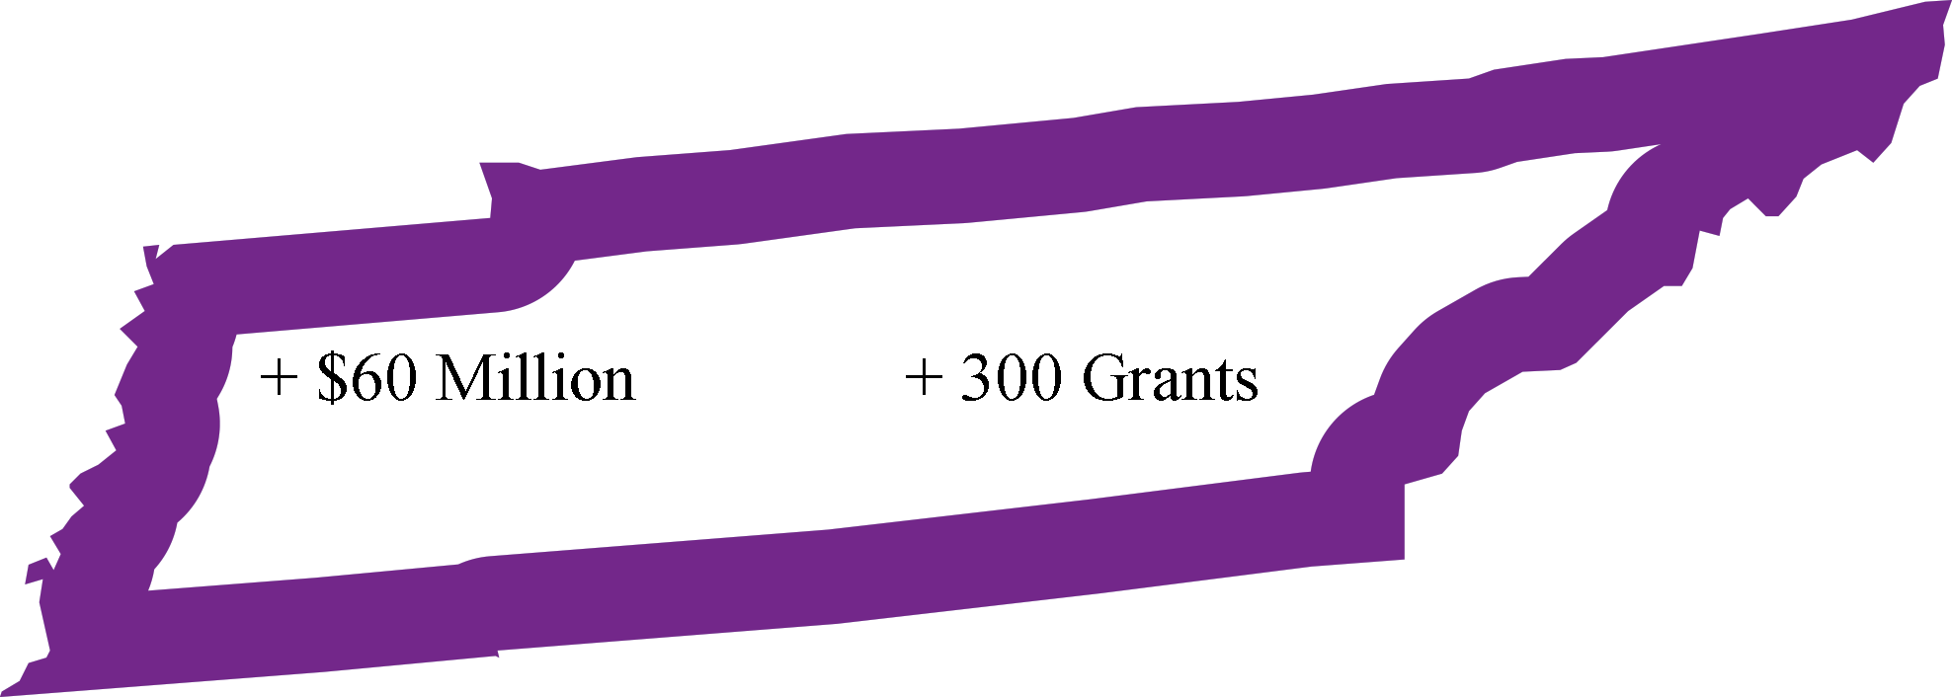
Tennessee as a Swing State

Slide 11
Politics and Realities in the Mountain West Region and Nevada
Swing States
Congressional Power
Substantial Need
Nevada, the poorest of poor performers
Nevada, the poorest among swing states

Slide 12
Nevada: Failure in Leadership & Grantsmanship
States Smaller than NV
New Mexico
West Virginia
Nebraska
Idaho
Hawaii
Maine
New Hampshire
Rhode Island
Montana
Delaware
South Dakota
Alaska
North Dakota
Vermont
Wyoming
States Outperforming NV ###
New Mexico
West Virginia
Nebraska
Hawaii
Rhode Island
Montana
South Dakota
Alaska
North Dakota

Slide 13
Nevada: Failure in Leadership & Grantsmanship
States Smaller than NV
New Mexico
West Virginia
Nebraska
Idaho
Hawaii
Maine
New Hampshire
Rhode Island
Montana
Delaware
South Dakota
Alaska
North Dakota
Vermont
Wyoming
States Outperforming NV $$$
New Mexico
West Virginia
Nebraska
Idaho
Hawaii
Maine
New Hampshire
Rhode Island
Montana
South Dakota
Alaska
North Dakota
Vermont

Slide 14
Nevada: Failure in Leadership & Grantsmanship
Additional Facts (2009-2011, non-stimulus)
Grants per capita: Nevada tied for 50th
Grant Dollars per capita: Nevada 49th
Comparing New Mexico and Nevada…
NM receives 101% more grants than NV
NM receives 159% more grants per capita than NV
NM receives 80% more grant $ than NV ($300M)
NM receives 136% more grant $ per capita than NV

Slide 15
What Can Be Done?
Hard to Change Politics

Slide 16
What Can Be Done?
Hard to Change Politics—and why would you?
Proactive Approaches
Changing Rhetoric
Changing Administrative & Governing Strategies
Administration Priorities
Changing Culture
“We’re not that kind of state…”

Slide 17
Administration Priorities
Presidential & Cabinet Priorities
Green Energy Grants
Community College Grants
Health Care Innovation/R&D Grants
Manufacturing Grants

Slide 18
“We’re not that kind of state…”
Geography vs. Tradition
Agriculture Grants
Manufacturing Grants
New path forward in federal funding
Blends public and private funds
Focus on ROI, restructuring, consolidation
Examples: Race to the Shop, Make It in America

Slide 19
Summing Up
Nevada: A child not living up to its potential
Mountain West: Growing political clout
Key: Create strategies to capitalize on politics
Key: Get to know the administration
Key: Effort & expertise pay dividends

Slide 20
Thank you.
Contact Info:
John Hudak
Fellow, Governance Studies
The Brookings Institution
Email: jhudak@brookings.edu
Twitter: @JohnJHudak
Web: http://www.brookings.edu/experts/hudakj

